Slide 1
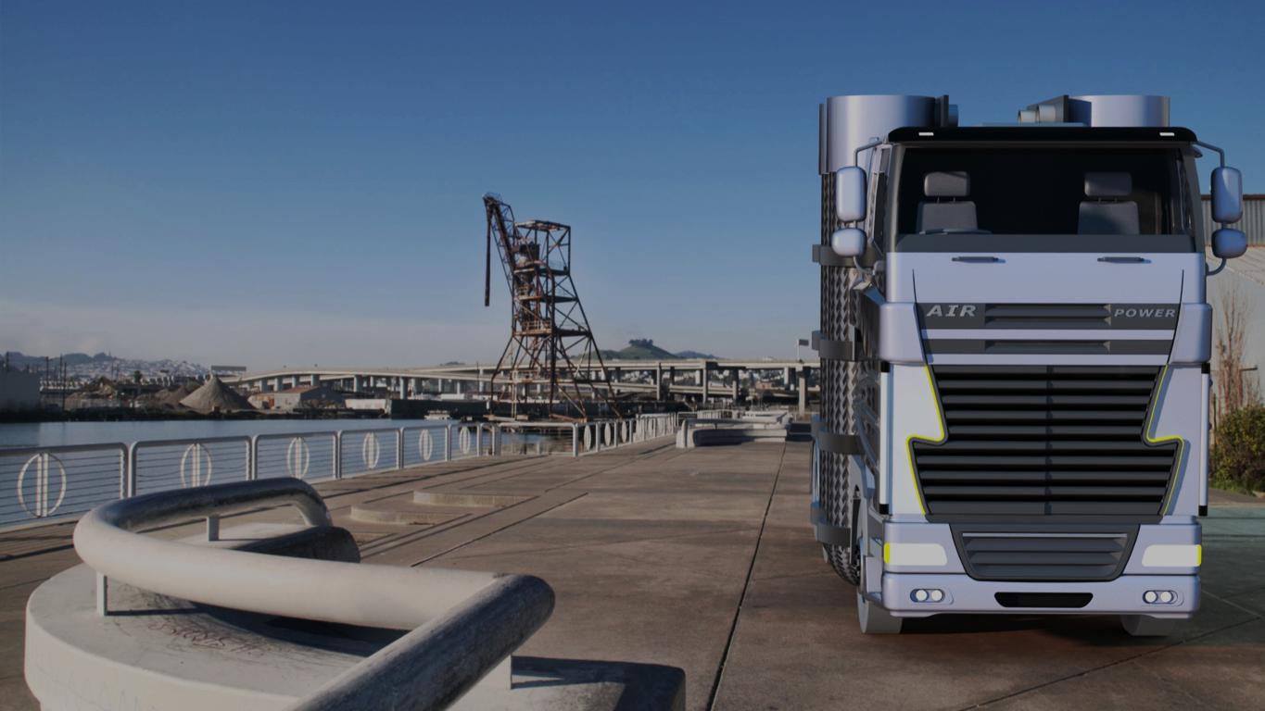
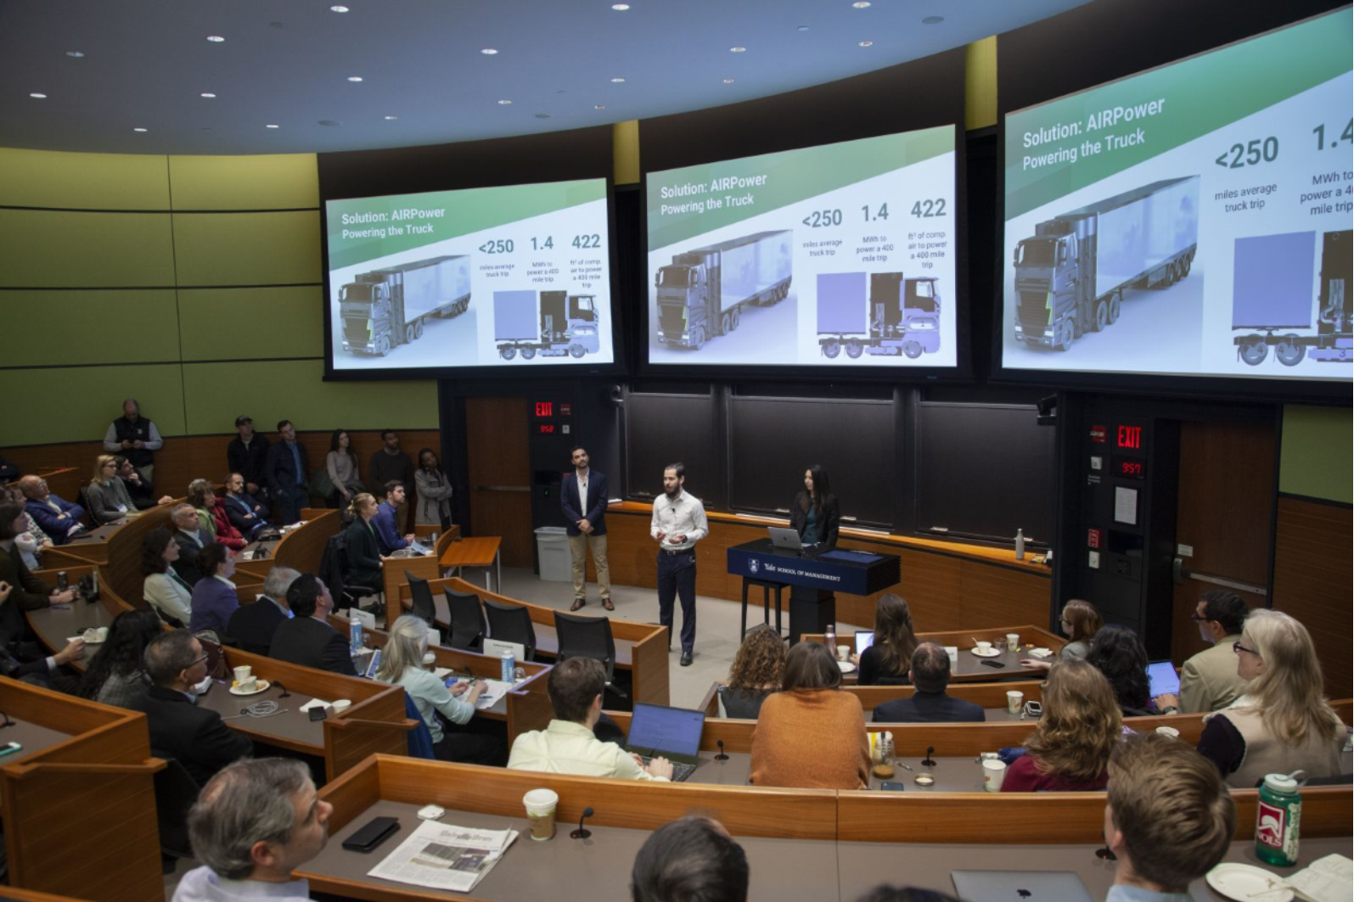

AIRPower - Electric powertrain system for Class-8 trucks
The system is designed with the philosophy of the More Electric Aircraft architecture which replaces fossil fuel engine systems with electrically driven systems.
PV panels installed on the roof of the truck capture sunlight and converts it into electricity. The electricity is stored in a battery. This system serves as an auxiliary power unit that is used to start the truck, to run hotel loads, and to release sustainable compressed air energy stored in carbon fiber compressed air tanks to turn mechanical power from motors and generators into the electricity that runs the truck. The compressed air tanks are designed so that they can be refilled or they can be easily switched and replaced throughout the distribution network.
Renewable Resources Producing Clean Energy
jennifer.gammond@yale.edu https://www.sunairfuel.com/

