Slide 1

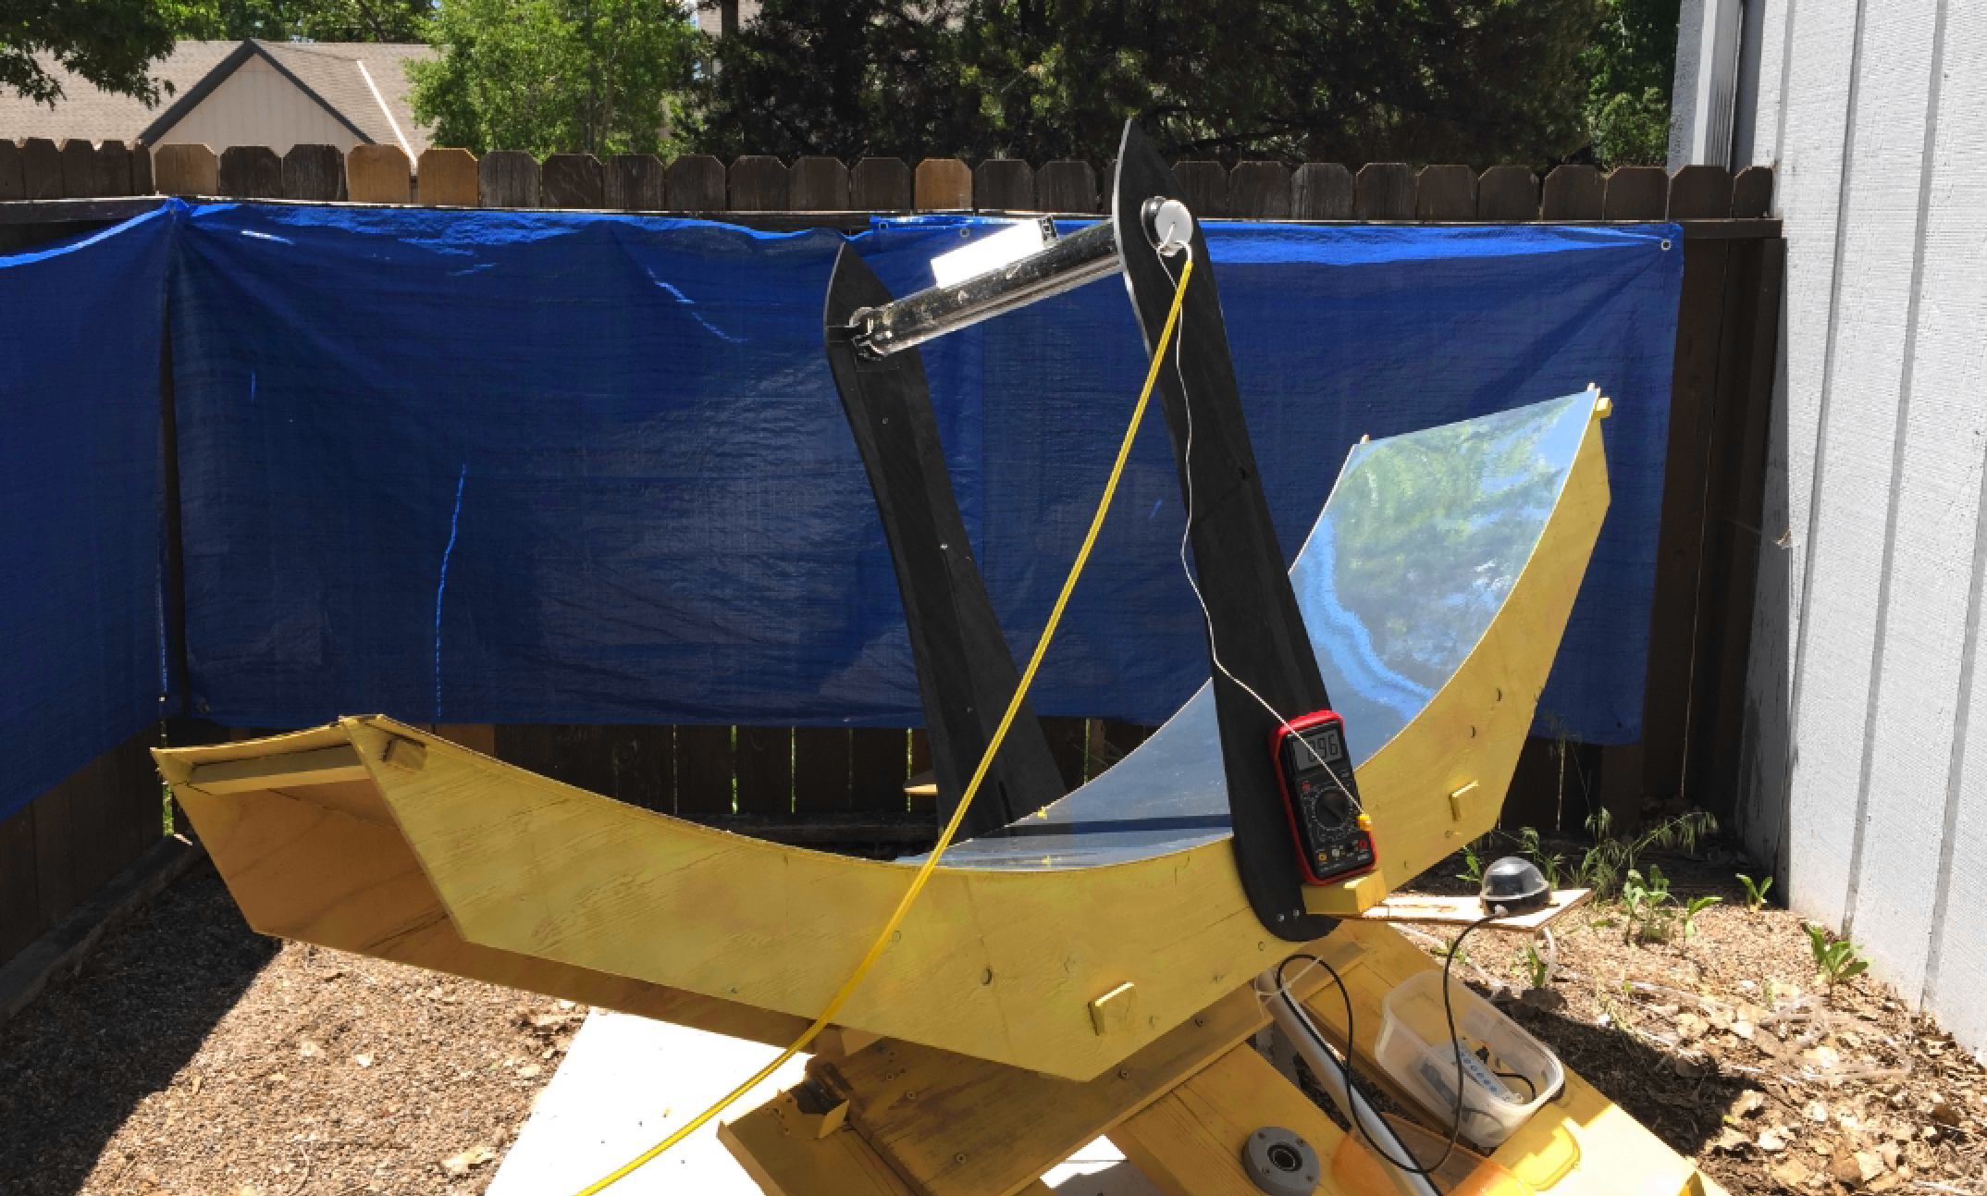
Small Scale Concentrating Solar Power
Utility Scale Works Great, Small Scale Concentrating Solar Can Too
Agricultural / Commercial Small Sizes Up To 25kw
Completely Unserved Market Segment For CSP
Distilling Capability To Purify Water For The 2 Billion People Without Clean Drinking Water
Utility Scale
Small Scale

