Slide 1
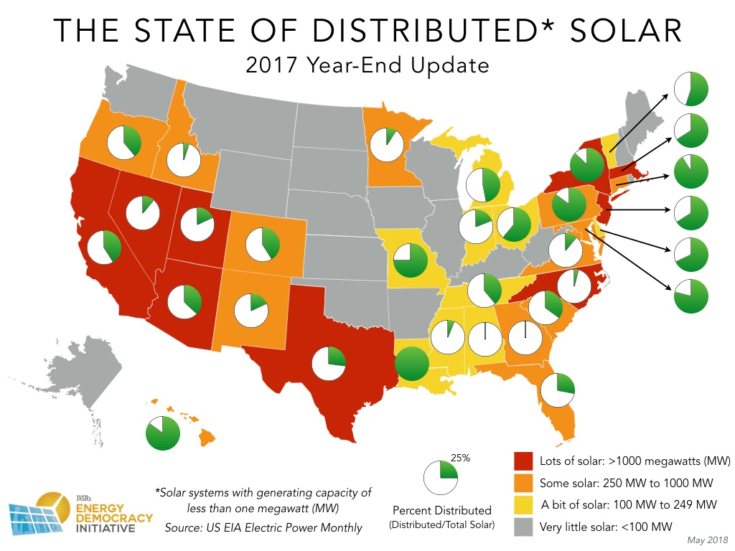
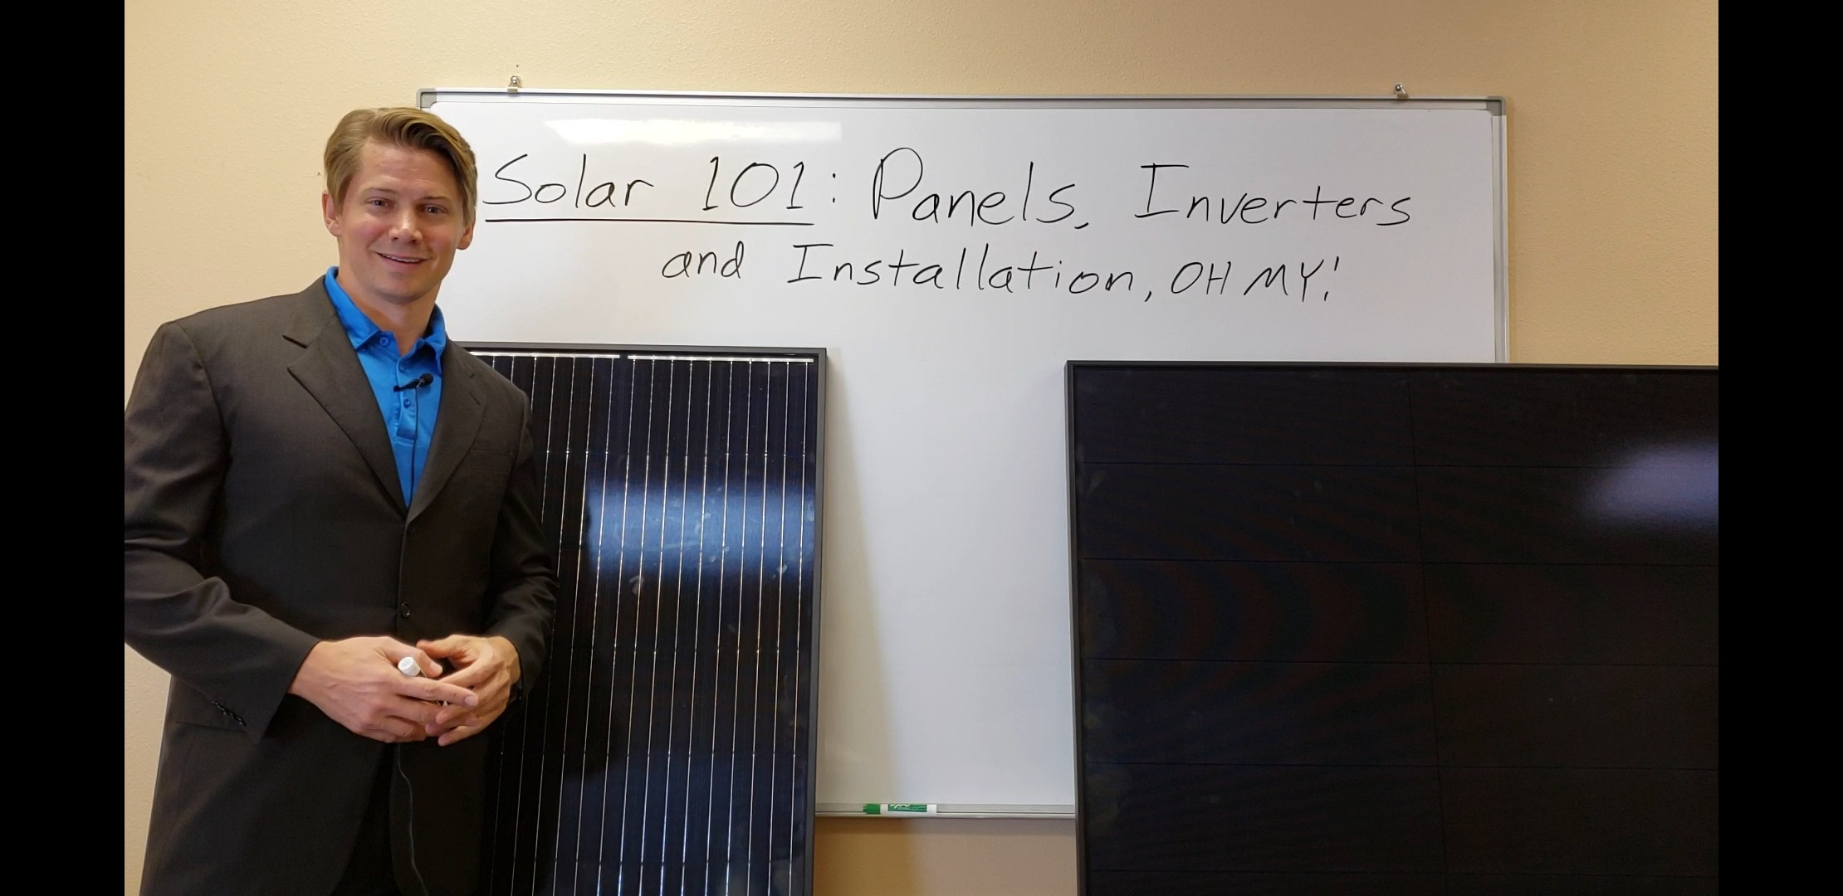

Awaken energy tv – episodes of entertaining content focused on American solar, the products, companies and policies that make up our grid
Created by Awaken Energy LLC – Americas independent power industry consulting company
Influence is the most powerful tool in media. Awaken Energy TV will become the most trusted brand in solar across America through daily content creation which captivates the public. The purpose of the content will be: to encourage solar adoption, become involved with local policy and solar programs, and to educate consumers on the best products and companies to meet their energy needs.
A social media presence which results in 100,000 followers (using actual solar company data across 4 states) will lead to 4,000 new solar customers. If the channel can reach 1 million followers, the direct and referral network will lead to over 50,000 new solar projects or approximately 400 MW of solar.

