Slide 1

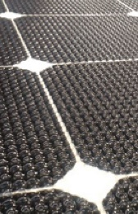
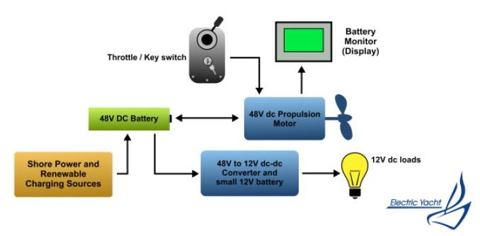
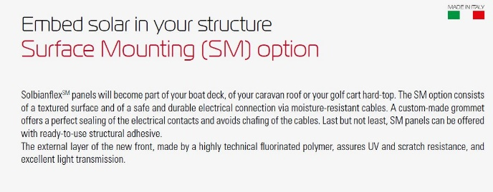


Solar applications for zero emission marine solutions
(embedding PV Cells into structure is applicable to any structure and this is an exciting area)

