Slide 1
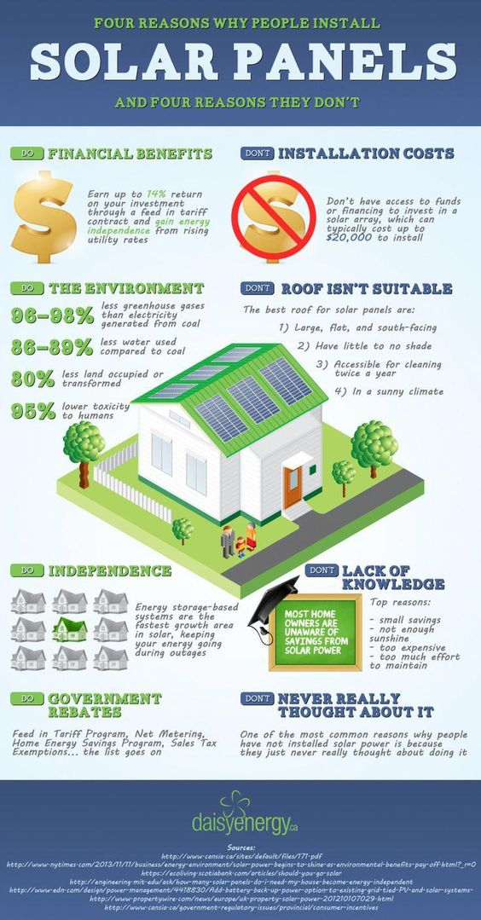
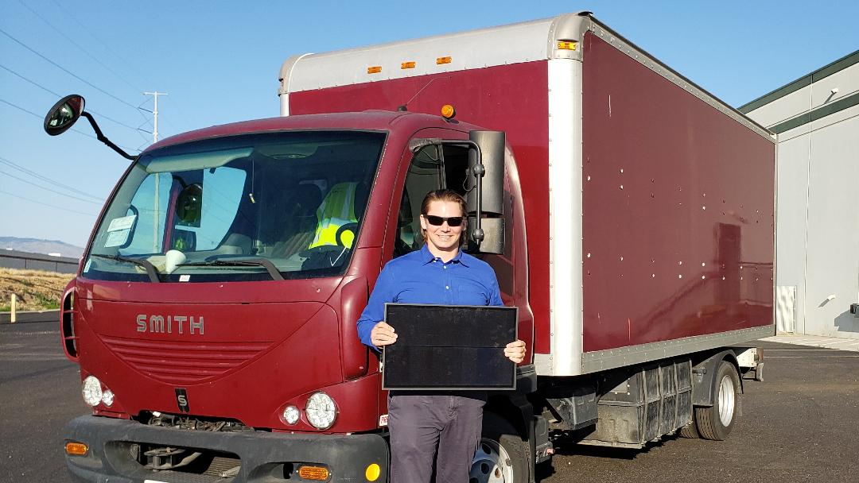
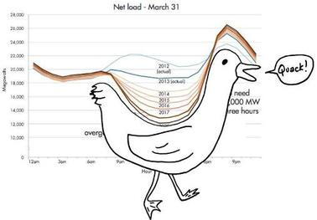
Meet GRIFF, Americas first solar- powered tour bus!
Electric box truck + Solar = GRIFF
A dedicated mobile solar learning lab which will create 1.21 Jigawatts (or Gigawatts) of solar power in America. Tour accomplishments to include:
Promotion of American made solar products and services.
Creation of interested client lists for top local solar providers.
Educational lectures delivered to communities and schools (all levels) on energy conservation and solving the DUCK curve problem.
Revenue creation through donation, product sales, and lead generation.
Increased application of modern energy conservation products & principles.
Griff will serve to influence the solar and Electric Vehicle markets in America, with a focus on rural communities, resulting in and estimated 5,000+ solar projects per year and millions of dollars in decreased energy costs.
Coming soon to a town near you! Schedule online - Awakensolar.com or follow us on facebook and social @Awakensolar for tour updates!

