Slide 1
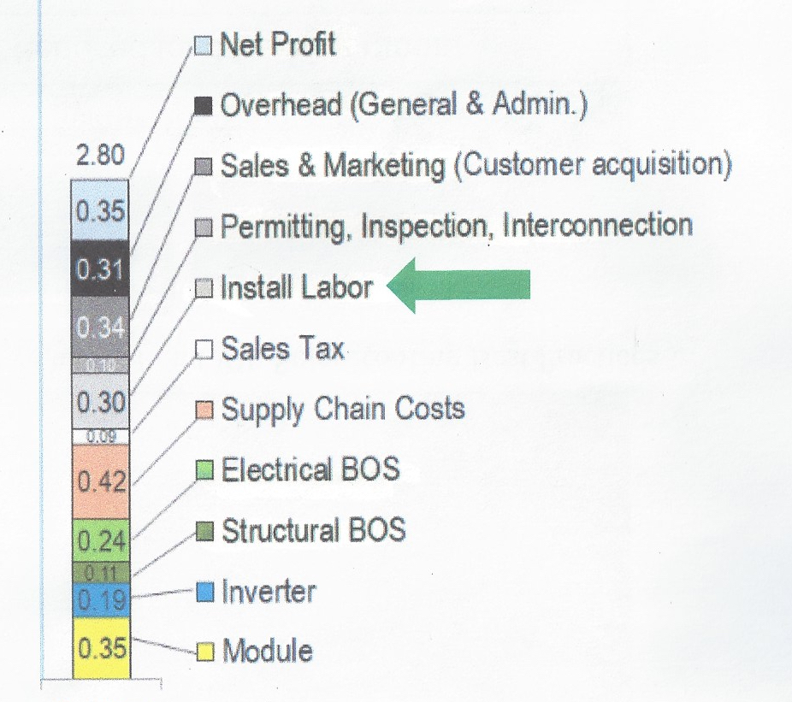
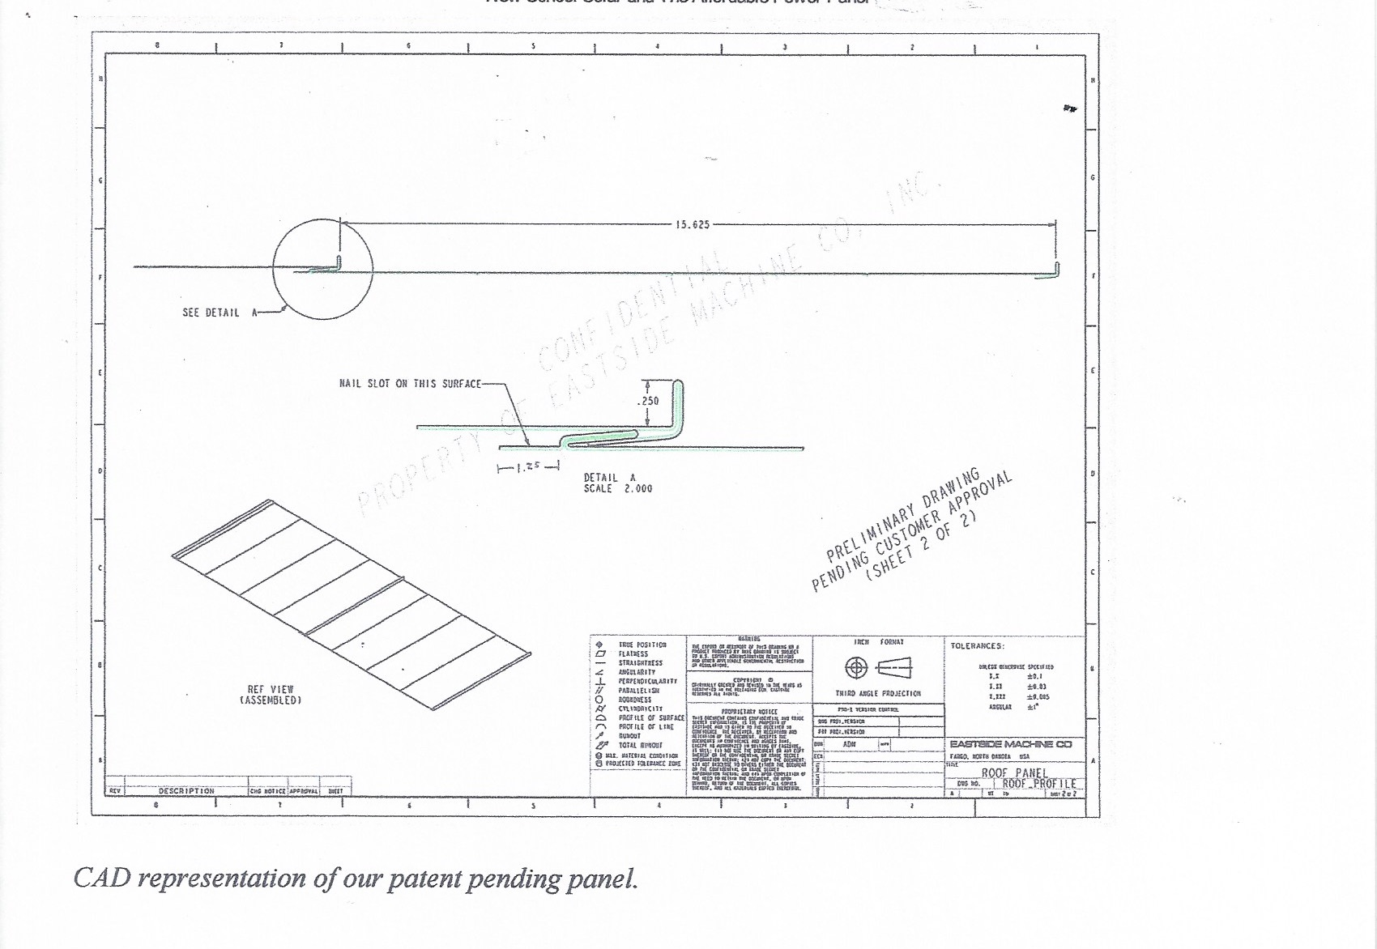
Reduce Soft Cost
With the Affordable Power Panel

