Slide 1


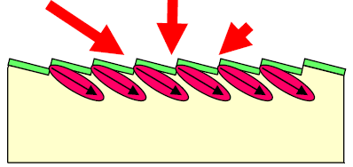
SAVD patented technology improves solar efficiency by etching, at a nano-scale, the AR layer of silicon solar cells.
Low cost photolithography process demonstrates ability to create optimal nano-structure.
Low cost masks created by 3-D printing.
SAVD Solar Solution
This Results in…
A surface dipole structure which reradiates incident light into glancing angles nearer the p-n junction
Production of photo-carriers with near 100% collection efficiency
Demonstrated efficiency improvement of 30% on standard solar cells
Incident light
Dipole structure
Silicon
Redirected light
And our development team has a competitive edge of
Over 100 years combined experience in renewable energy research, , manufacturing, and business operations supported by two university research teams at the University of Pittsburgh and SUNY Polytechnic
Notes:
Update with new images & technology specifics from UIG

Slide 2

John Easoz
CEO
Over 35 years of experience in energy engineering and research, photovoltaics development and manufacturing, and technical and corporate management. Former Executive Vice President and COO of Solar Power Industries, Inc. a $100M solar company.
Dr. Hong Koo Kim
Technology
Director of the Petersen Institute of NanoScience and Engineering, University of Pittsburgh
World-renowned expert in the field of nano-optics and nano-electronics research
Mark Vernallis / Tim Fogarty / Tim Appleberry
Founders
Vernallis: Experienced entrepreneur, C-level executive, start-up/turnaround specialist and venture capitalist
Fogarty: Director of Energy Programs at Innovation Works, one of the most active early stage energy technology investors in the US. Previously CEO of university start-up that completed IPO.
Appleberry: Proven track record as an inventor and global operations executive. Twice named to Entrepreneur Magazine’s “Hot 100”
Our Team

