Slide 1

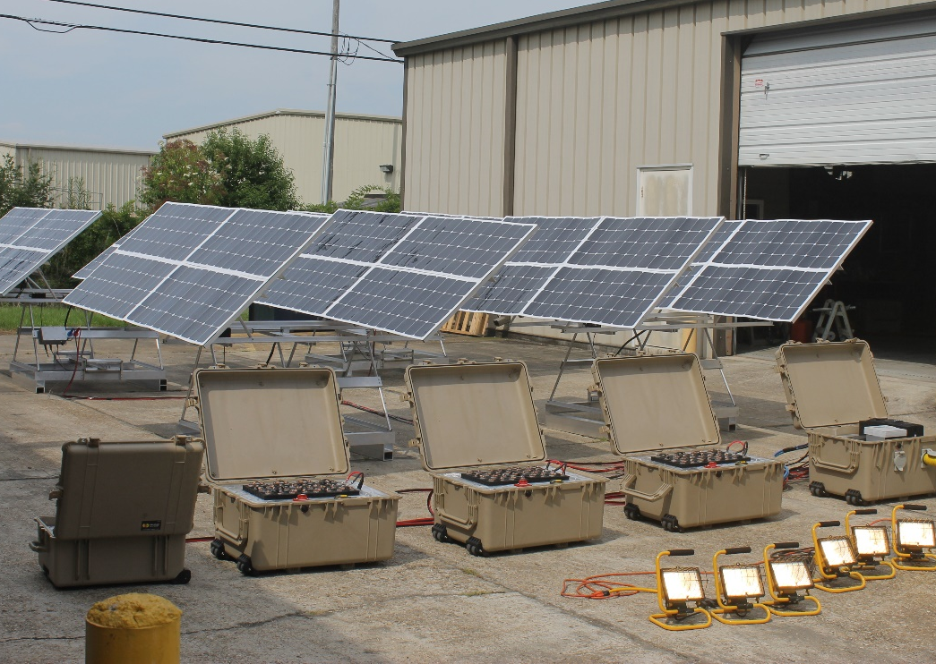
Apollo Hybrid Micro Grid
Bill DeVillier / Energy Solutions, LLC
Project Summary
Key Personnel/Organizations
Energy Solutions introduces a portable hybrid microgrid designed for easy setup and continuous power day and night. The Apollo Hybrid Microgrid is based on a modular design so whether you need 500 watts or 30000 watts continuously, this system can supply your needs. This microgrid system consists of a portable dual axis solar tracker, portable lithium batteries and a portable power conversion case. A standby diesel generator is automatically enlisted by the system to provide additional energy when electrical demand is high, if battery power is depleted during the night, or when weather conditions prevent optimum solar energy harvesting.
Energy Solutions, LLC.
Bill DeVillier, P.E.
225 205 8911
Bill@MoreEnergySolutions.com
Estimated price per watt
$10 - $15 per watt depending on options
Key Features
1 | Tracker Weight: 135 lbs including PV panels Tracker Height: 55” flat; 88” full tilt
2 | Portable lithium batteries are rated for 5kWh each. An unlimited number of batteries can be integrated into the system for improved storage capacity and enhanced system reliability.
3 | Portable power cases house both the charge controller for battery charging and the inverter for AC power generation.
4 | Systems can be arranged to provide 30kW at 120VAC or 10kW 3-phase 208VAC.
Project Impact
Municipalities and businesses are in need of energy solutions that address the absence of electricity following natural disasters. Population growth in developing countries is exceeding their electrical infrastructure capacity and upgrading utility grids is often slow. Energy Solutions’ Apollo Hybrid Micro Grid addresses energy shortfall in a number of crisis situations.

