Slide 1
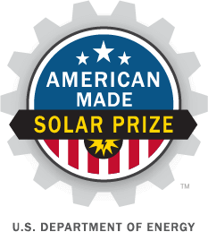
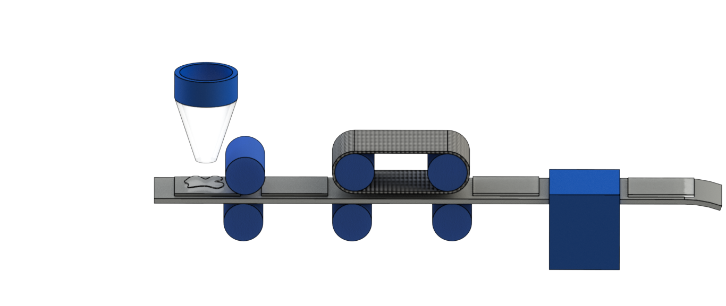
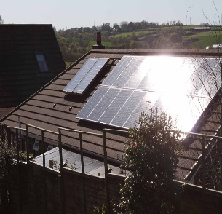
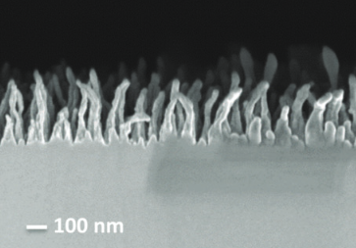
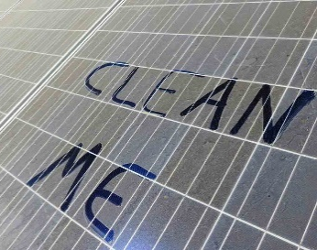
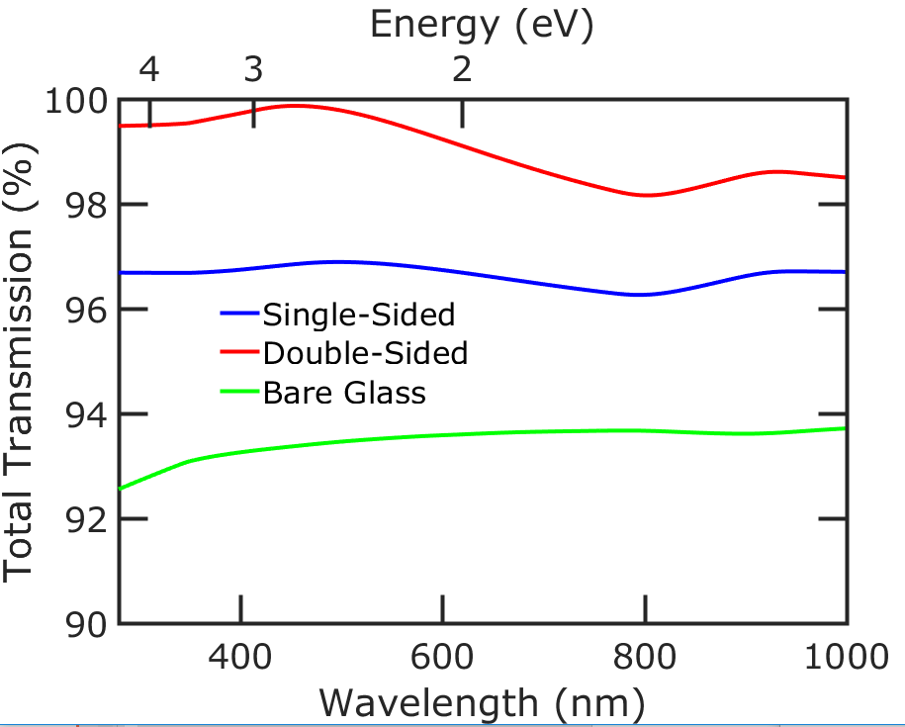
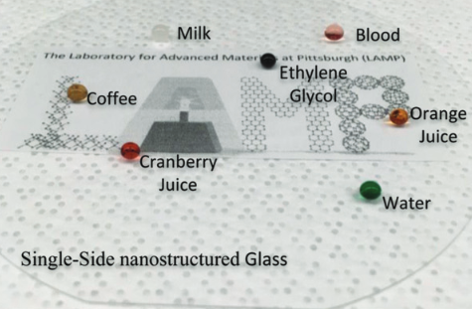
Durable Antireflective, Anti-Soiling, and Self-Cleaning Glass for Solar Modules
The Issues
Scalable Fabrication: Roll to Roll Nanoimprinting
Specular Reflection/ Glare - due to an instant change in the index of refraction, light is reflected.
Pipette nozzle
Nanopatterning rollers
UV and/or thermal curing device
Soiling from Particulates/Pollutants – lead to as much as ~60% efficiency loss!
Bare solar glass with resist
Roller dies
Antireflective
Proposed Work
Anti-Soiling and Self-Cleaning
Scale up fabrication of nanostructures to 1 m x 1.5 m glass needed by industry.
Understand how nanostructures can affect properties like antireflection, durability, anti-soiling, and self-cleaning.
Grades the index of refraction - between air and panel surface
Irregular like nanostructures on the Glasswing butterfly.
Reduces reflection across many wavelengths and directions.
Key Personnel/Organizations
Superomniphobic: repellent to a wide array of liquids
Uses naturally forming dew droplets to remove particulates.
Pitt
Dr. Paul W. Leu
Sajad Haghanifar
Sooraj Sharma
Corning
Dr. Carl E. Crossland
NETL
Dr. Paul Ohodnicki
Dr. Bryan D. Morreale

