Slide 1
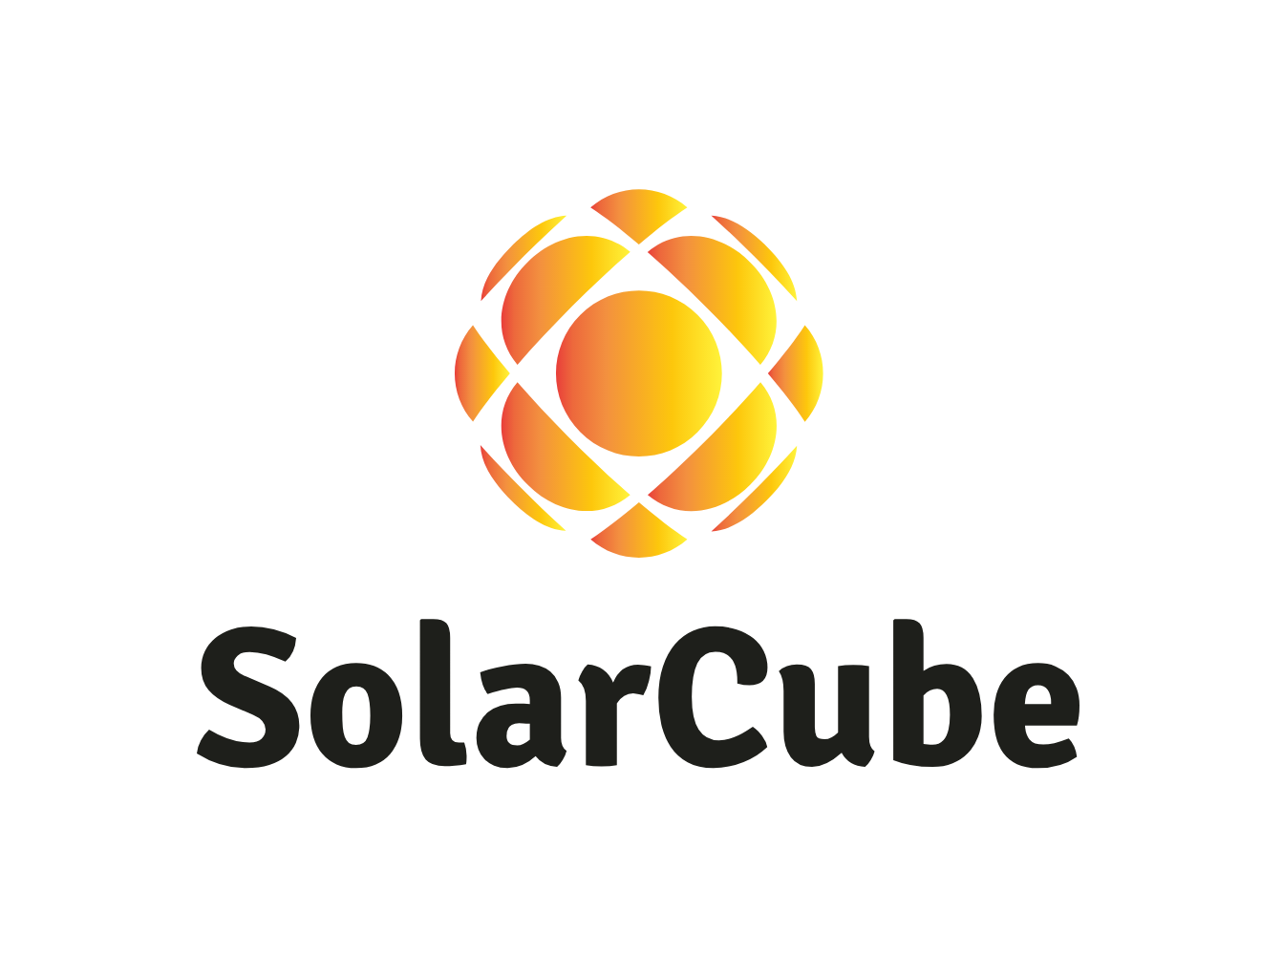
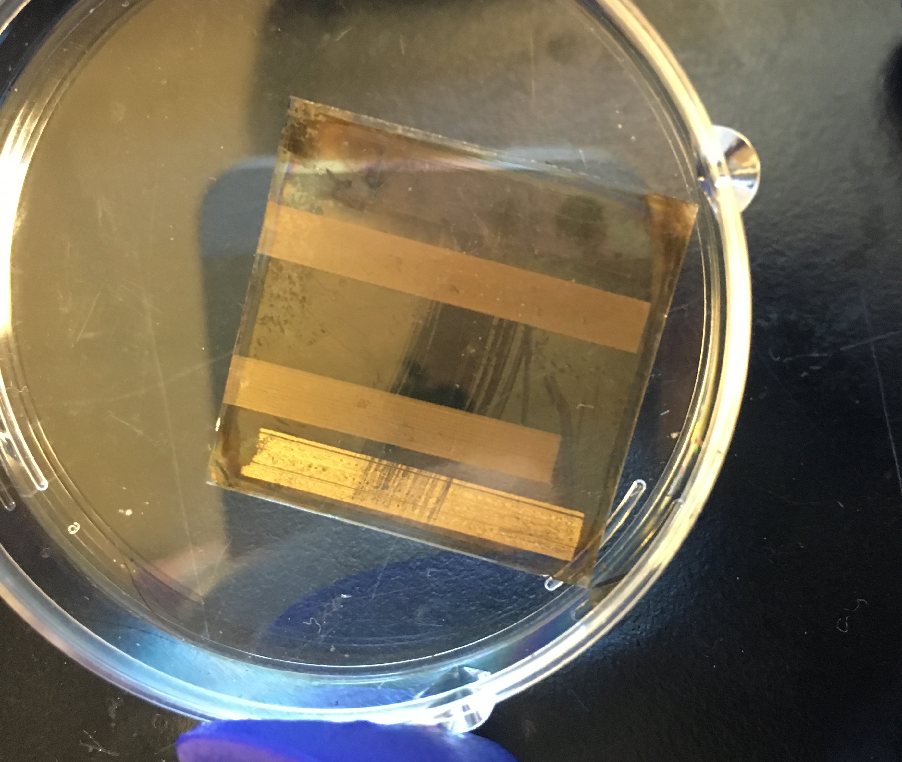
Printable Perovskite Solar Cell Technology SolarCube, LLC
Perovskite’s are printable crystalline structures with excellent light absorption properties and energy harvesting applications.
Our Design will build a homogenous rooftop array, and system design, at a fraction of the cost of traditional silicon PV.
Spiro-OMeTAD
Spiro-OMeTAD
Gold
ITO
Zinc Oxide
Perovskite
Perovskite
ZnO
Glass
ITO

