Slide 1






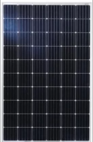


Micro grid Ready, Storage Enabled, Cyber secured Microinverter
µGrid switch
DC
Higher Grid Resilience
Secured DER communication
Micro-grid capable
Multi Port inverter (Grid, Panel, Storage, Solar)
Easy upgrade to Storage
Flexible Design (Distributed Storage, One inverter for multiple panels)
µInverter 1
Panels
µInverter 2
µInverter n
Loads
07/01/2019
1

