Slide 1

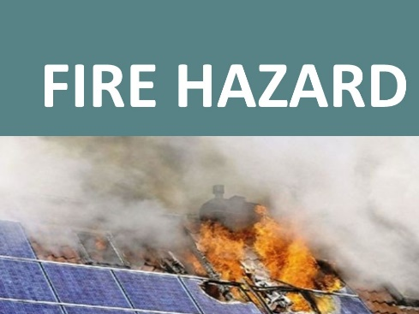
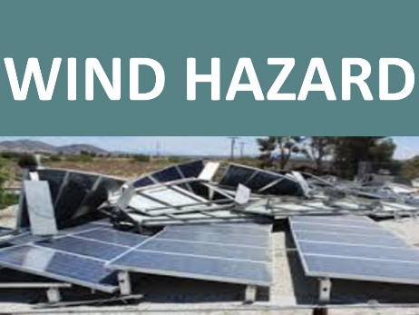
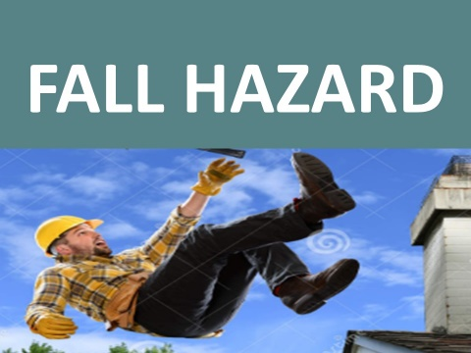
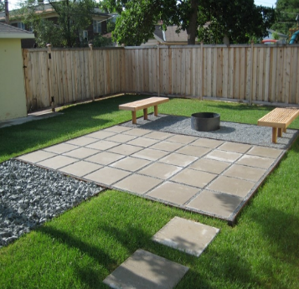
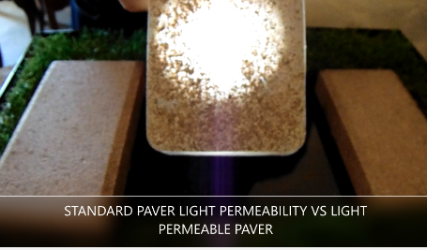
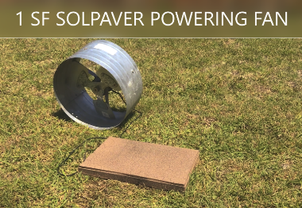
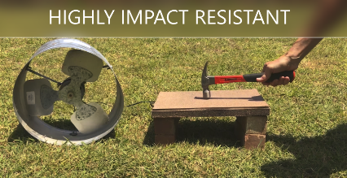
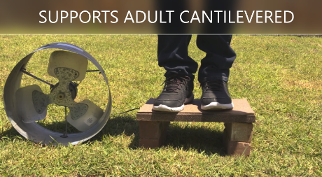
Elegant, Invisible, Low-cost, Safe Solar
PROBLEM: CURRENTLY ROOFTOP SOLAR IS COSTLY, DETRIMENTAL TO ROOFING MATERIAL, SUBJECT TO DESTRUCTIVE FORCES SUCH AS WIND AND FIRE, AND UNSAFE TO INSTALL
SOLUTION: SOLPAVERS ARE SUNLIGHT PERMEABLE COMPOSITE CONCRETE
LANDSCAPE PAVER WHICH INSTALL AT LESS THAN $2/WATT WITH NO ON-ROOF LABOR AND ARE EXTREMELY DURABLE AND TOUGH. THEY HAVE ENHANCED PRODUCTION PERFORMANCE DUE TO TEMP REGULATION AND SUN REFRACTION

