Slide 1
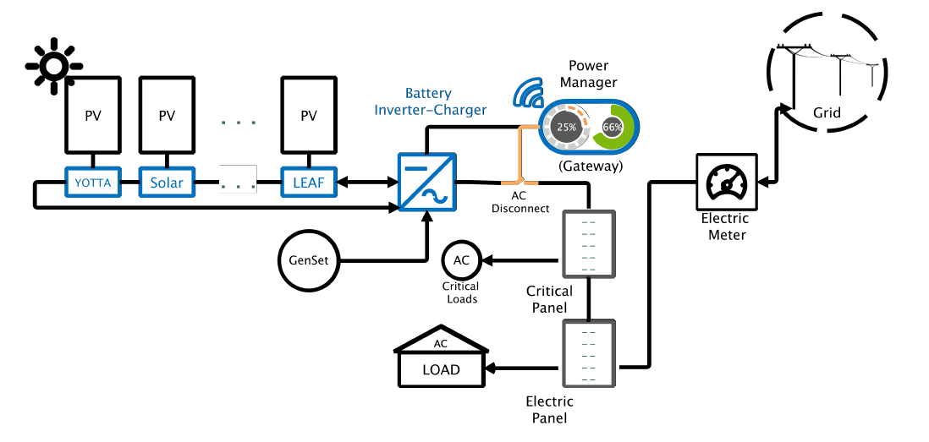
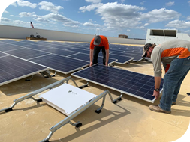
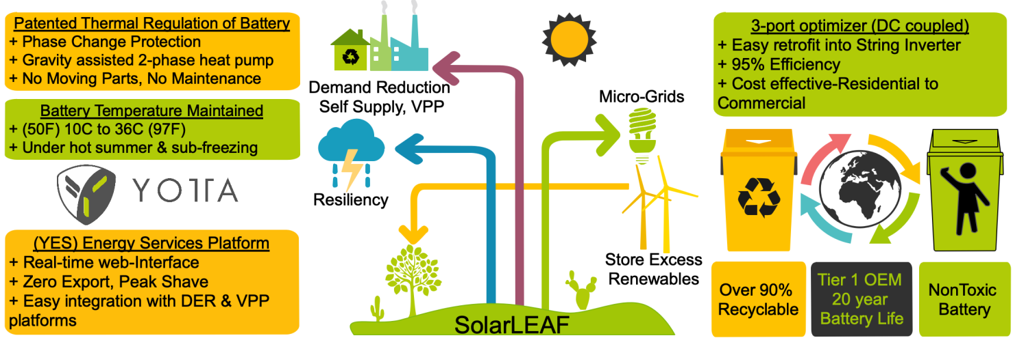
Summary Slide - Yotta Solar
Notes:
public-facing one-slide submission summary that contains technically specific details but can be understood by most people. There is no template, so feel free to present the information as you see fit. Please make any text readable in a standard printout and conference room projection.

