Slide 1
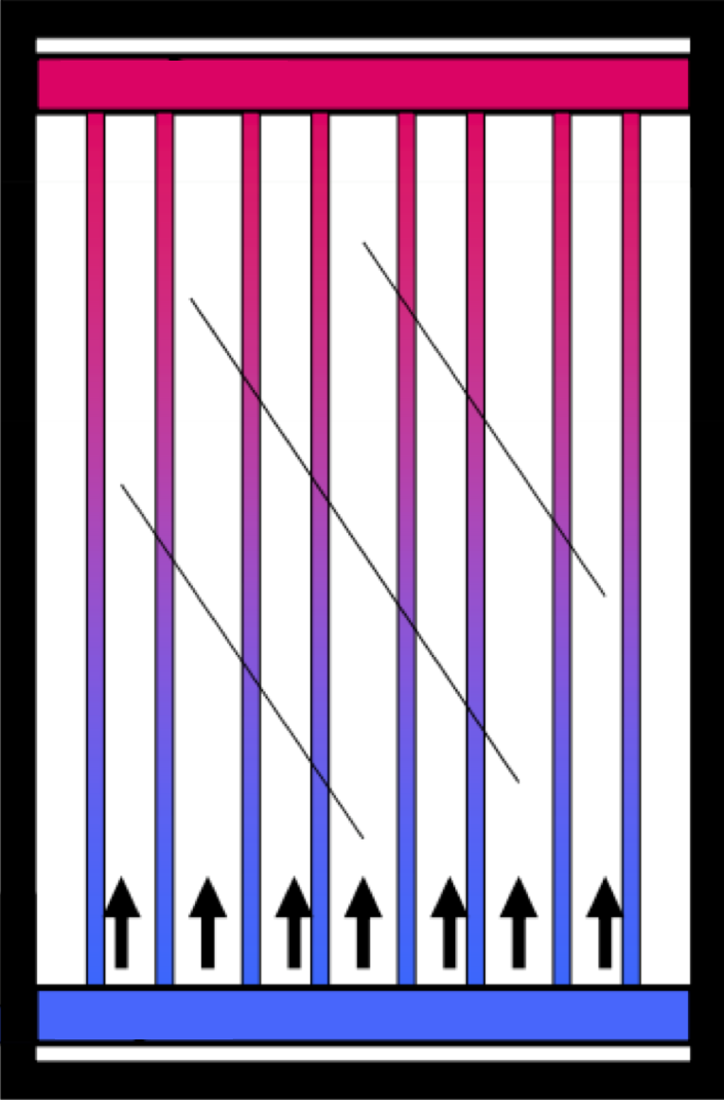
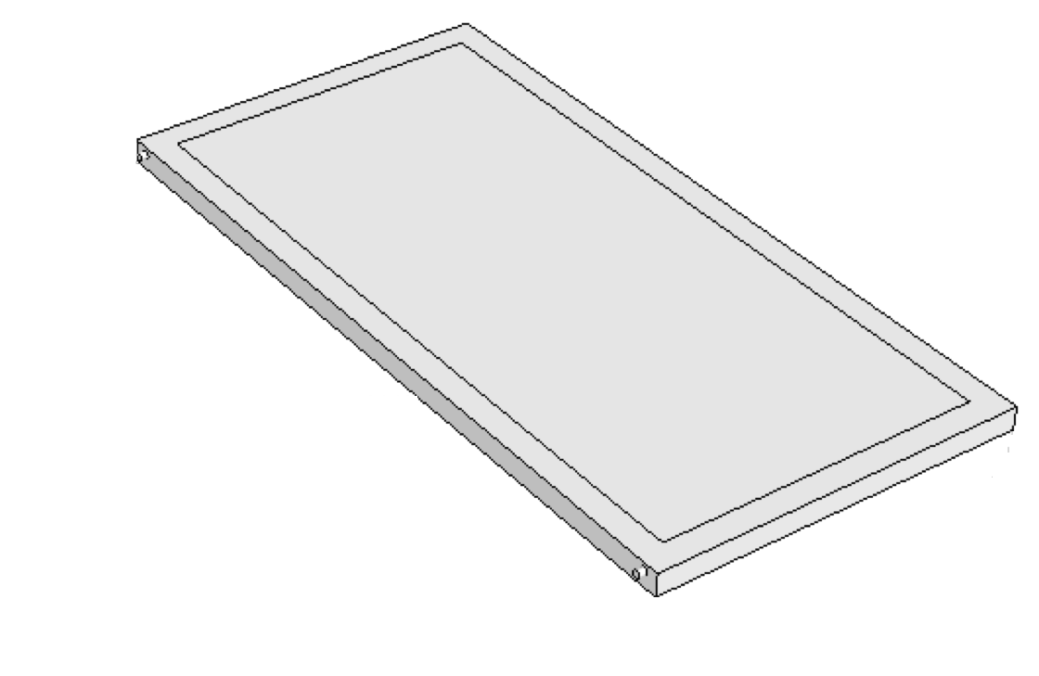
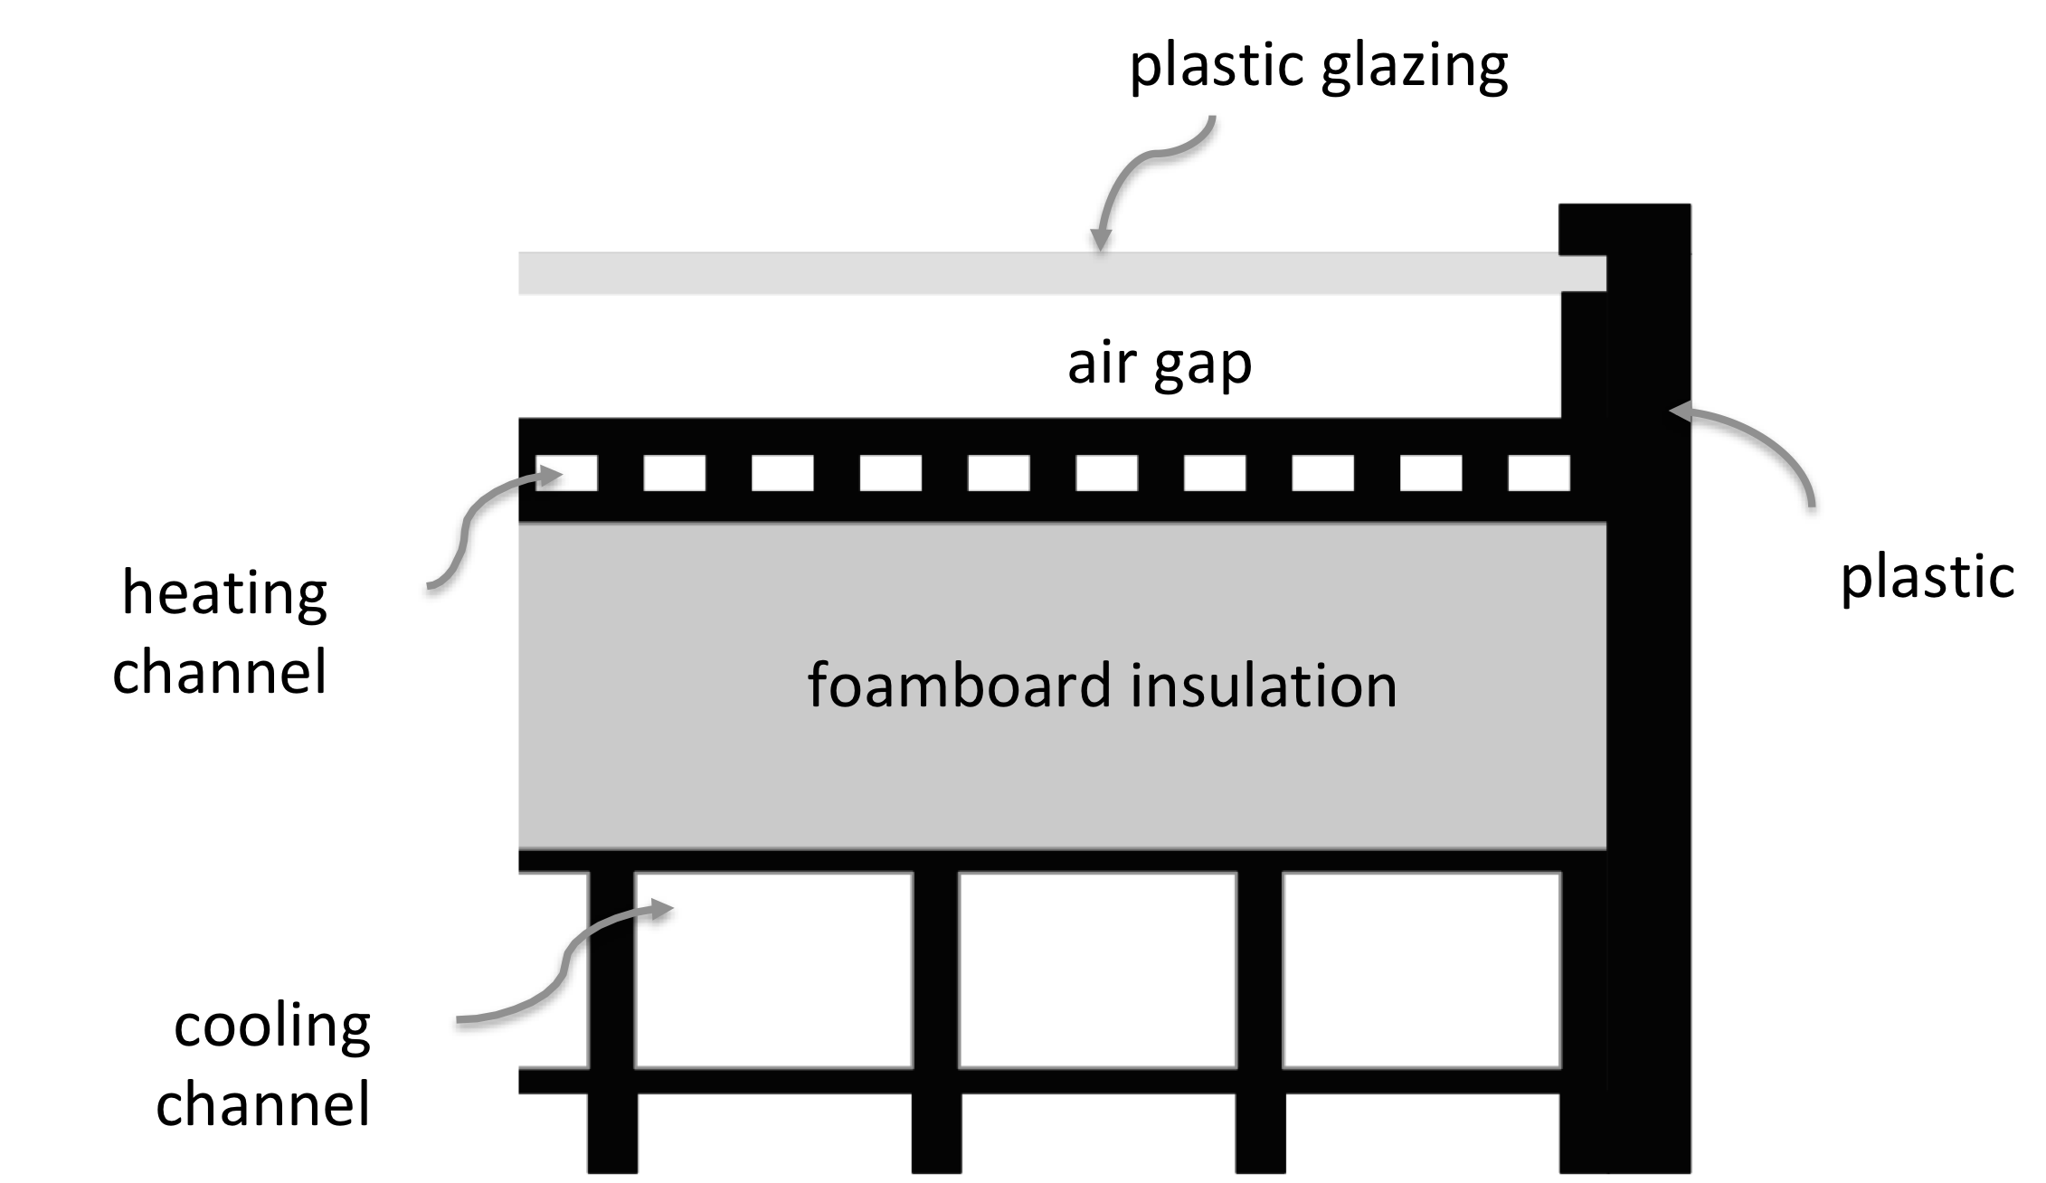
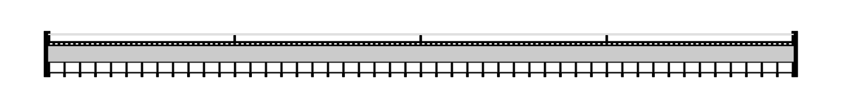
SOLARSPOT COLLECTOR STAYS COOL
SOLARSPOT CONCEPT ADDS A PASSIVE
HEAT EXCHANGE FLOW PATH
COOLING HEAT EXCHANGE FLOW PATH IS ON THE BACK SIDE OF THE COLLECTOR
to tank
FLUIDIC DIODE
from tank
PUMP ON
PUMP OFF
FLOW THROUGH BACK SIDE DURING NATURAL CIRCULATION
NO FLOW THROUGH BACK SIDE DURING NORMAL FORCED CIRCULATION

