Slide 1
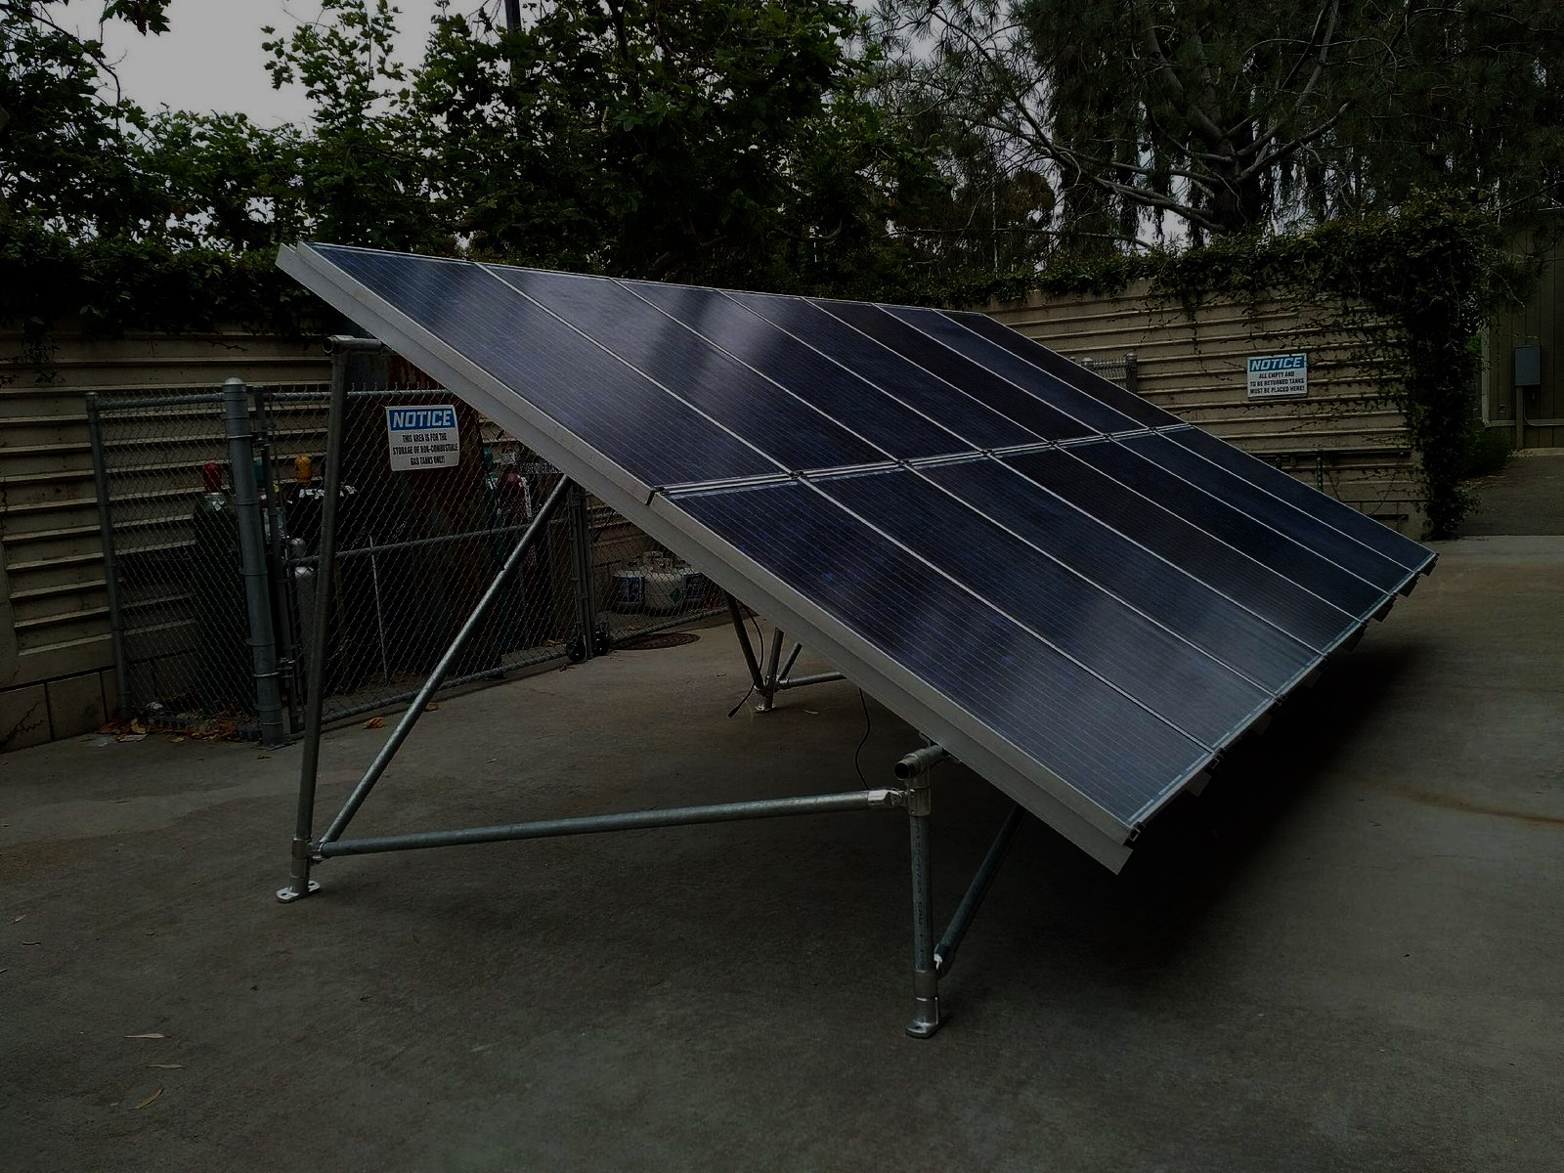
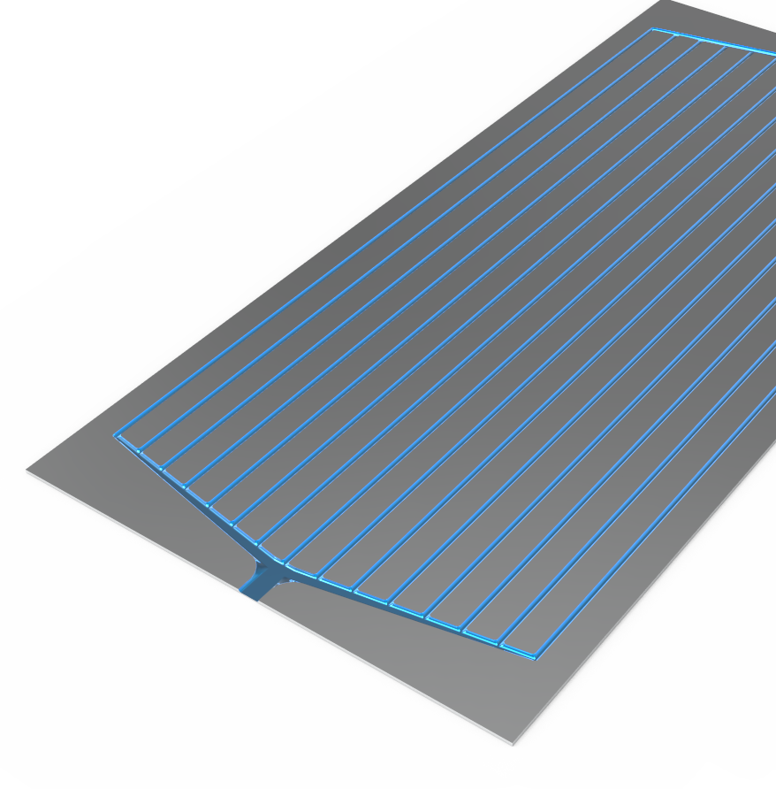
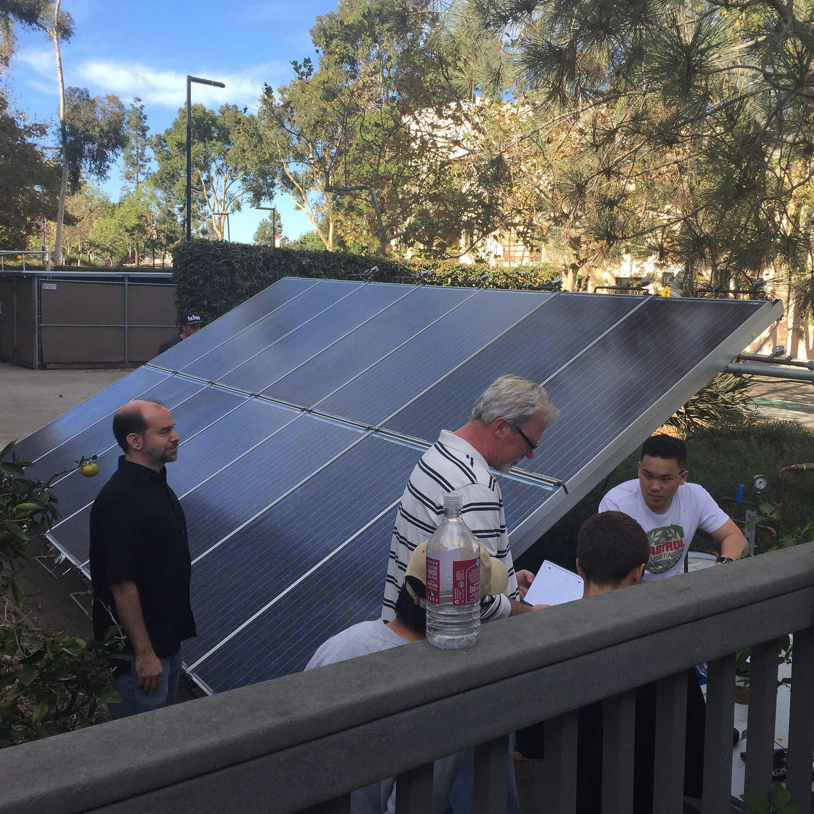
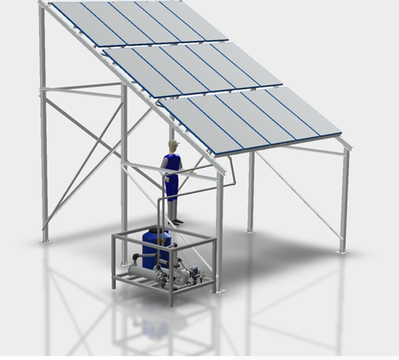

Icarus Hybrid Solar Photovoltaic/Thermal (PVT) Energy Storage and Power Boost
Proprietary approach boosts PV power, adds thermal storage
Less than 50% of the cost/watt than PV with Li-ion batteries
Collects and stores waste heat in thermal battery to generate power on demand

