Slide 1
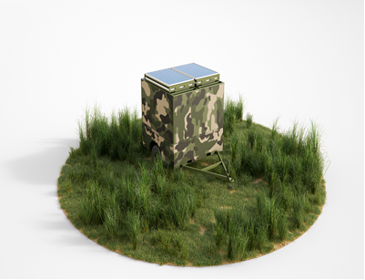
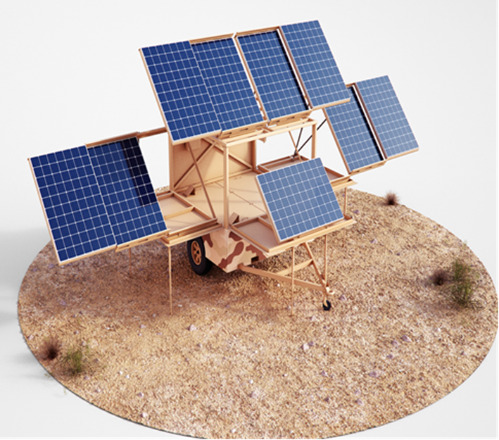

The Open Energy System (OES)
We have re-made the
Remote Solar Power Unit:
Mobile.
Transportable.
Pre-assembled.
Modular.
Durable.
Affordable.
Life Saving.
Clean, Reliable Easy-to-use Emergency Power…
when you need it most

