Slide 1
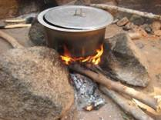
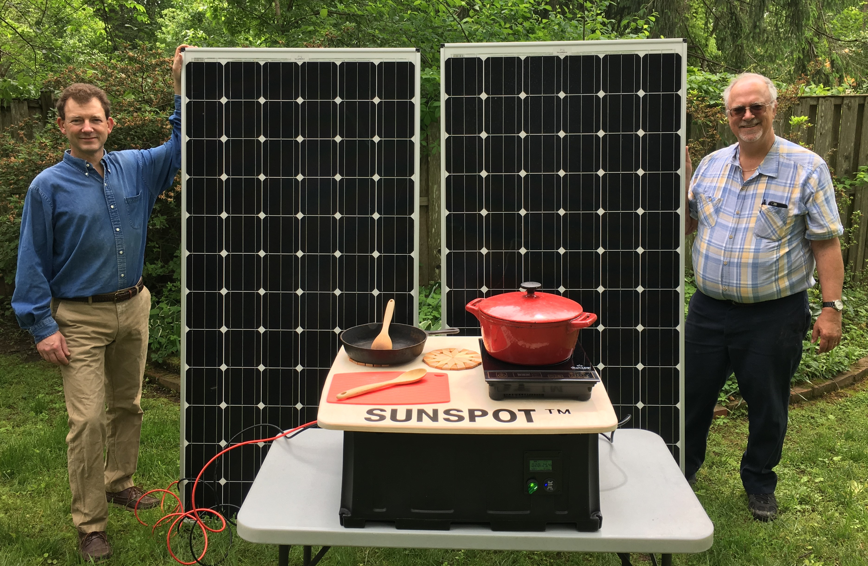
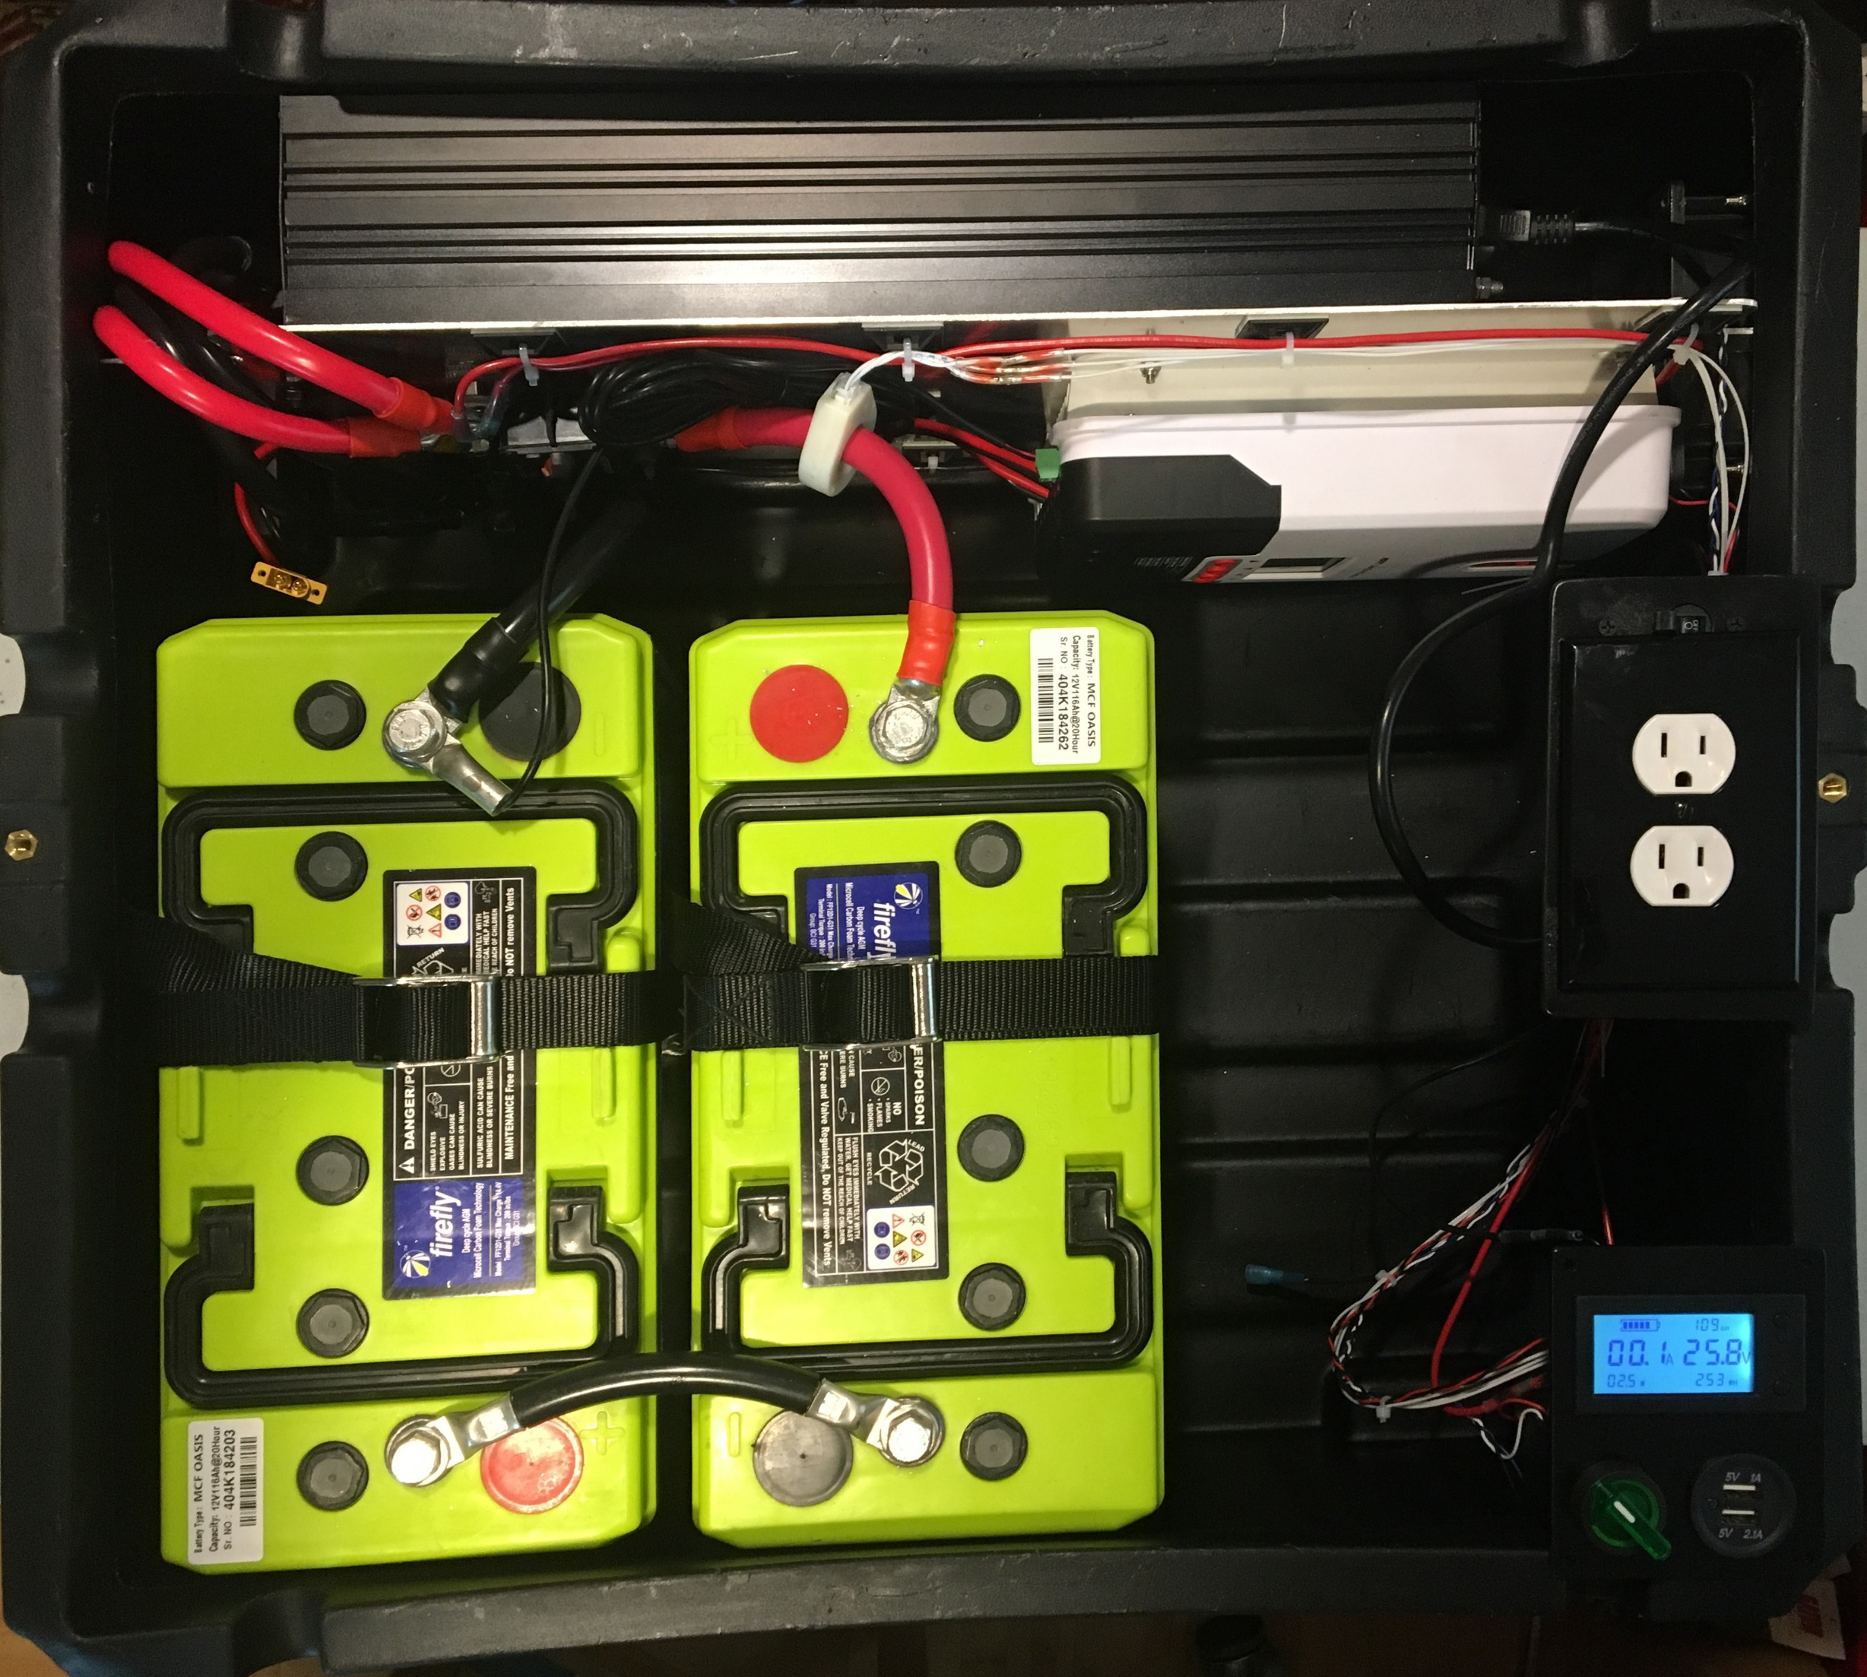
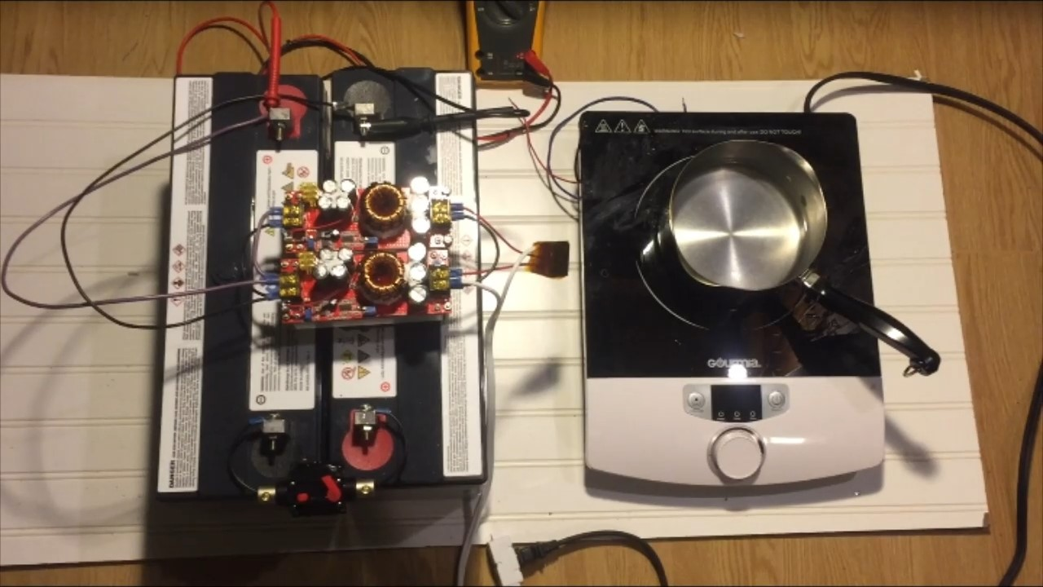


SUNSPOT™ Solar Electric Cooking System
A Submission to the “American-Made Solar Prize” Round 2
Three billion people around the world continue to cook with biomass fuels, causing significant problems both to their health and to the environments around the. The SUNSPOT™ is a cost effective alternative to traditional cookstoves.
Benefits of SUNSPOT™ include:
Elimination of hazardous fumes from cooking fires
Reduced time collecting fuel and tending fires
Improved fire safety – no open flames
Instant on-off reduces wasted fuel
Reduced pressure on forests
PAYG financing makes systems affordable
The SUNSPOT™ team will use funding from the American-Made Solar Prize Round 2 to fabricate custom power and control electronics for a “proof-of-concept” second-generation system, which will power appliances using DC instead of requiring a complex and expensive inverter.
We are collaborating with EarthSpark International to do a field trial in Haiti this summer and are developing a hybrid franchise / cooperative business model to enable scaling into the target markets.
www.sunspotPV.com
Doug Danley
doug.danley@gmail.com

