Slide 1
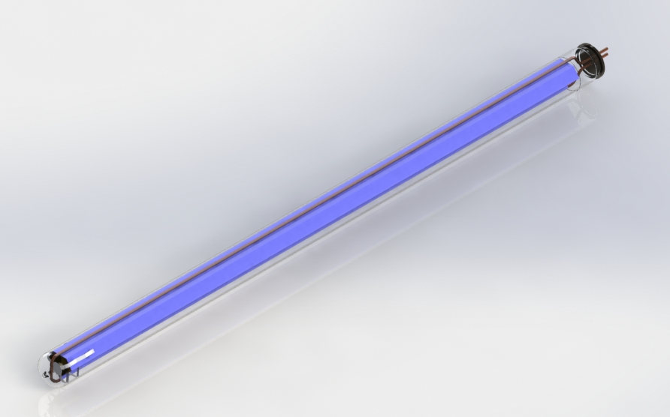
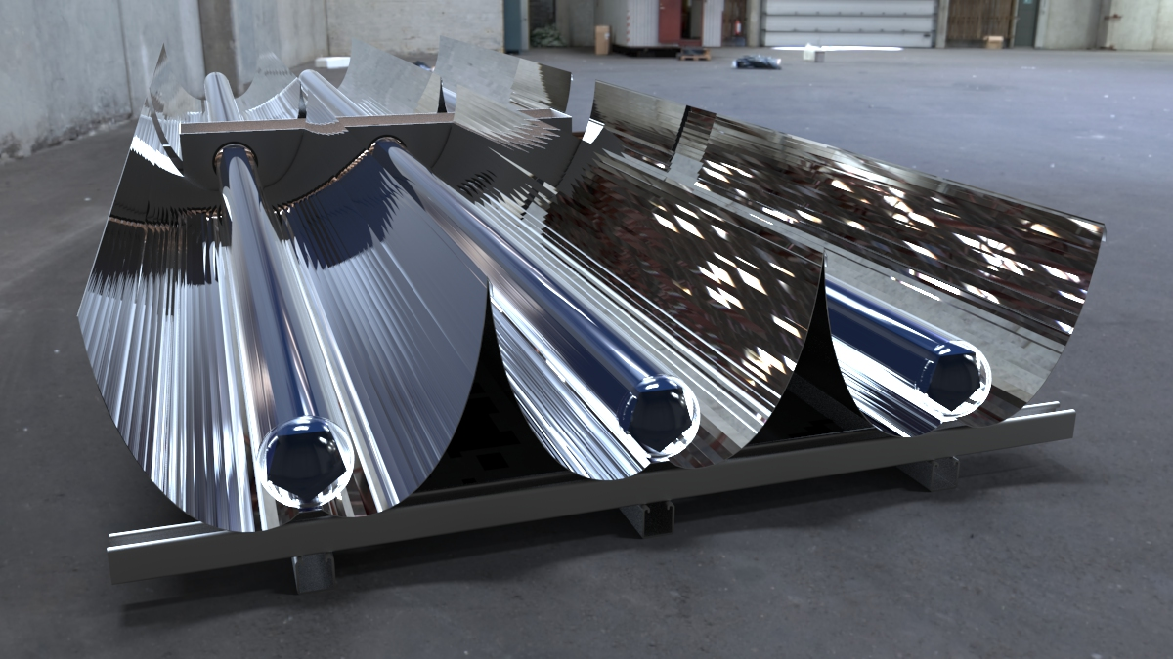
Make America Manufacture Again!
High Temperature Solar Thermal requires a High Temperature Receiver or an Evacuated Tube
Advanced High Temperature Solar Thermal
PROBLEM:
China is the only suppler and manufacturing of Evacuated Tube (EV) technology.
Current Evacuated Tubes are unreliable at stagnating temperatures above 400ºF.
High temperatures are required for industrial and commercial heating applications.
New EV tube designs need to be developed and US developed IP will be shared with
Chinese manufacturers who are direct competitors in the market.
Delays and costs associated with designing and testing new receivers in China
increase costs for R&D, necessary to compete in the High Temperature Solar market.
Recent trade issues and tariffs significantly increase our cost of goods.
US based EV tube manufacturing will assist other Universities and Laboratories
needing evacuated tubes for R&D projects and prototypes.
Applications:
Steam Generation, Industrial Process Heat, Desalination, Pasteurization, Wastewater Clean-up, Evaporation, Pasteurization, Air- Conditioning & Refrigeration & Power Generation
Bring evacuated tube manufacturing back to the US. Take control of the supply chain and manufacturing of solar technologies is critical for National Security and Energy Independence. The ability to compete in the global Solar Heating & Cooling market is dependent on US capabilities to deliver advanced technology at competitive costs.
SOLUTION:

