Slide 1
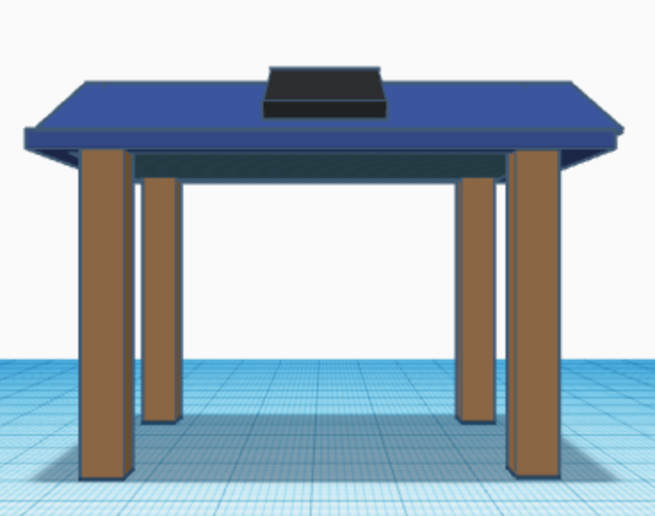
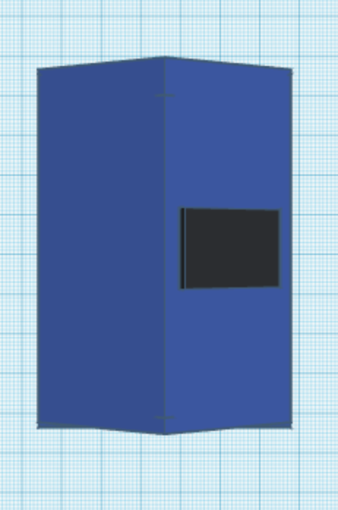
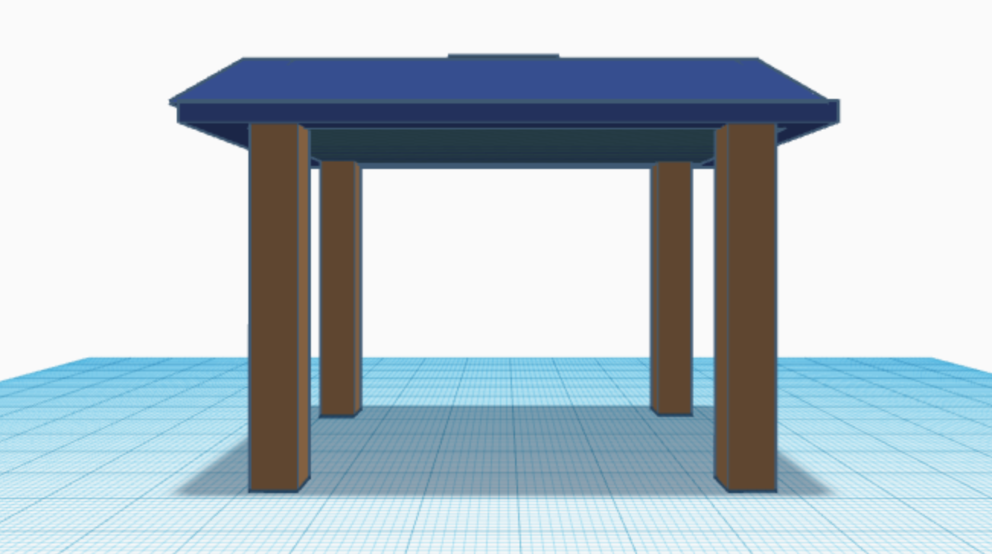
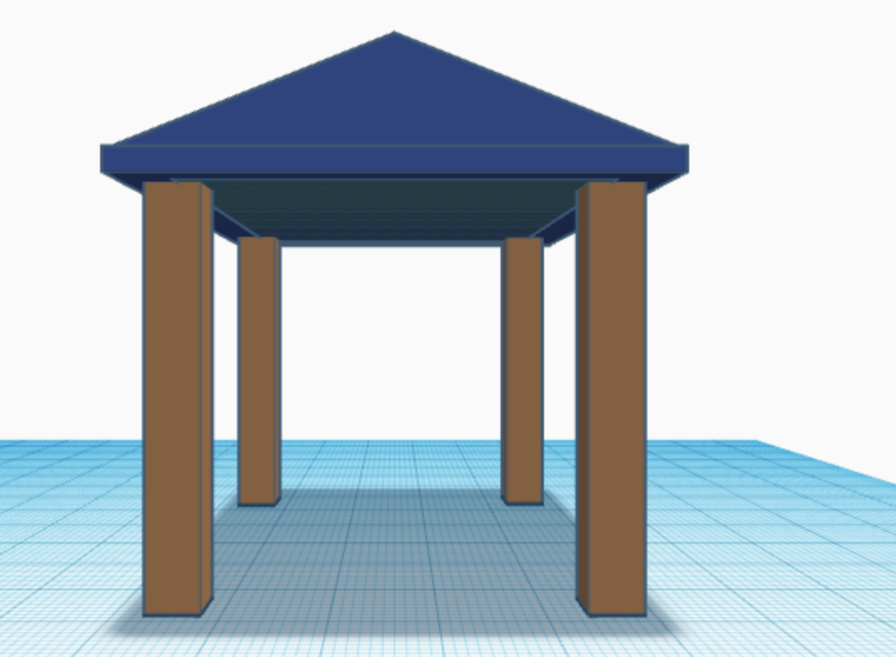
Pop-Up Solar Classroom
A modular pop-up classroom, similar to a pergola, with solar panels on the roof to charge phones and provide shade to improve learning.

