Slide 1








Low Cost and Highly Feasible Improvement for Commercial Silicon Solar Cell

Slide 2
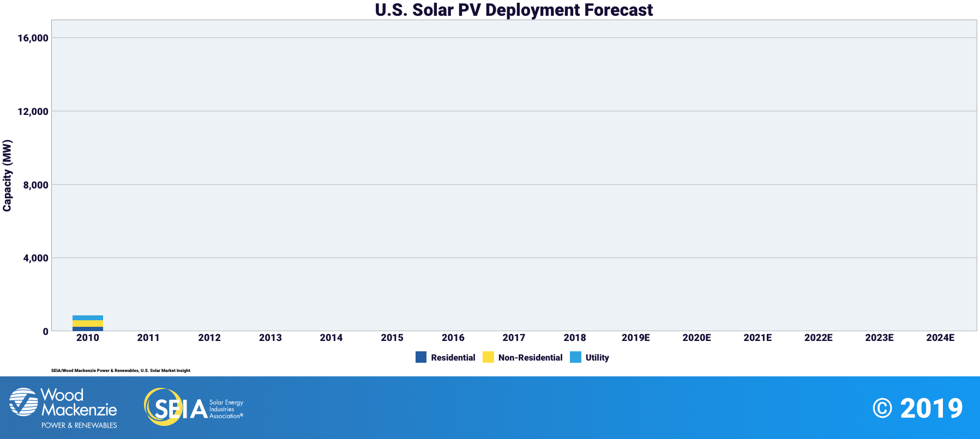
The capacity of solar cell is rising

Slide 3





Their photoelectric conversion efficiency stop around 18% in decades of years

Slide 4
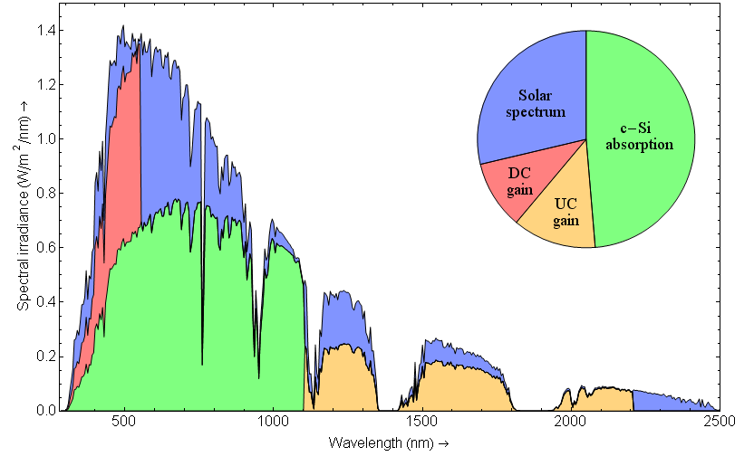
Input limit output

Slide 5
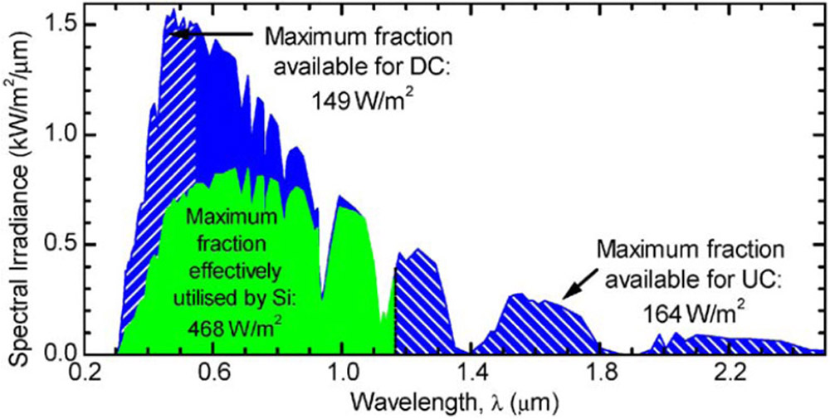
Downconversion is a promising way to improve the input

Slide 6
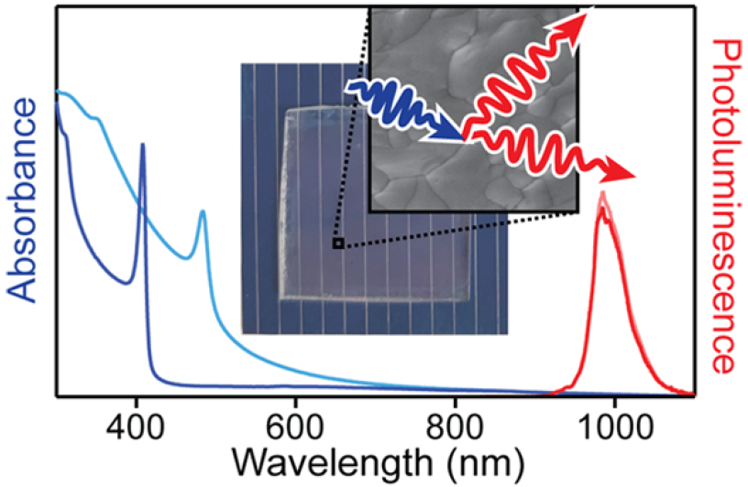
Input optimization strategy No.1
Yb³⁺ ion doped CsPb(Cl_{1-x}Br_{x})₃ Thin Films
这是一个副标题
Maximum photoluminescence quantum yields: 193%
https://pubs.acs.org/doi/abs/10.1021/acsenergylett.8b01528
Reprinted with permission from {ACS Energy Lett.2018,3,10,2390-2395}. Copyright {2018} American Chemical Society
The transparent thin film convert UV light to NIR light by quantum cutting, which can be greatly absorbed by silicon solar cell

Slide 7
Input optimization strategy No.1
Directly cover CsPb(Cl_{1-x}Br_{x})₃ :Yb³⁺ thin film on silicon solar cell

Slide 8
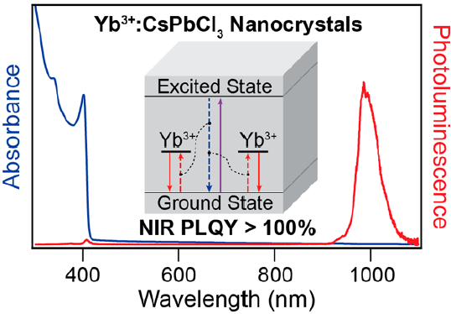
Input optimization strategy No.2
Yb³⁺ ion doped CsPbCl₃ Nanocrystals
这是一个副标题
Maximum photoluminescence quantum yields: 170%
https://pubs.acs.org/doi/abs/10.1021/acs.nanolett.8b01066
Reprinted with permission from {Nano Lett. 2018,18, 6, 3792-3799}. Copyright {2018} American Chemical Society
The easily made nanocrystals solution convert UV light to NIR light.

Slide 9
Silicon Solar cell
Input optimization strategy No.2
Mix CsPb(Cl_{1-x}Br_{x})₃ :Yb³⁺ nanocrystals solution into encapsulation

Slide 10

Summary
By DC, the estimated photoelectric conversion efficiency of commercial silicon solar cell can be improved to about 22% from 18%.
These two strategies are sample, easy and awesome. Low cost for high improvement.
These strategies are suitable for the existed silicon solar cell for upgrade.
Notes:
1图；2文

