Slide 1
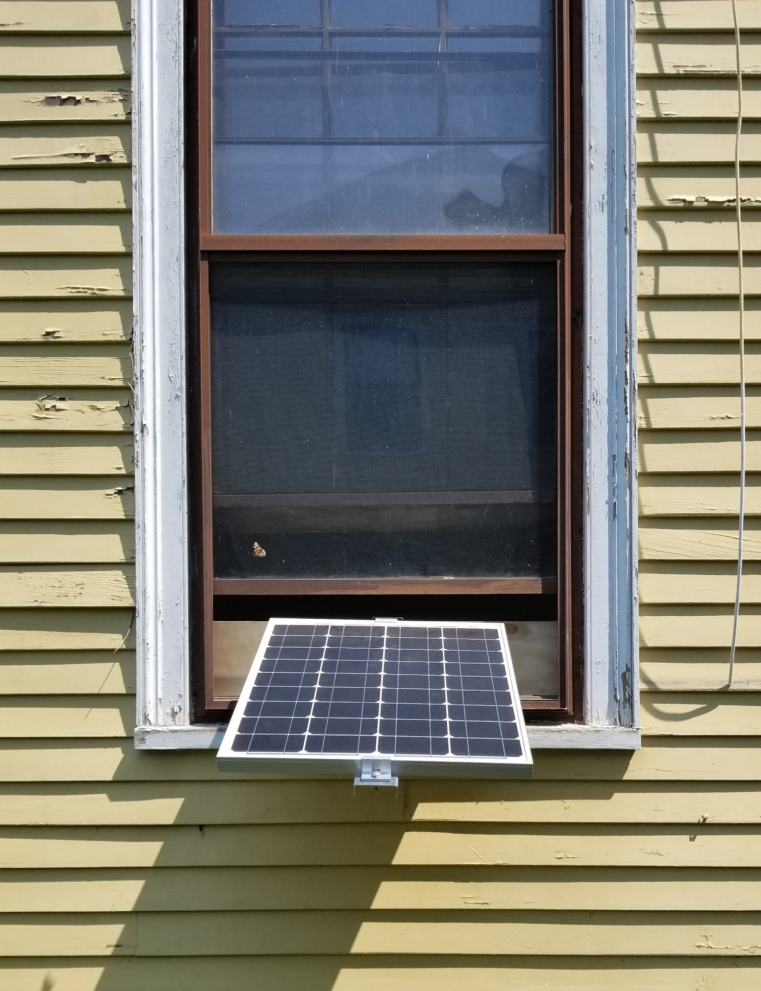

Solar Clamp
A modular and non-invasive PV mounting system for windows and parapet walls.
As easy to install as a typical air conditioner
Designed for urban areas with limited space
Adjustable for a range of installations
Building code compliant
Supports 50 - 200 watt modules
Team: Alex Nathanson, Project Lead; Pratik Jain, Product Designer; Mitchell Dose, Fabricator
Image: An early prototype of the Solar Clamp with a 50 watt PV module.

