Slide 1

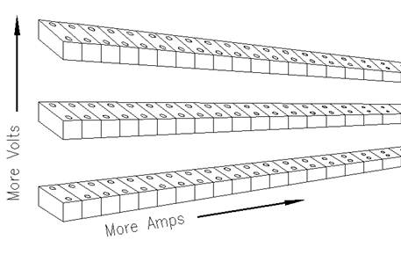
The world needs to store clean, renewable solar energy.
We will provide a unique, complete, and scalable battery management system for repurposed automotive lithium batteries.
Our energy management solution will open opportunities to create stationary and portable systems to efficiently deliver solar energy to areas where it is needed.
Scalable voltage
Scalable current
Actively balance
Moon Shine
Green Cycle Design Group, LLC
Creating affordable, optimized lithium solar storage for stationary or mobile applications powered by natural resources

