Slide 1
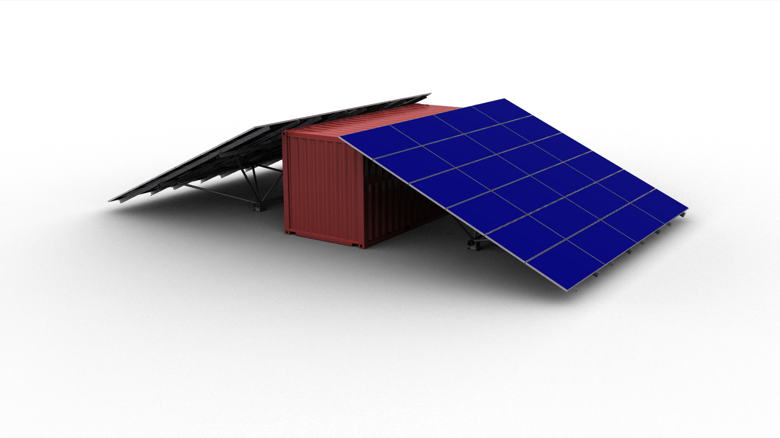
Storm-Resilient Essential Grid Services
GOAL
To save lives by enabling communities who have just experienced a hurricane rapid access to critical infrastructure services including electricity, pure water, and medical refrigeration.
OUR IDEA
After Hurricane Maria, access to clean water and medical supplies actually declined once gas generators ran out of fuel. Our solution provides essential services within hours of the storms arrival, and will serve the community indefinitely. Within a 20-foot modular shipping container are all materials needed for assembly, medical-grade, water purification, and battery storage. The system will be pre-placed on-site prior to a disaster, in central locations to the community. In can be mobilized only if needed.
BENEFITS
Rapidly deployable: capable of providing electricity within hours after the threat ends.
Proactive solution: pre-placed on-site prior to the occurrence – not dependent on post-storm infrastructure.
TEAM AND PARTNER ORGANIZATION
The Quest Renewables, Inc. Team led by: Norman (Finn) Findley, William Arnold, Rainey Jernigan
Partners: Georgia Tech Enterprise Innovation Institute, Tiedown Engineering, Cermak-Peterka-Peterson Engineering

