Slide 1
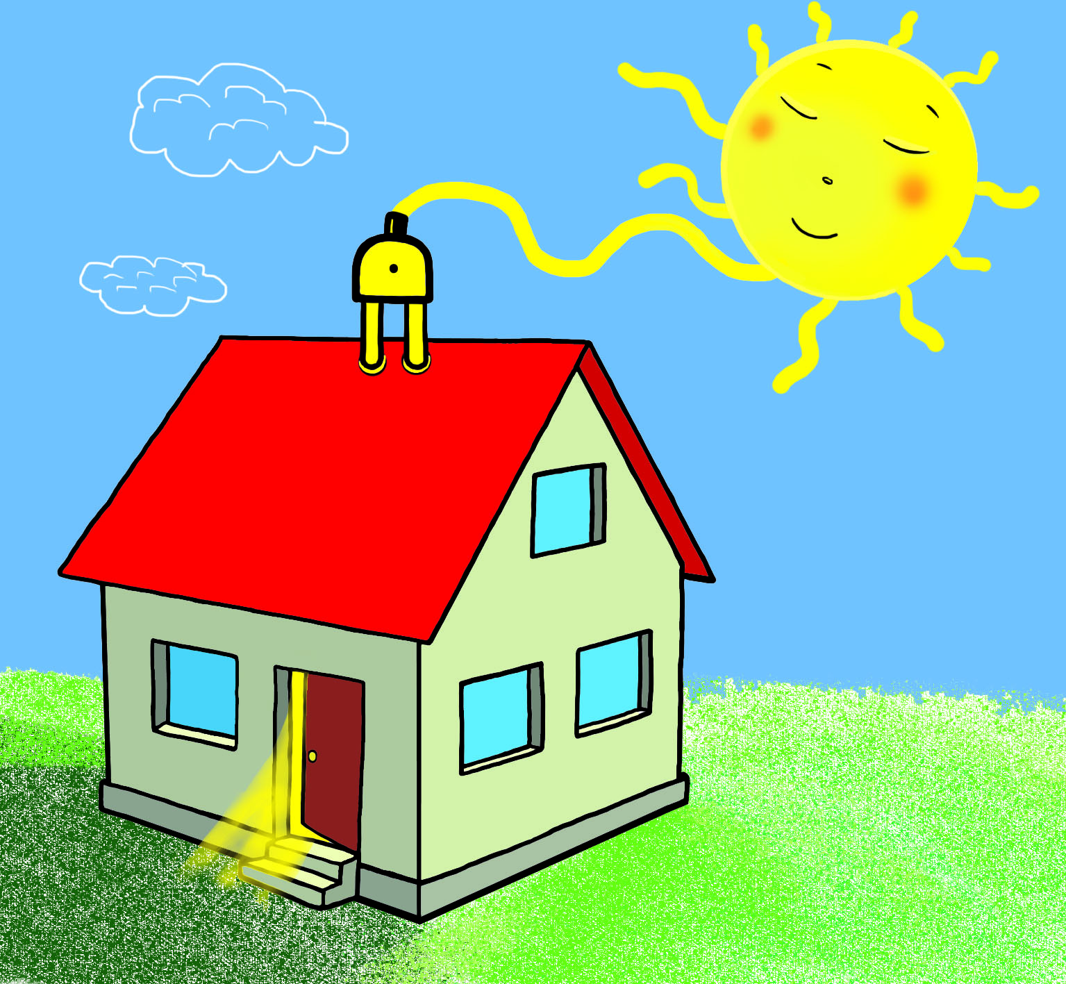
A technology to eliminate hot spots in solar panels
A plan to make solar work for low-income households
Locally Grown Power
Making the sun more powerful

