Slide 1
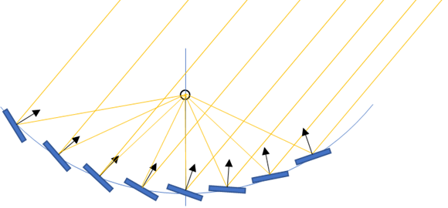

Tensile Based Large Aperture Parabolic Trough
Team Skysun, LLC
Project Summary
Key Personnel/Organizations
A tensile based large aperture parabolic trough is proposed. Substantial groundwork has been completed at Sandia National Laboratories in collaboration with Skysun, LLC through a Department of Energy Small Business Voucher, (SBV 2015/2016). A prototype will be installed at the NSTTF and evaluated for optical and mechanical performance. Here, the tensile support structure also partially defines the optical geometry. Reduced infrastructure promises cost effective apertures in excess of 50 meters. Hybrid of PTC and LFC.
Skysun, LLC: Jim Clair, Sean Milroy CE, PMP, Adam Halperin, Engineer
Sandia National Laboratories: Dr. Julius Yellowhair, Dr. Kenneth Armijo National Solar Thermal Testing Facility
Key Milestones & Deliverables 12 Months
System Modeling FEA, CFD and Optical evaluation
Construction/Operation of automated prototype
Achieve CR > 100 single axis
Achieve CR > 250 dual axis
Evaluate performance in single and dual axis modes
Reduce receiver size dual axis mode, Achieve TRL 6
Project Impact
Parabolic trough technology enjoys wide and growing deployment. One constraint on increasing aperture size is the associated cost of wind survivability. Skysun proposes a low cost tensile based approach for large apertures capable of surviving extreme events and with comparable optical performance and thermal efficiency to the current art with collector field installed cost < $90/m2.
Evaluate system performance
Overall efficiency and accuracy
Determine collector installed cost $/m²
Projected $/kWh and LCOE
Design, construct and evaluate a tensile-based, automated trough heliostat with CR > 100/250.

