Slide 1
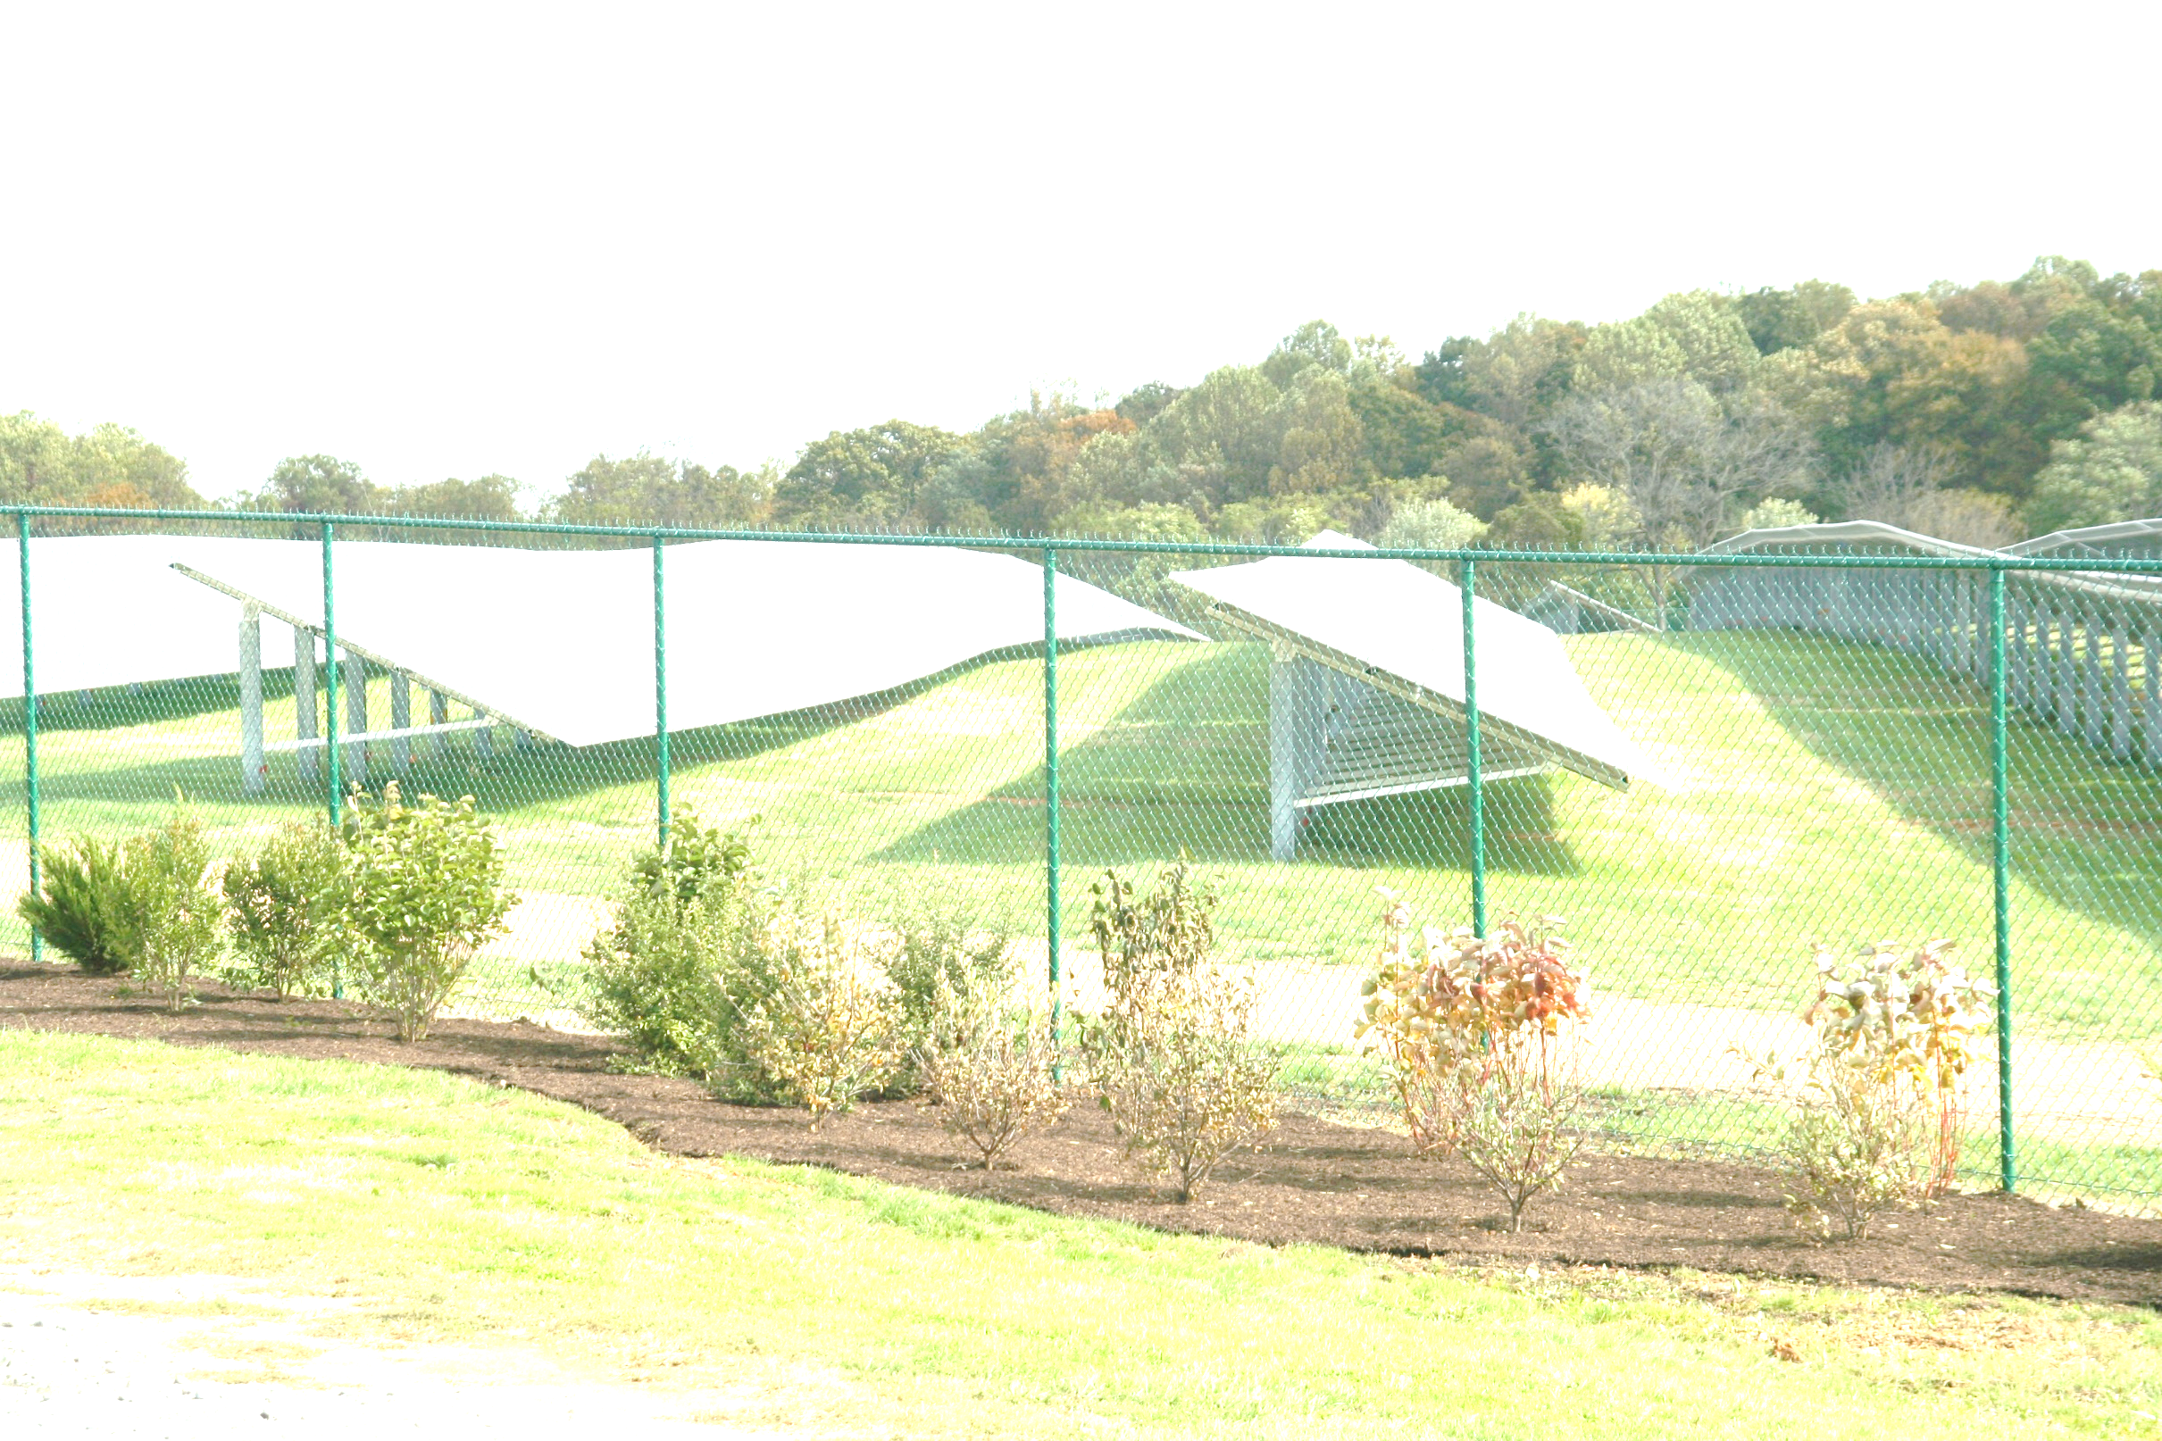
PV And Agriculture
A unique approach for PV electricity generation and food production on the same land.
People need both electricity and food.
There has been opposition to the conversion of farmland to solar farms.
Our goal is to share the land and its sunlight between crops and PV electricity generation.

