Slide 1
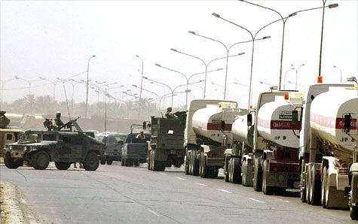
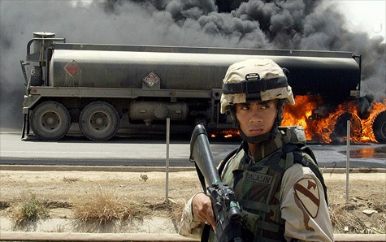
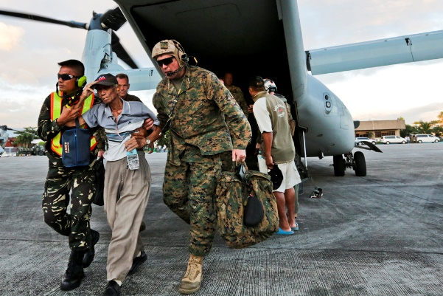
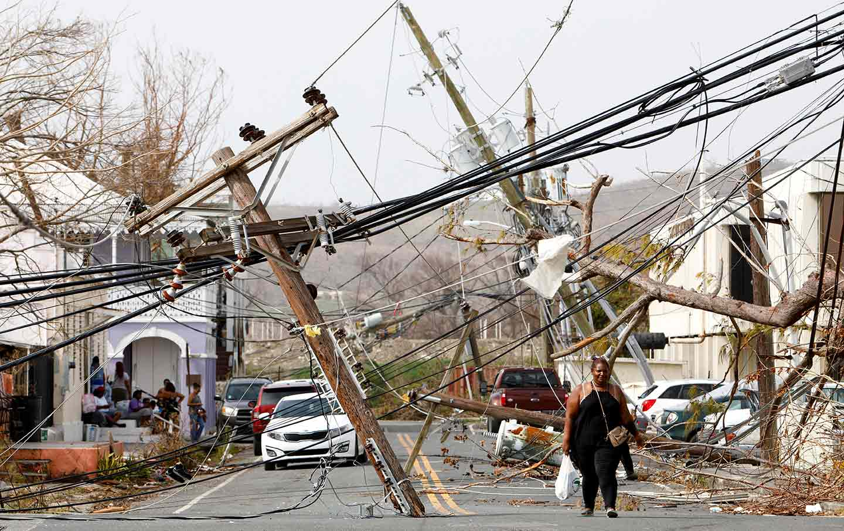
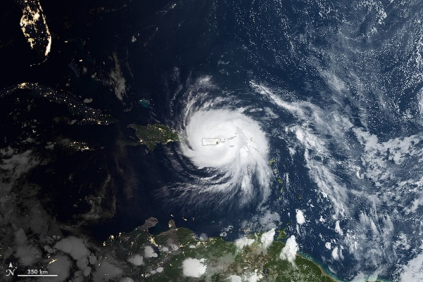


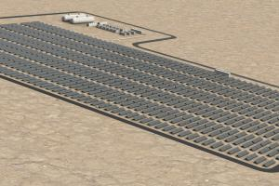
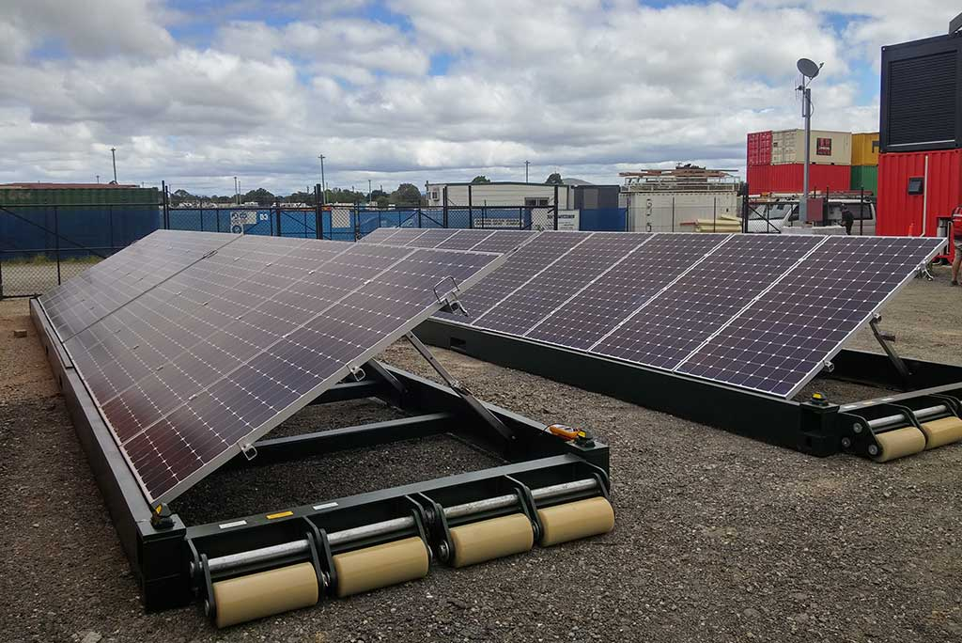
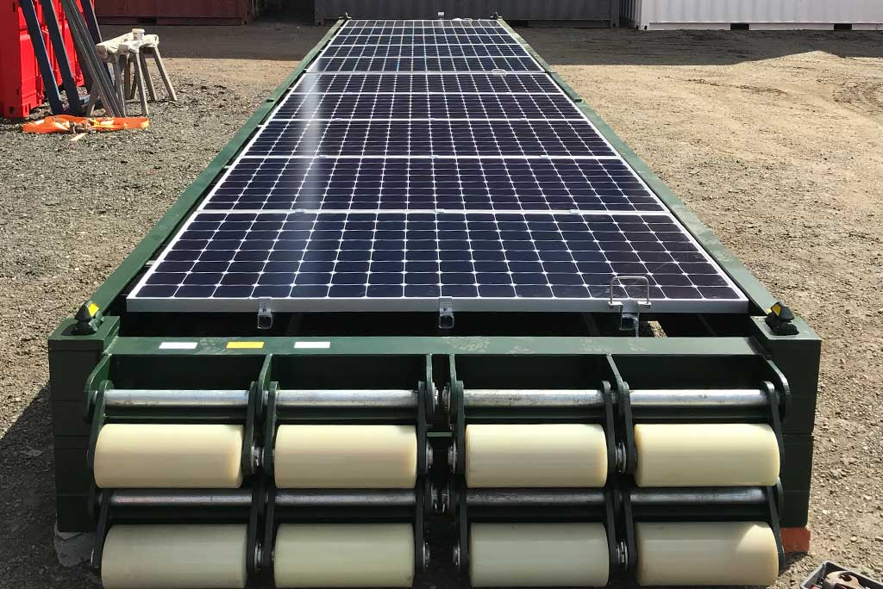
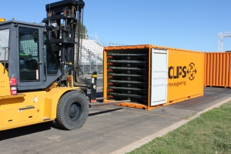
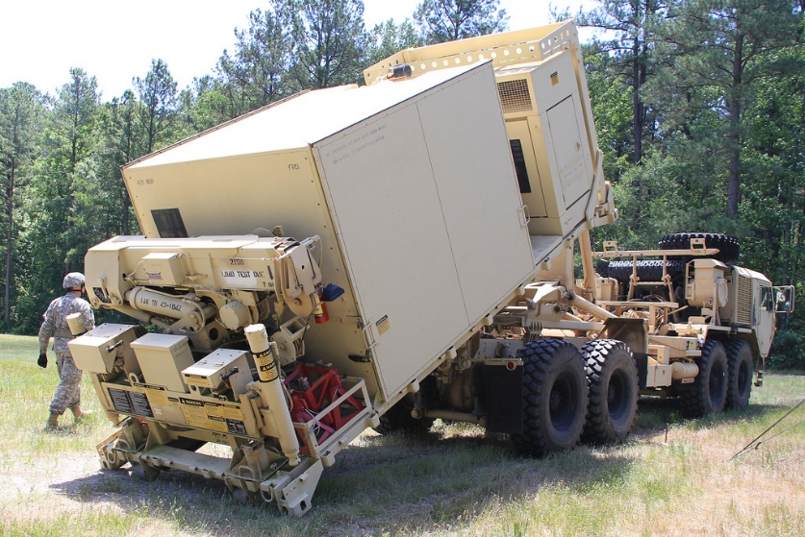
Energy Infrastructure before/after natural disasters in a Humanitarian
Assistance & Disaster Relief (HARD) Operations.
Military fuel convoy to Forward Operating Bases (FOBs)
FOR THE MILITARY CLEAN ENERGY SAVES LIVES
By Steve Hargreaves @CNNMoneyTech August 17, 2011: 2:40 PM ET NEW YORK (CNNMoney) - One out of eight U.S. Army casualties in Iraq was the result of protecting fuel convoys. This statistic, derived from an Army study looking at fuel convoys in Iraq from 2003 to 2007, is a powerful incentive for the military to move away from oil and toward renewable energy, and that's exactly what it's doing…
CROSSTM – CONTAINER ROLL-OUT/RAPID-DEPLOYMENT SOLAR SYSTEMS 20’, 40’ - is an already assembled relocatable mobile military grade solar array/s that can be expandable on-site. CROSS is freighted, air-lifted in standard 20 ft and 40 ft shipping containers, and rolled out using a forklift and setup on site within minutes of being delivered. CROSSTM is fitted with torsion springs at the bottom of each array, which supports raising the panels through the 10/20/30 degree tilt angles. The lifting of the arrays to the required angles is measured in seconds. CROSS are delivered to site pre-assembled and pre-wired to DC isolators, and are generally matched to containerized Battery Energy Storage Systems (BESS), which includes inverters, batteries and control systems. This means the entire solar or hybrid system can be picked up by forklift or side-loaders and moved to the next site, without the need for refits or refurbishment.
http://www.ecoestates.us info@ecoestates.us
CROSSTM @ Forward Operating Bases (FOBs)
“CROSS is out-of-the-box eco-friendly solution that can save lives around the world” David Pham

