Slide 1

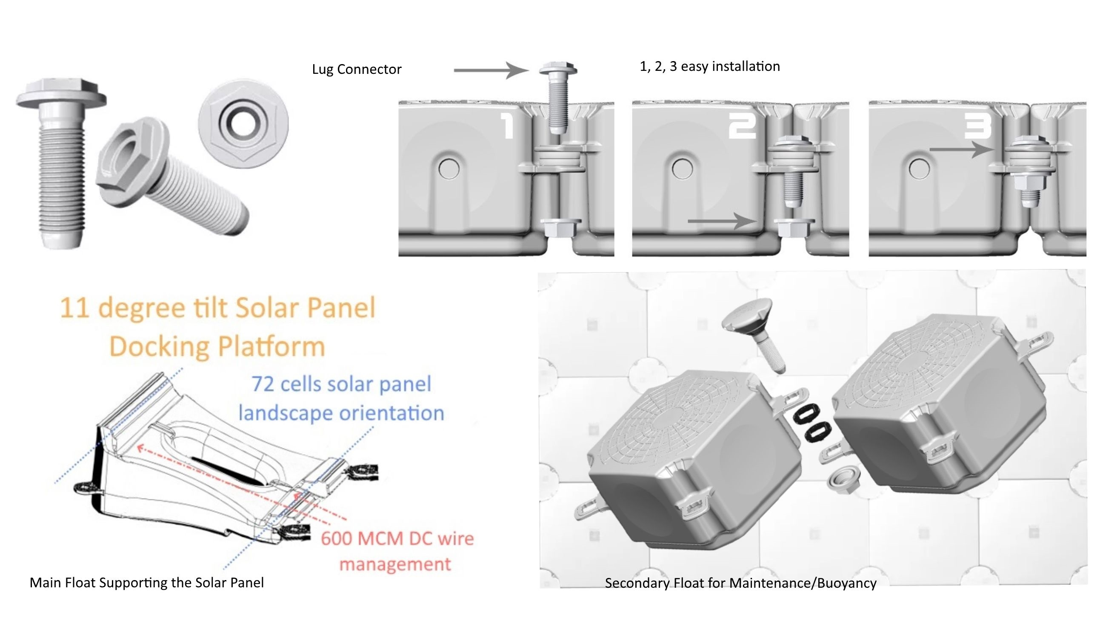
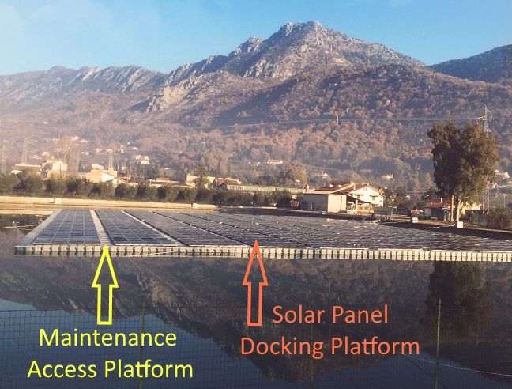
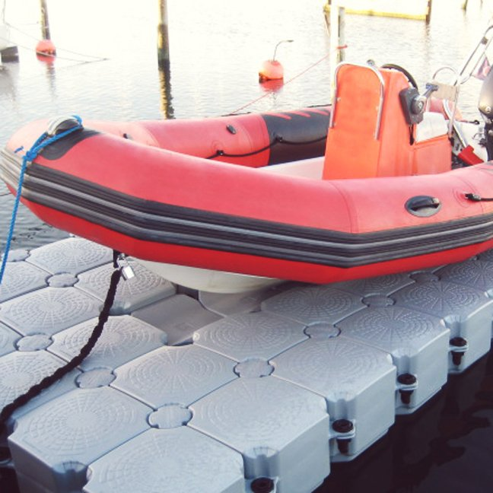
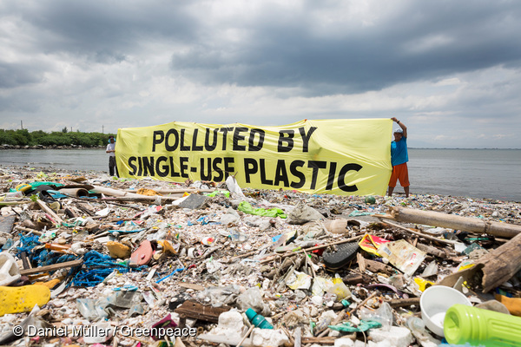

SolarDOCKTM System is the Made in USA solution for FLOATING SOLAR PROJECTS
The SolarDOCKTM System is Made in the USA Eco-Friendly Cost-Effective products for the racking mounting system for floating solar projects.
Eco-Friendly because all the floats are made from recycled plastics.
Cost-Effective because
a) intelligent design w/ wire management system for DC combiner-less
b) requires less plastic
c) very easy & fast to install – 1, 2, 3 easy installation
d) strong stable very buoyant maintenance access floats to support >+500lbs
d) dual use for the solar and marine watercrafts industry
COST-EFFECTIVE & ECO-FRIENDLY
The USA & the world floating solar projects need new floating platform system MADE in the USA with less plastic, uses recycled plastic, cost-effective, eco-friendly, stable, stronger more buoyant maintenance float for access, no/very little maintenance for DC solar panel strings/arrays, no/very little metal parts on the water and easy to install.
SolarDOCK™ System will help with the Plastic Pollution Crisis by using recycled plastics. According to National Geographic online article on Dec. 20th, 2018 “… only about 9% of all plastic ever made has likely been recycled…” and also solved a major need in the floating solar industry.
SolarDOCK™ System
HAS ALL THE SOLUTIONS
TO THESE NEEDS
WWW.ECOESTATES.US INFO@ECOESTATES.US

