Slide 1
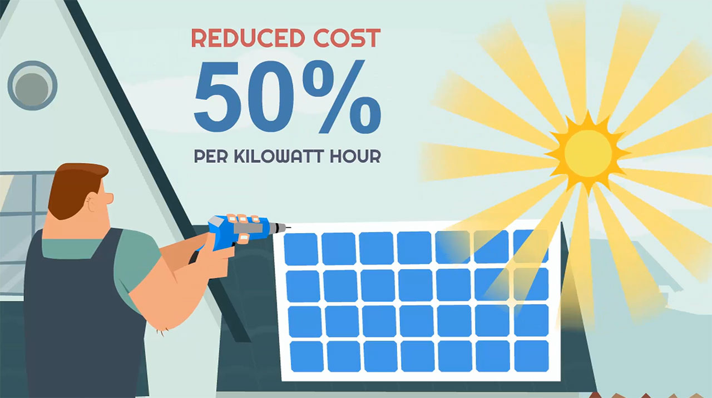
Transforming Solar Power from Environmental Investment to a High Yield Financial Investment through Substantial Cost Reduction

