Slide 1
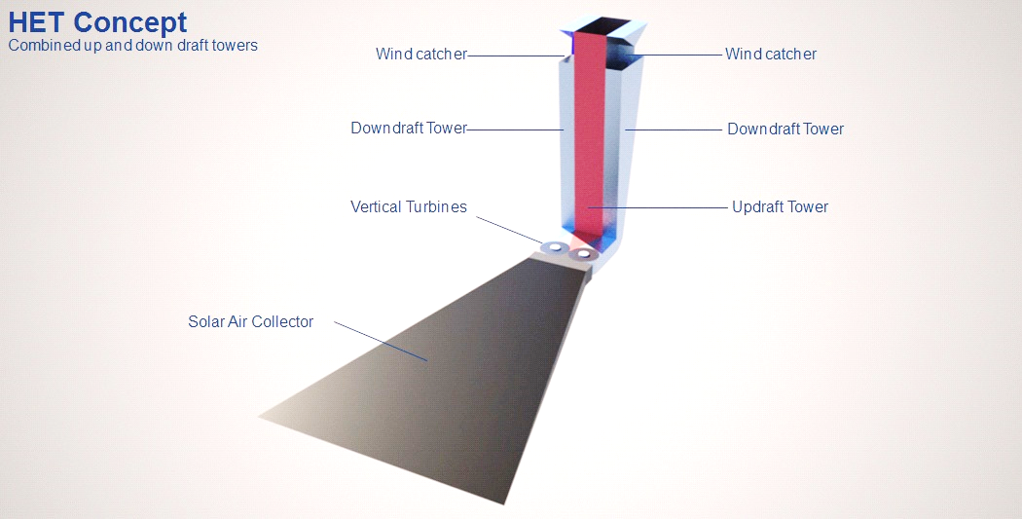

SolarWall Power Tower
Conserval Systems Inc., Buffalo NY
Project Summary
Key Personnel/Organizations
SolarWall Solar Power Tower is a revolutionary concept which combines the best features of multiple renewable technologies into one Hybrid Energy Tower (HET)
Project will expand upon current developments and patents to complete the HET development, which includes transpired solar air collectors, solar updraft tower, wind downdraft tower, Venturi or diffuser chamber for turbines, ground thermal storage and optional integration of PV for recovery of wasted PV heat.
GO phase will complete demonstration installation of minimum one 250 kW modular tower system (excluding the PV contribution)
Conserval Systems and SolarWall inventor, John Hollick
Conserval’s existing supply chain for SolarWall components
New supply chain required for turbines, tower, PV and grid interconnect equipment
Budget and Timeline
Federal funds: $Prize Cost-share: $balance Start immediately
Key Milestones & Deliverables
SET: | Complete design for 250kW prototype ready to start demonstration project
GO: | One signed contract for minimum 250kW and one completed demonstration installation
Project Impact
Insert a picture or chart
summarizing key project
milestones and outcomes.
SolarWall Power Tower generates power 24 hours a day with towers100 feet tall
Scalable from 250kW to many MW at costs competitive with PV systems
New PV farms can be built to recover thermal energy to increase capacity and operate continuously without battery storage
Potential to displace wind projects
Solar heat producing power in updraft tower assisted by downdraft wind

