Slide 1
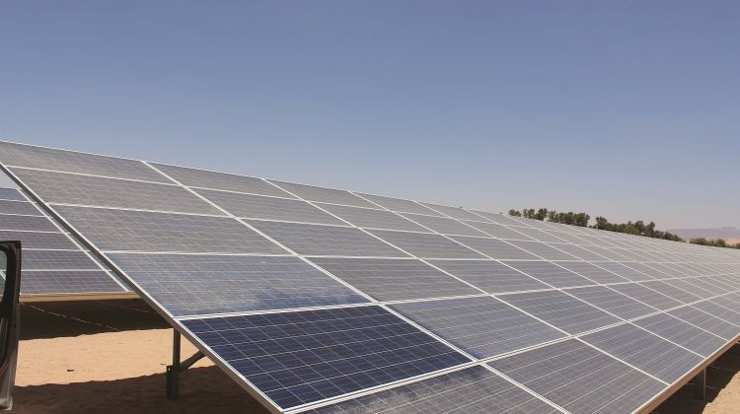
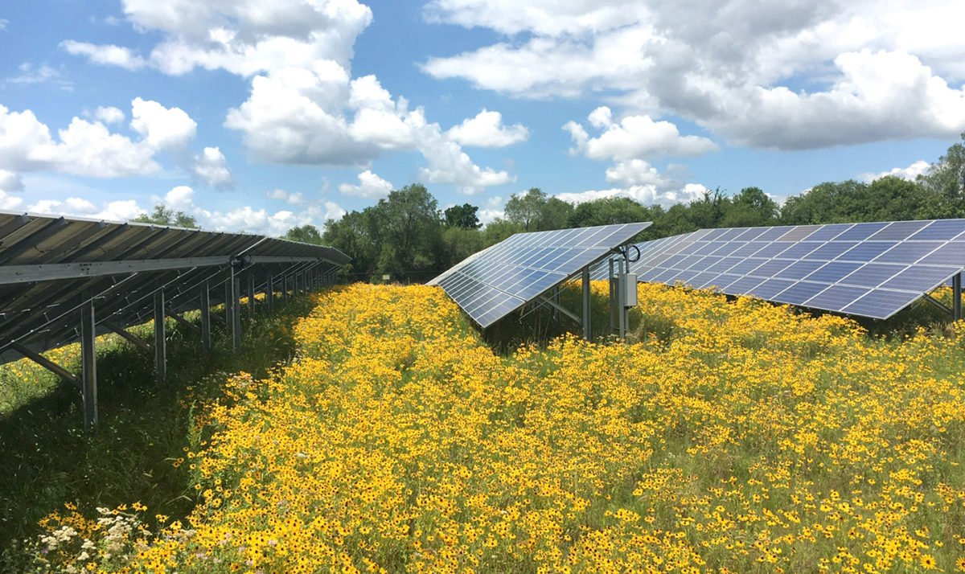
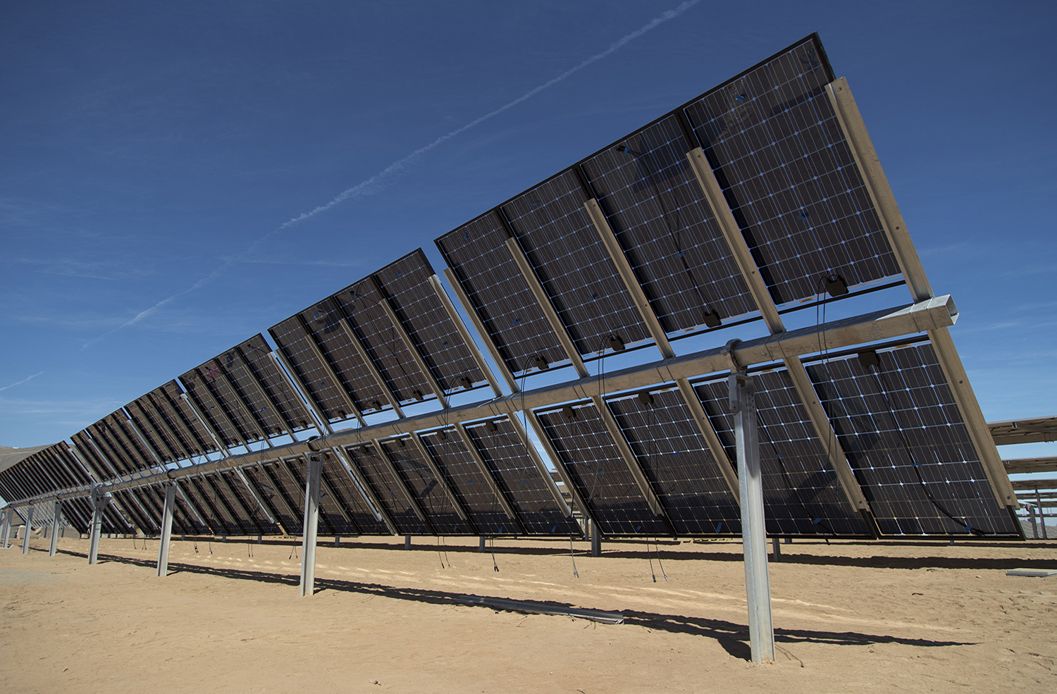
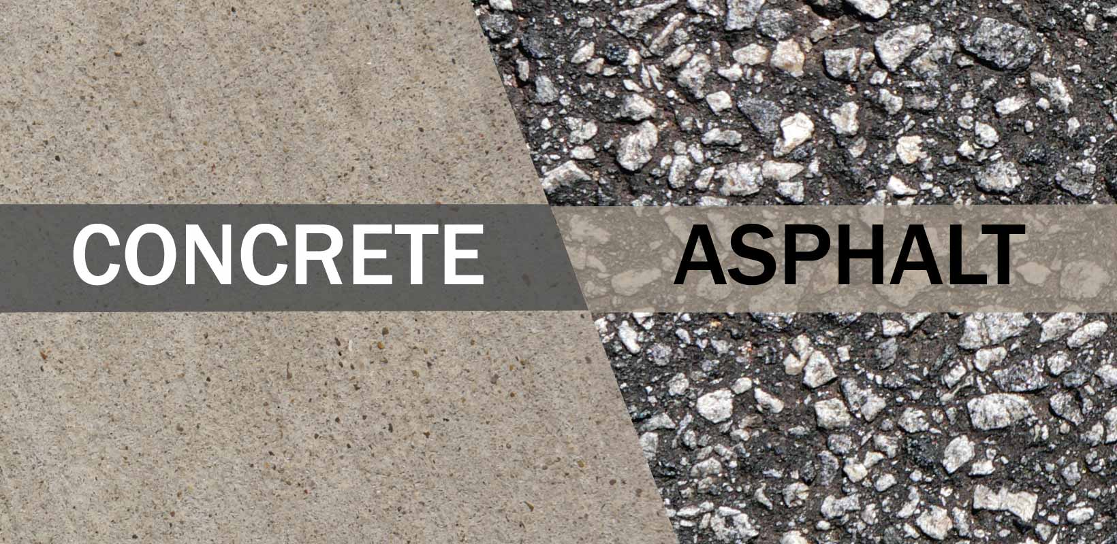

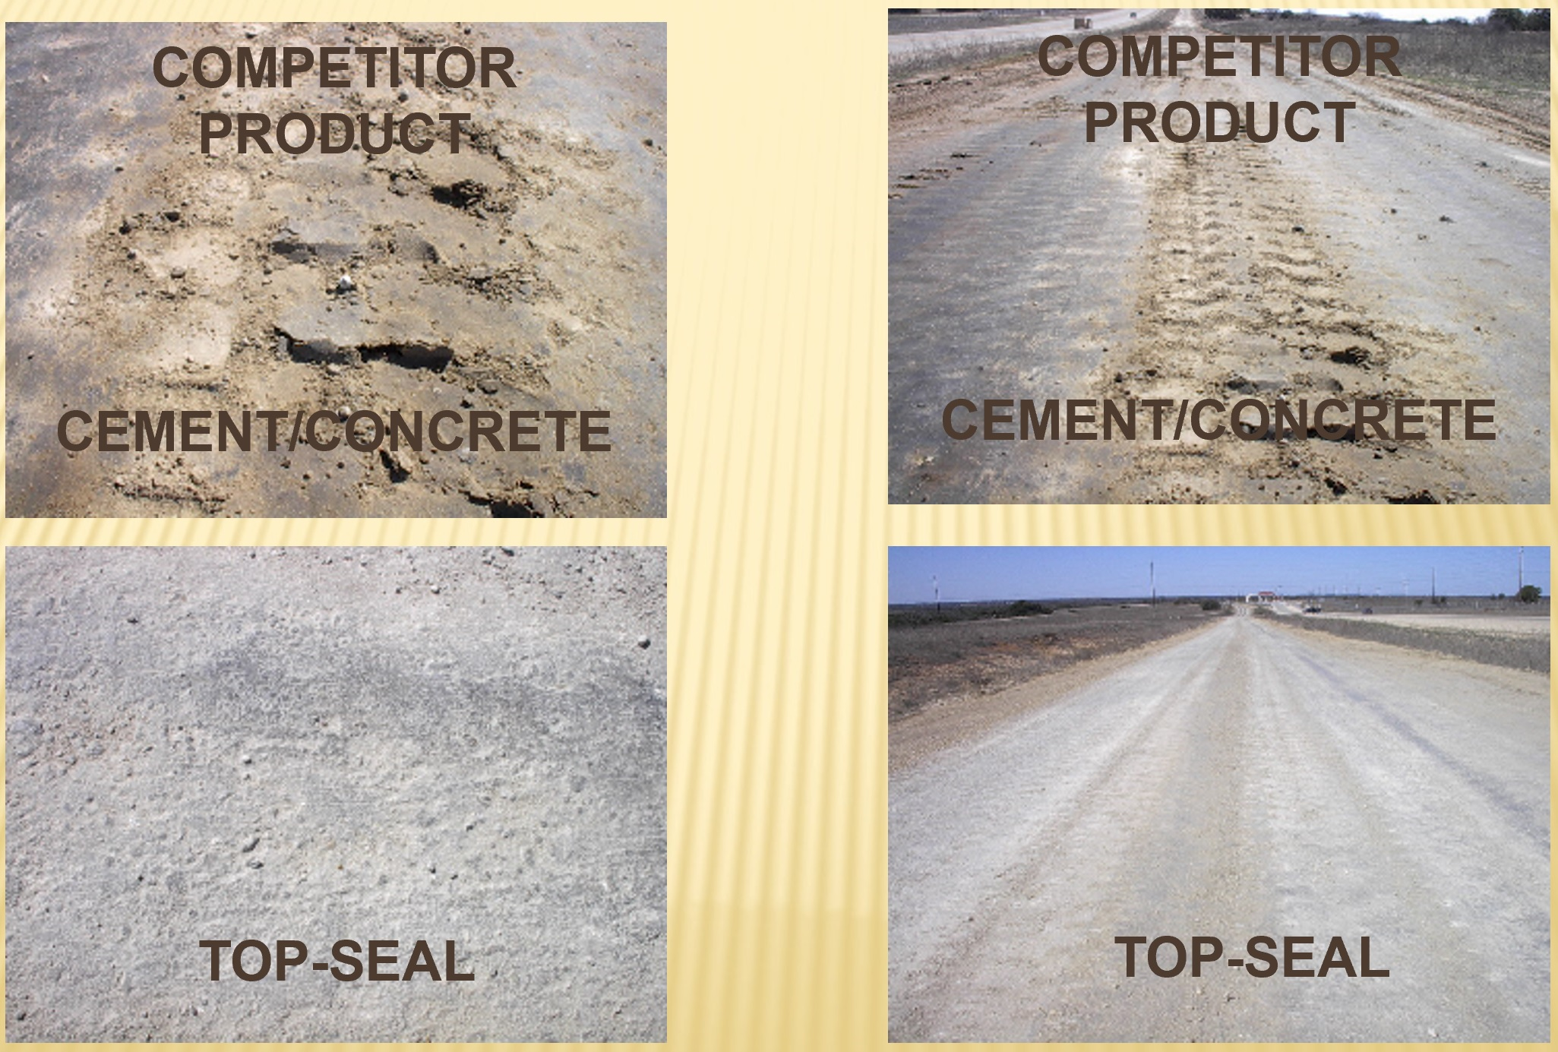
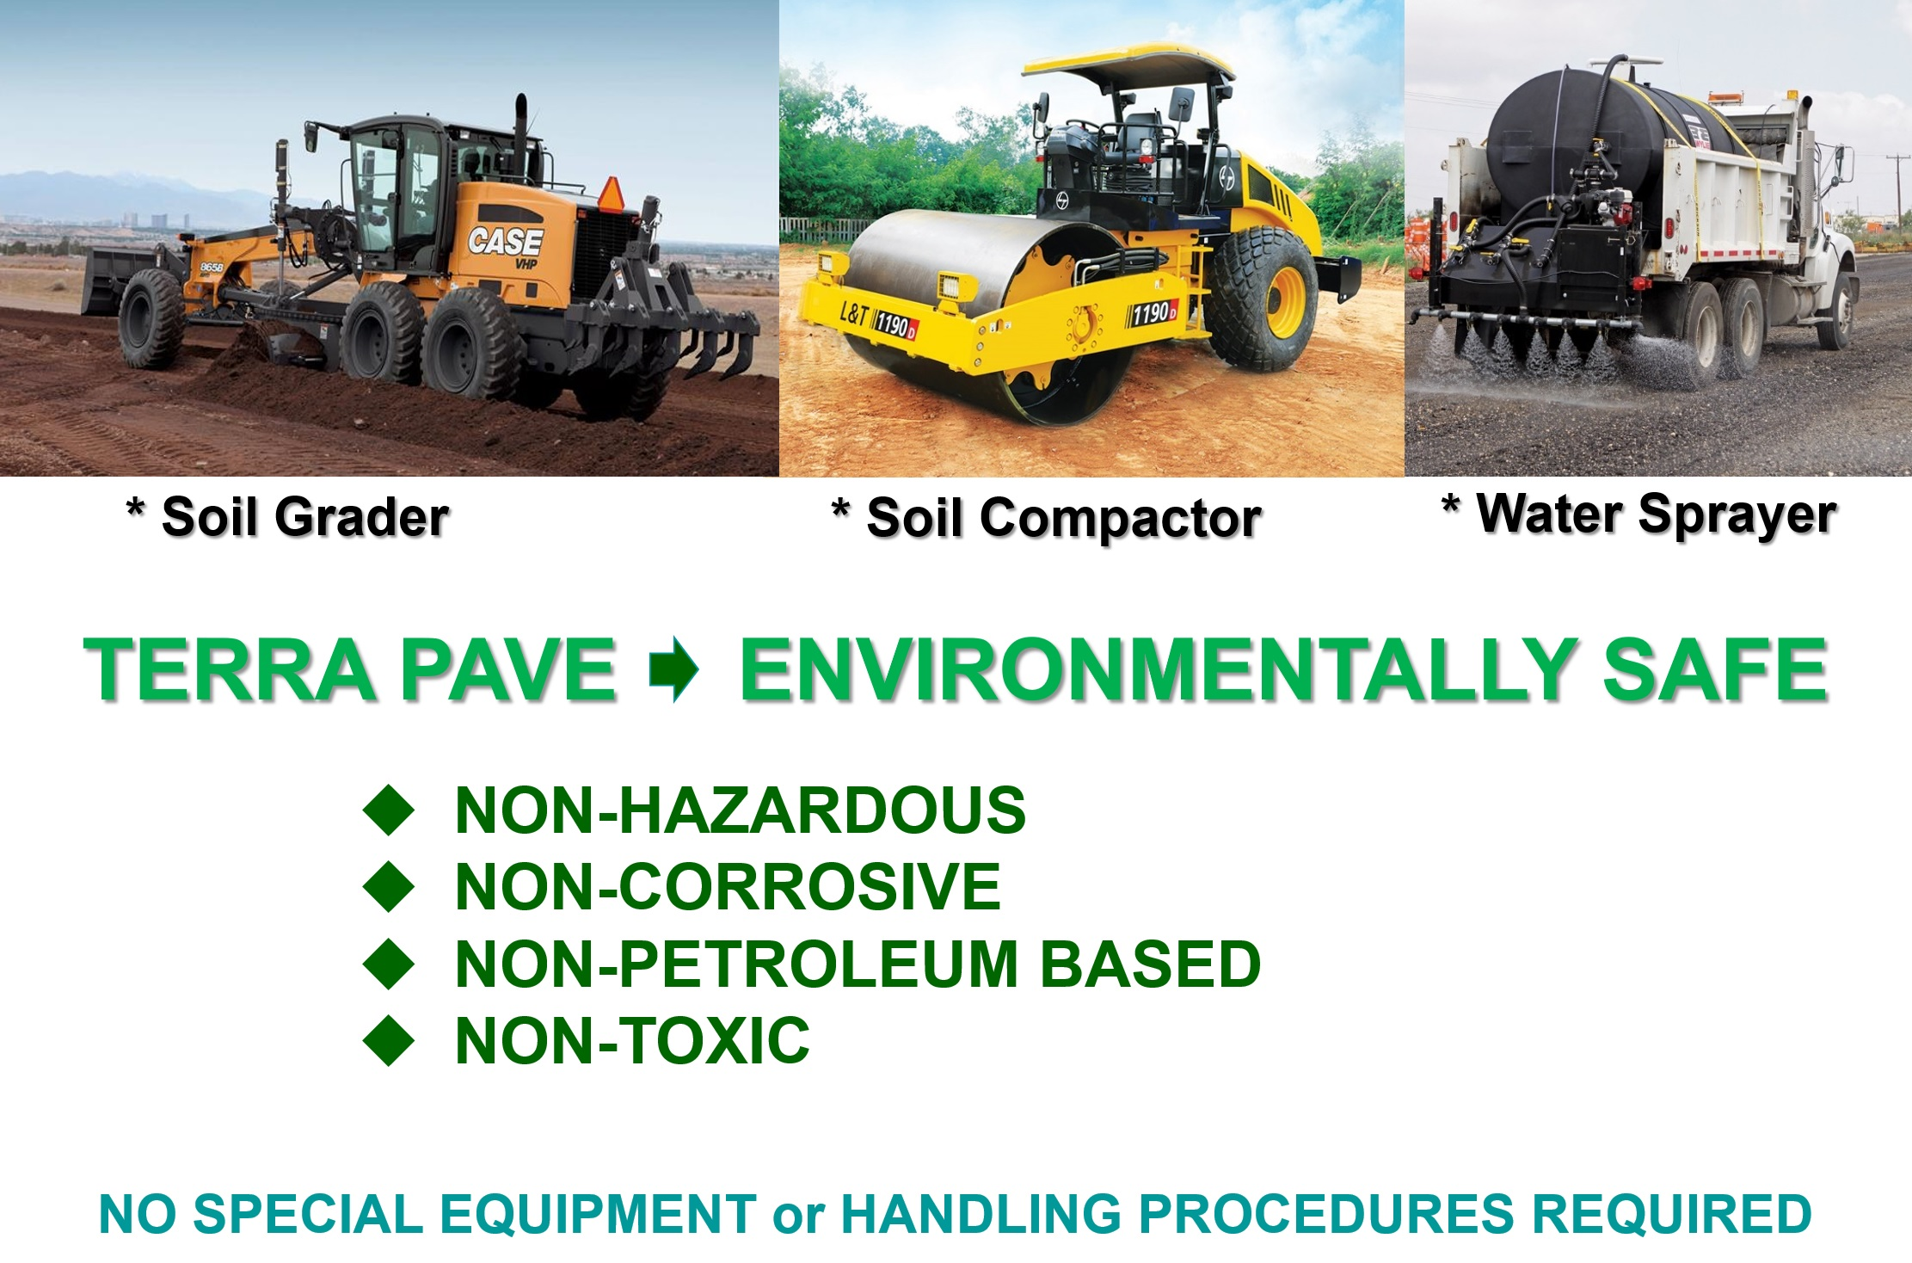
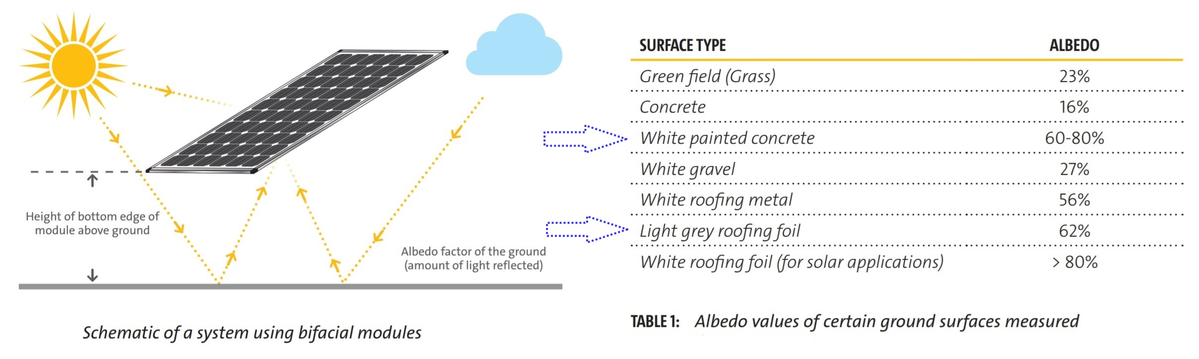

TERRA PAVE PRODUCTS ARE THE ECO-FRIENDLY COST-EFFECTIVE SOLUTIONS
FOR THESE ISSUES FOR SOLAR FARMS
DIRT/DUST SOILING
SOLAR PANELS
GROUND ALBEDO
FOR BI-FACIAL PANELS
REFLECTED SUNLIGHT
NOT ECO-FRIENDLY
INVERTER’S PADS, ACCESS ROADS
OVERGOWN WEEDS &
VEGETATION
The Eco-Friendly Cost-Effective products (Haul Road Top Seal HR-TS™, Top-Seal White™, Top-Seal Black™) were developed, manufactured in Austin, TX, tested on a small scale basis and then field applied and proven through testing with the Texas Department of Transportation (TXDOT), US Army, the City of Austin, TX and City of San Marcos, TX. The products have superior strength and binding properties, dries within an hour thus allowing work to be completed days and weeks ahead of schedule, have no odor or tracking issues and is much safer to workers and the environment. Product testing, done by San Antonio Testing Labs, a NELAP certified lab, following EPA approved test method shows that no detectable concentrations of volatile, semi-volatile, heavy metals or petroleum hydrocarbons.
Haul Road Top Seal HR-TS™: Durable Low maintenance, eco-friendly dirt / Dust / Vegetation Control, BiFacial panel reflection surface, Dirt Roads and Haul Roads top seal.
Top-Seal White™: Durable Strong Low Maintenance, Eco-Friendly dirt/Dust/Vegetation Control, Bi-Facial panel reflection surface, strength is comparable to cement concrete, concrete pavement surfaces/road base replacement.
Top-Seal Black™: Durable/low maintenance, eco-friendly asphalt pavement surfaces replacement, excellent to prevent the penetration of water and air into the pavement surfaces, increase surface friction thereby shortening braking distance.
WWW.ECOESTATES.US INFO@ECOESTATES.US
COST-EFFECTIVE

