Slide 1


Clean Energy Investing in Opportunity Zones
www.MyOZFund.org
DOE “Set!” Submission
July 9, 2019

Slide 2
Submission Summary Slide
With the passing of The Opportunity Zone tax incentive in Dec. 2017, ~$6T of capital gains in the US could potentially be invested in transforming the US economy to non-fossil generation, grid management and mobility.
The challenges are that stakeholders are unaware that the tax incentive exists and that it applies to clean energy, do not have an education on how to use it correctly and have little experience and knowledge on compliant fund structuring to use and benefit from this power new Federal tax incentive.
Our solution is simple: www.MyOZFund.org (be sure to watch the simple explainer video)
Think of this new digital platform as a “mashup” of LegalZoom + DocuSign + TurboTax for QOFs in clean energy
    Awareness
    Education
    Facilitation of compliant, user-owned QOF structures

Slide 3
Partner Support
New Energy Nexus, DLA Piper, Homecoming Capital, High Noon Advisors, Bitwise Industries are all committed to making this a successful project.

Slide 4




Thank You
Jon Bonanno
getstarted@myozfund.org
energynexus.co

Slide 5






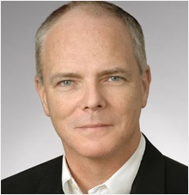












Speakers & Support Partners
Jon Bonanno
Speaker
CXO, New Energy Nexus & California Clean Energy Fund
jon@newenergynexus.com
Craig Tighe
Support Partner
General Partner, Energy & Corporate Securities, DLP Piper
craig.tighe@dlapiper.com
Greg Rosen
Support Partner
Principal, High Noon Advisors
greg.rosen@highnoonadvisors.com
Cody Evans
Support Partner
Principal, Homecoming Capital
cody@homecomingcapital.com

Slide 6
EV Rubber On The Clean Energy Road
www.MyOZFund.org
compliant, low-cost and fast
<video>
First Project Equity Transaction Completed
First Corporate Equity Transaction Underway
Notes:
JSS

Slide 7
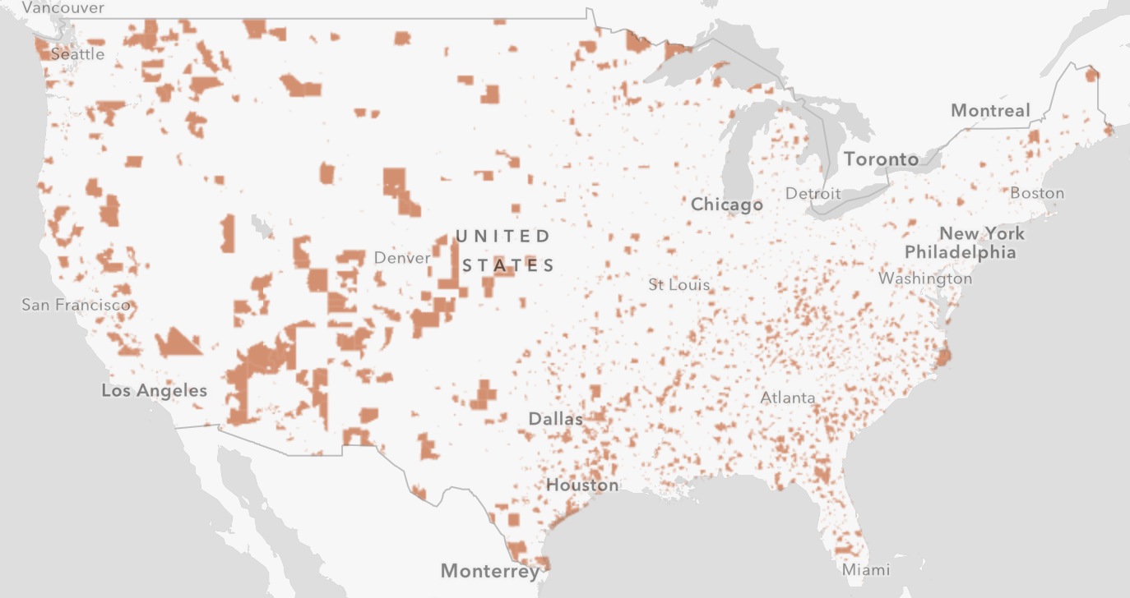
Basics of the Opportunity Zone Act
The Tax Cuts and Jobs Act of 2017 created “Opportunity Zones” Incentive: The Investment in Opportunity Act
    Final Zone Map: https://esrimedia.maps.arcgis.com/apps/View/index.html?appid=77f3cad12b6c4bffb816332544f04542
    There are 8,761 zones throughout the US, including nearly all of Puerto Rico
    These zones are low income zones and the purpose of the Act is to encourage long-term patient capital to vitalize these areas.
    Updated and clarifying Treasury rules for the Opportunity Zone tax treatment released April 2019
    There is no capital limit on deal size, investor amount or fund size.
    Qualified Opportunity Zones remain in effect for 10 years following designation

Slide 8






How Opportunity Zone Finance Works
Tax payers can get tax deferral (& more)
…make a timely investment in…
Qualified Opportunity Zone Fund (“QOF”)
…which invests in…
Qualified Opportunity Zone Fund Business (“QOZBiz”) or Business Property (“QOZBP”)

Slide 9
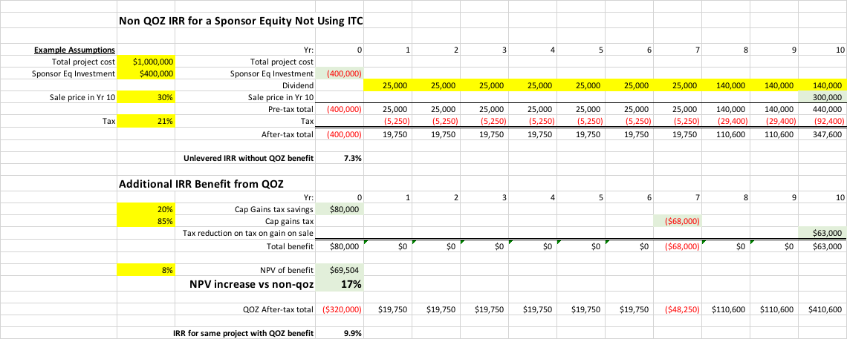
Transformational Economic Value Creation
Under the right circumstances there is additional economic benefit
It is best if the OZ investor also uses the ITC benefits, but a Sponsor can also use them if structured appropriately (but keep an eye on transaction costs)

Slide 10
Clean Energy Developers’ Benefits
  Bottom line: Projects in OZs are worth more than ones that aren’t, if OZ benefit is monetized
  Sharing potential: Extra “umph” from the OZ Benefits can be shared with developer and other stakeholders in the project, such as solar power off-takers
Notes:
JSS

Slide 11
Clean Energy Developers’ Checklist for Benefitting from OZs
Check and see if any of your projects under development are in an OZ (www.MyOZFund.org)
Take OZs into consideration when looking at future development activity
Go to www.MyOZFund.org to learn about how you--or an interested investor you are talking to--can monetize the OZ benefits
Ask investors if they have the ability to monetize OZ benefits – those that can might give you a better deal than those that can’t (and help educate investors who don’t know about OZs)
Notes:
JSS

Slide 12
Capital Sources’ Roles
Identify what clean energy assets are of interest
Form a clean energy due diligence team for that asset class/type
Select key developers with whom to prepare a program
Go to www.MyOZFund.org
          Prepare your Qualified Opportunity Zone Funds (“QOFs”)
Invest maximum amount of capital gains into QOFs before 12/31/2019
Use a 1-1-1 Strategy
Combine benefits of ITC + OZ + accelerated depreciation in a single source to maximize returns
Notes:
JSS

Slide 13
Capital Sources’ Benefits
Significantly improved financial returns: OZ alone + combination
All clean energy OZ investments are at least double bottom line
Be directly responsible for deploying clean energy at unprecedented scale and velocity to solve the Climate Crisis
Notes:
JSS

Slide 14
State, County and City Governments’ Roles
Federal and State tax conformity
Interconnect priority and penalties for delay
Permitting streamlining
Financial bonuses for companies/projects that train or hire new
Look at municipal land maps/ownership and consider concessionary leasing to clean energy project developers
Identify locations where certain assets are optimal for maximum societal benefits: solar, energy storage, EV charging
Bring mobility fleet and infrastructure managers to the table to electrify the entire mobility fleets: replace fossil fleet fueling stations with EV charging + sign leases for EV fleets
Notes:
JSS

Slide 15
State, County and City Governments’ Benefits
Clean energy job training and job creation (jobs of the next 30 years)
Energy reliance for the most vulnerable communities
Lowest cost electricity
No risk of gentrification
Clean air – reduced rates of asthma
Clean water
Low visual impact
Lower noise pollution
Notes:
JSS

Slide 16
Interactive Questions & Responses
Q & A
www.MyOZFund.org
getstarted@myozfund.org

Slide 17

Period of Deferral
Earlier Sale
December 31, 2026
The period of capital gain tax deferral ends upon the earlier of:
2019
2020
2021
2022
2023
2024
2025
2026
2027
2028
Notes:
JSS

Slide 18
Partial Forgiveness & Forgiveness of Additional Gains
Year 5 – Basis increased by 10% of the deferred gain
Up to 90% of deferred gain taxed
10% forgiven
Year 7 – Basis increased by 5% of the deferred gain
Up to 85% of deferred gain taxed
Additional 5% forgiven
12/31/26 -
Remaining 85% of deferred gain recognized/taxed
After year 10-
Basis is equal to fair market value
No tax on gains attributable to appreciation of investment
Requires an election by tax payer
Sale
Investment
HELD FOR 5 YEARS
HELD FOR 7 YEARS
HELD FOR 10 YEARS
2018
2019
2020
2021
2022
2023
2024
2025
2026
2027
2028
Notes:
JSS

Slide 19
Real Life Example
Jan. 2, 2018
Taxpayer enters into a sale, generating $1M in capital gains (10%-37%)
-Taxpayer is deemed to have a $0 basis in its QOF investment (deferred gain of $1M)
-QOF invests the $1M in Qualified Opportunity Zone Property
June 30, 2018
(Within 180 days)
Taxpayer contributes entire $1M in capital gain proceeds to a Qualified Opportunity Fund (“QOF”)
Makes self-certifying election with the IRS
2018
2019
2020
2021
2022
2023

Slide 20
Real Life Example
June 30, 2023
(After 5 years)
Taxpayer's basis in investment in QOF increases from $0 to $100k
($100k of deferred gain forgiven)
June 30, 2025
(After 7 years)
Taxpayer's basis in investment in QOF increases from $100k to $150k
(additional $50k of deferred gain forgiven)
Dec 31, 2026
(After 7 years)
$850k of the $1M if deferred capital gains is recognized and taxed.
The basis in QOF investment increases to $1M
June 30, 2028
(After 10 years)
Taxpayer's sells its investment for $2M
Basis in the investment is deemed to be FMV
The effect is no tax on appreciation in investment
2023
2024
2025
2026
2027
2028

Slide 21
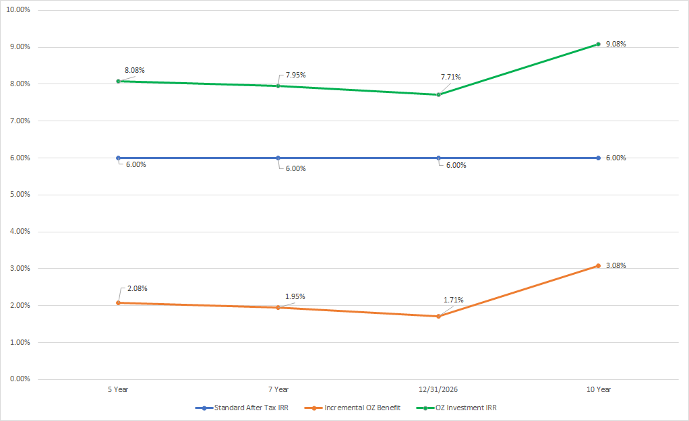
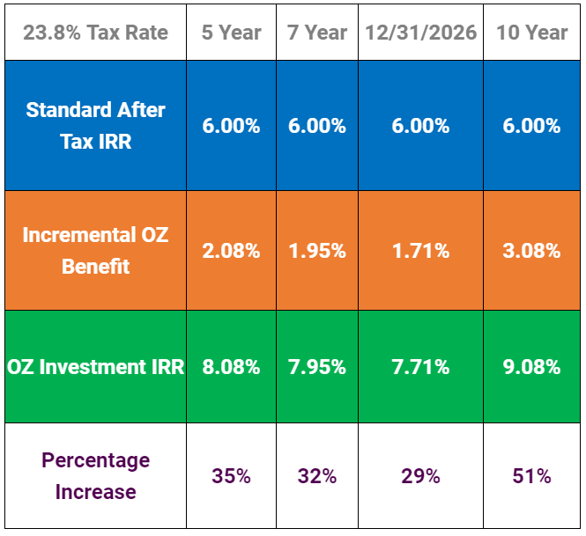
Opportunity Zone
Incremental Benefits
Notes:
JSS

Slide 22
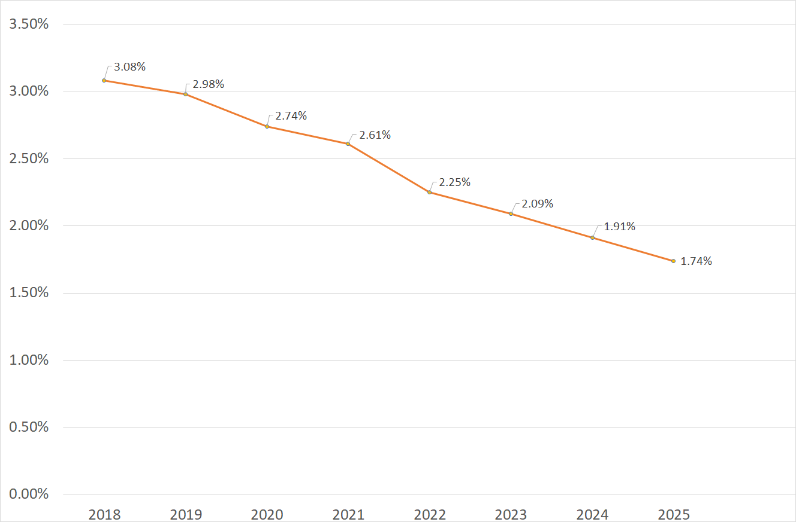
Perishability
of
Incentives
Incremental IRR
Year of QOF Initial Investment
Notes:
JSS

Slide 23
QOZBiz Excluded Businesses
Can’t be a “Sin Business”
A private or commercial golf course, country club, massage parlor, hot tub facility, suntan facility, racetrack or other facility used for gambling, or any store the principal business of which is the sale of alcoholic beverages for consumption off premises.
Notes:
NEIL

Slide 24




Readily Identifiable Investment Types for Opportunity Zones
Real Estate in Opportunity Zones
Opening New Businesses in Opportunity Zones
Expansion of Existing Businesses into the Opportunity Zones
Expansion of Existing Businesses already in Opportunity Zones
YES: equity in clean energy projects and companies
Energy storage
Solar: new and repowering of residential bundles, C&I, community and utility
EV charging stations
EV leasing companies
CAPCs/DFPAs (carbon avoidance purchase agreements/demand flexibility purchase agreements)
Wind

Slide 25
Combining with Other Tax Incentives
LIHTC
NMTC
HTC
RETC
1202
1031
Opportunity Zone
ITC
PTC
Notes:
JSS

Slide 26

Multi-Stakeholder Benefits:
Win –…
  Community:
    Energy resilience
    Low cost
    Clean air & water
    Does not promote gentrification
    Low visual impact

Slide 27
Win – Win –…
  Investor:
    Up to 15% basis adjustment
    Delay capital gains liability: 7 yrs
    No tax on value appreciation of underlying investment after 10yr hold
    Annuity benefits
    Can be combined with ITC investment to increase post-tax IRR

Slide 28
Win – Win – Win
  Clean Energy Entrepreneur: project equity or corporate equity
    Lower cost of capital
    Potentially better investment terms

Slide 29
A Solar Opportunity
Sample Project Details:
  500kW, ground-mounted
  100% in Opportunity Zone
  Delaware location
  Site control, PPA (w/ local housing authority) & interconnection

Slide 30
A Solar Opportunity:
www.MyOZFund.org
  DE entity formed (“QOF”)
  IRS filing for QOF self-certification
  No Foreign Qualification required
  Standard Contracts:
    Investor <-> QOF
    QOF Operating Agreement
    QOF <-> Energy SPV

Slide 31
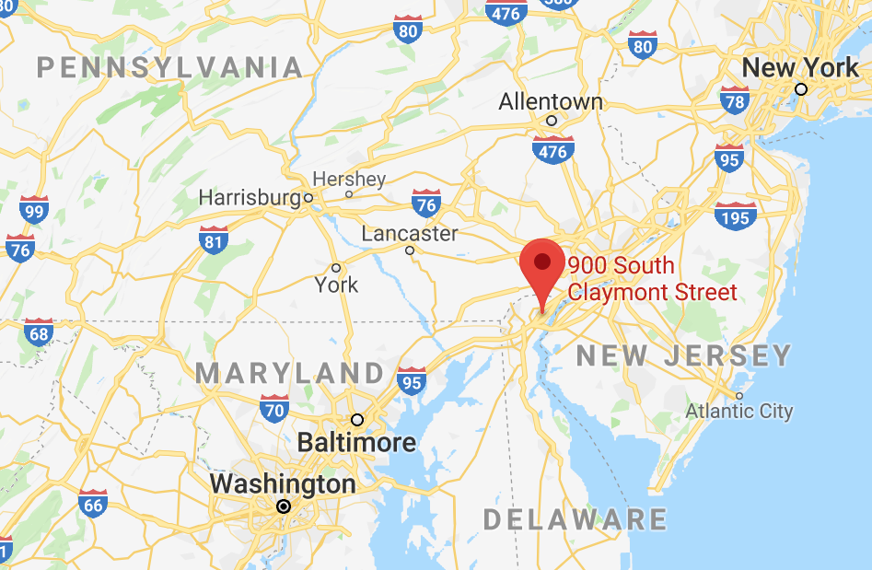
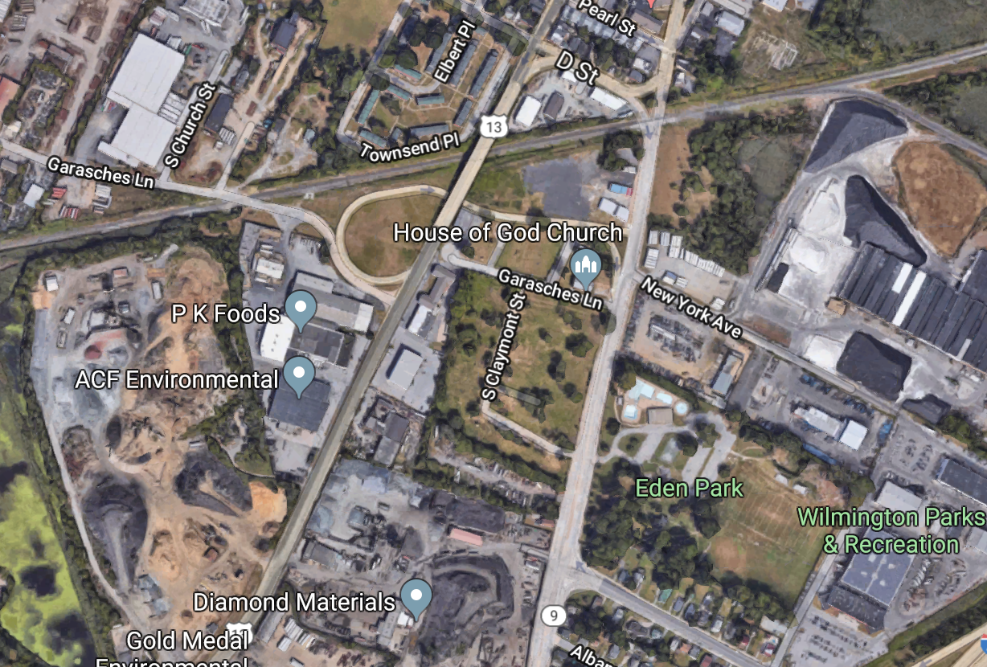
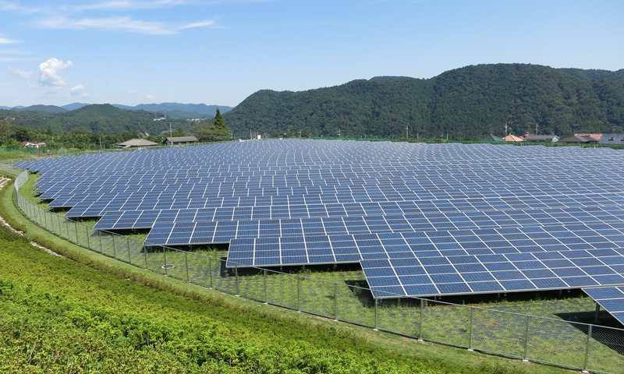
A Solar Opportunity

Slide 32
Game On / What YOU can do?
  Projects Now & Capital Looking
    DE: 500kW
    WI: 1MW
    TX: 200MW
    AZ: 110MW
  Permitting & Interconnect
  Bonus Perks: job training, new job
  Conform State + Federal Tax Law

Slide 33
Thank You
Jon Bonanno
getstarted@myozfund.org
energynexus.co

