Slide 1



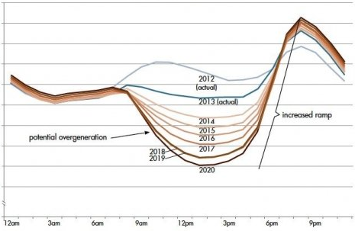
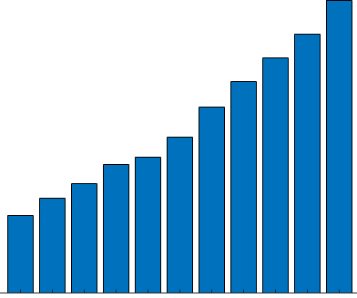

Ranier Solar Panel | SolarBlade
Summary Slide & Lean Canvas
High Panel Count = More Area
More land & roof space.
High Panel Count = More Cost
Increased materials & labor cost
.
Increased Battery Demand
Most power generated is 10am to 2pm.
More batteries are required to take
peak output from solar to meet
peak demand from consumers
6am to 9am & 3pm – 6pm
SolarBlade's dual-sided
custom design provides:
20% - 60% more power per sqft
Less panels reduces land area &
overall system cost.
“Sunrise-To-Sunset” power
Longer all-day power generation
reduces battery demand &
flattens “The Duck Curve”.
Works in harsh environments
Performs great in heat, dust & snow.
Modular installation flexibility
More places to install including
roads, farms, walls and windows.
Moves Renewables Forward
New supplier for worldwide demand
Pollution reduction
Less CO2/GHG, more fresh water conservation & better air quality.
The Problems With
Today’s Solar Panels
Harsh Environments
Poor performance
in extreme heat, snow
& high dust areas.
The Ranier Solar
Panel Solution
“The Duck Curve”
Too much power in
middle of the day is
not beneficial to grid.
Low morning & late afternoon power when demand increases.
Trackers are expensive
& problematic.

