Slide 1



SOLAR PRIZE
Solar Guardian®
Photovoltaic Connector
5/20/2019
1
Kenny Blemel & Charmaine Tunell

Slide 2
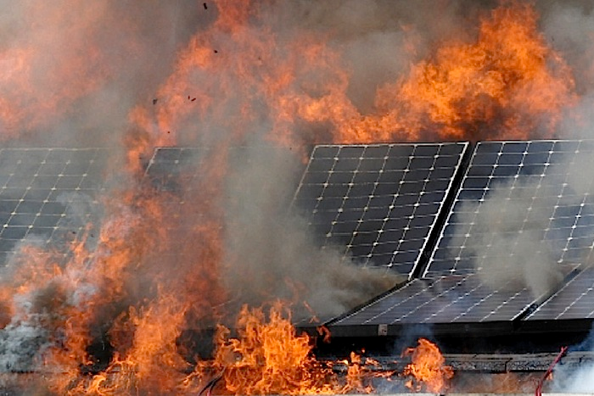
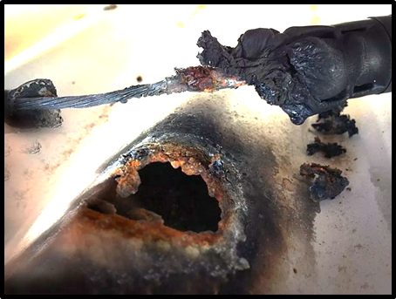

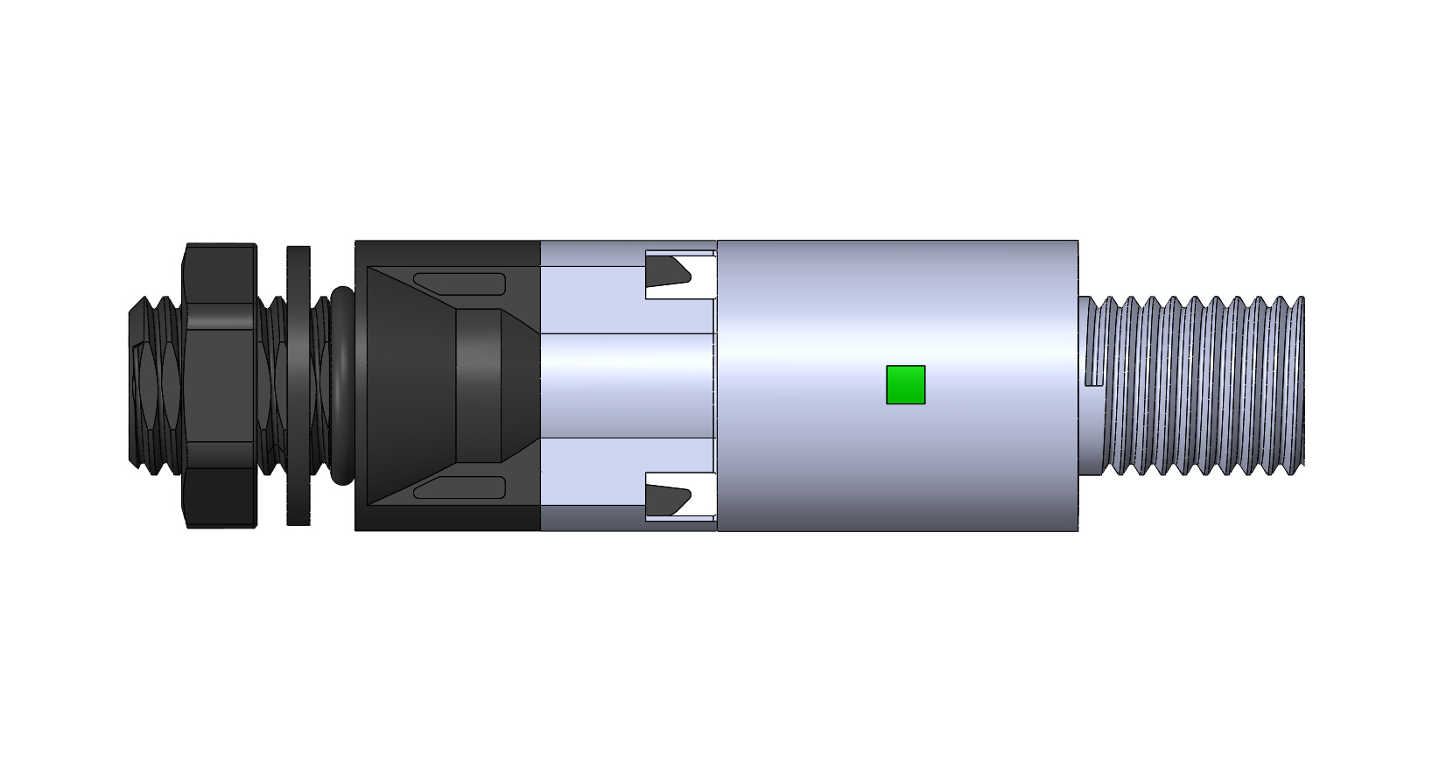
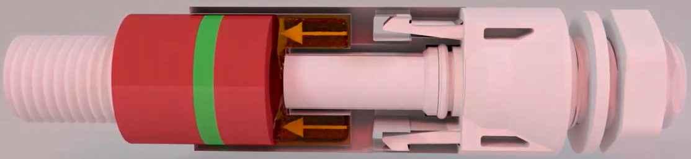
Arcing-Faults Cause 76 Home Fires / Day
Solar Guardian® Prevents Fires
Our patented, Solar Guardian® photovoltaic connector detects existence of circumstances that could lead to an arc-fault before damage occurs. The proprietary proof-of-concept developed by MSI, VAMCO, NMT, and Amphenol has been validated by a national laboratory for feasibility. We continue to work with national laboratories to test and develop a prototype. Capabilities include:
A dielectric material expands as temperatures rise to unsafe levels, disconnecting electricity, and preventing a fire.
Potential secondary arcs are quenched.
The affected panels in a string are disconnected.
Unaffected panels continue to operate at full capacity to produce clean energy and a maximum return on investment.

