Slide 1
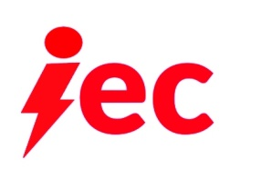
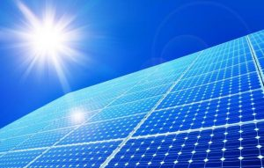
Quick Lift PV System
Impower Energy, Inc.
Project Summary
Impower Energy Corporation
The Lift system combines both of IEC’s products into one streamlined solar PV system. Our affordable and durable system creates a product that is highly desirable for new customers to adapt solar, and also creates a new option for the 78% of customers that have previously been denied a rooftop solar array for various reasons. The Lift system uses both wireless connector arrays that have built in battery storage, resting in our innovative rack technology, no rooftop connection, no specific home direction, a system that is installed faster and safer than currently available, and at a lower price point than currently available on the market.
Located at Innovation Hub at the University of Massachusetts - 110 Canal St., 3rd Floor Lowell, MA
A minority owned and certified small business
Project Impact
• Eliminates: all cabling on the solar panels, 93 rooftop wires, microinverters/optimizers and their cabling, electrical conduit connections to the array
• Connectors, with tri-layered protection from the elements, interconnect solar panels in an array
• Reduced installation times, saving 65 hours or more in labor and installation costs
• A PV solar installation that does not require a specific roof or house pitch/direction, roof attachment or roof penetration
• A home PV solar array that can be moved and adjusted for maximum collection, can be installed over a structure or without structure, such as a solar field installation
• A system that is portable, easy to disassemble, durable and can withstand the elements
• Battery Storage built into modules vs. in-home powerwall: Proprietary lithium-ion battery storage system are built into our PV modules.
• Installation requires no roof attachment
• Ground level installation with lifting mechanism and wireless magnetic connection points allows for a quick plug-and-play installation, reducing installation times by 65
hours or more
Wireless PV Solar systems - for a system easy to install & built to last

