Slide 1



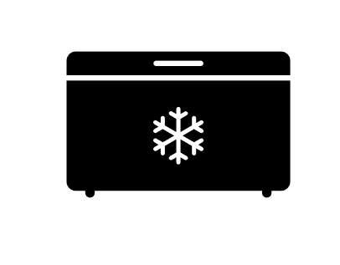
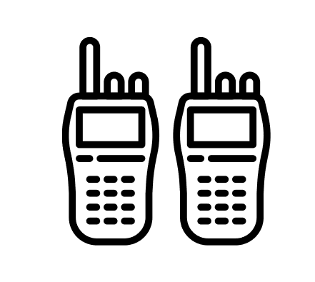
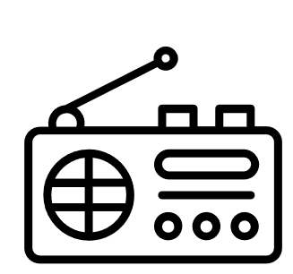


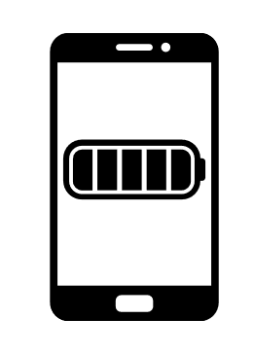



Solar SEED -
Scalable Energy Empowerment Device
WORKS DIRECTLY OFF SOLAR PANEL
PV Input V=12 - 70Vdc
21V 12V
5V USB
SOLAR SEED
UP TO 1000 WATTS OF POWER
Solar Power Regulator
Power Output V=12/ 24/ 48Vdc
UP TO 1000 WATTS OF SOLAR
12/ 24/ 48V DC
INVERTER
120/ 220V AC
WORKS CONTINUOUSLY
DAY and NIGHT
PV Input V=12 - 70Vdc
21V 12V
5V USB
SOLAR SEED
UP TO 1000 WATTS OF POWER
Multi-Stage Charging
Power Output V=12/ 24/ 48Vdc
UP TO 1000 WATTS OF SOLAR

