Slide 1
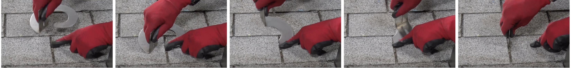
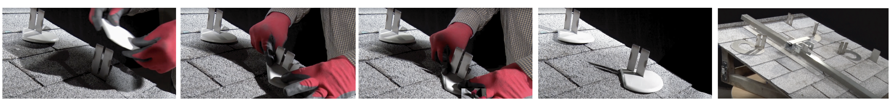
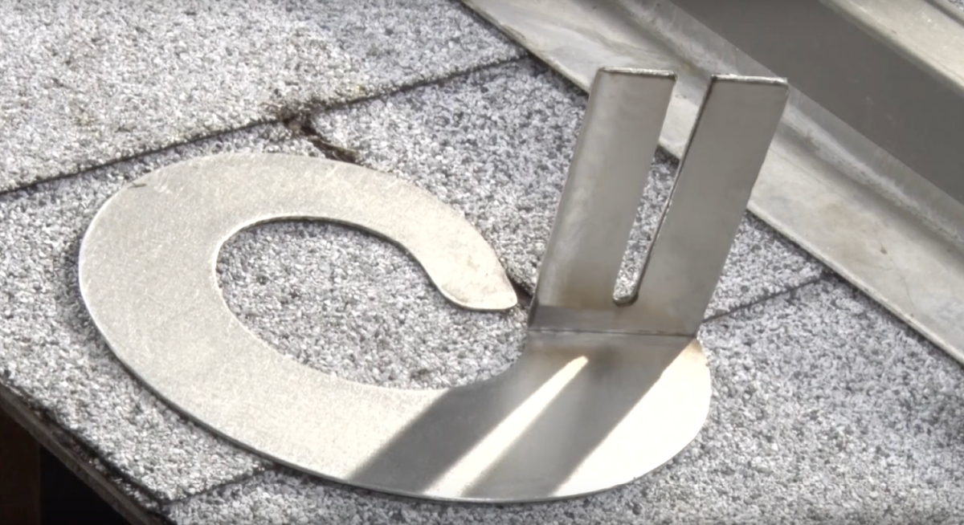
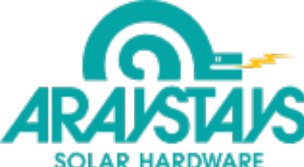
NOTHING GRIPS LIKE PYTHON CLIPS !
U.S. PATENT, No.10,145,116
ARAYSTAYS Python Clips
Non-invasive, non-permanent solar panel application system
Saves 50% in roof installation costs
Eliminates need to find rafters, drill pilot holes, attach lag bolts and flashing.
Adaptable to all racking systems
Portability settles solar panel ownership disputes
Simple design pattern facilitates manufacturing
Corrosion resistant stainless steel
Toolless installation
Makes the checklist for UL-2703 test requirements
Reduces roof damage Insurance claims

