Slide 1

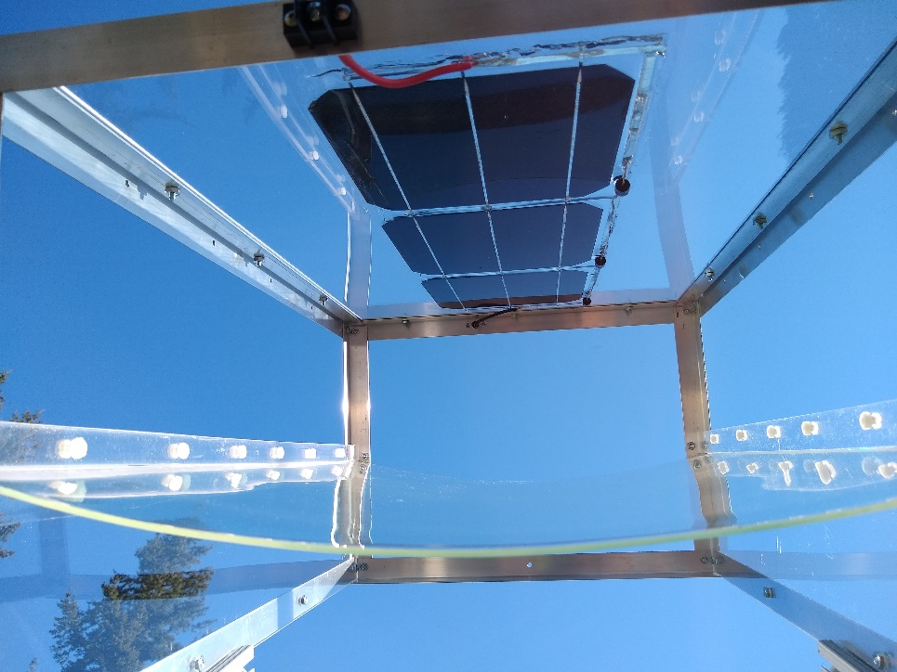
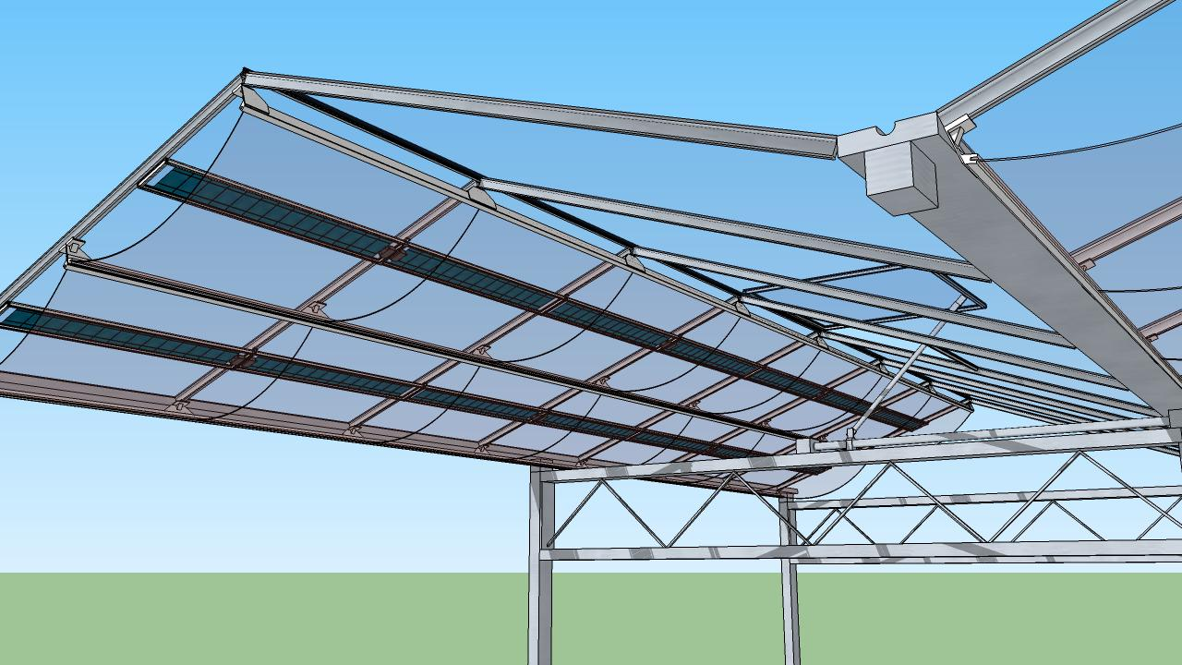
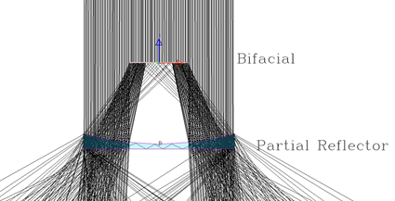

DWP Energy Solutions: Translucent Solar Panel for Greenhouse Farming
Bifacial solar cells
Dichroic reflector
Sunlight
Bifacial Si solar cell
NIR
Integral part of greenhouse roofing − minimize added cost
Pass visible light − good for plants photosynthesis
Reflect unwanted IR − boost solar panel output power & regulate greenhouse temperature
Dichroic reflector
Visible light

