Slide 1
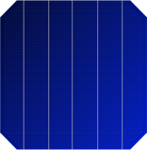

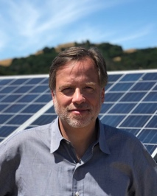
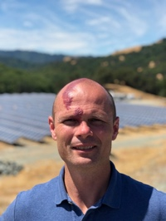
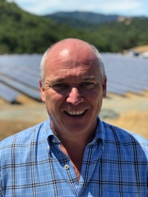
Configurable Current Cell (C3): ultra-low-cost gains in PV module energy & safety
C3 Benefits:
3-6 watts more power per panel
Reduced hotspot risk
Increased shading tolerance
Works with and improves BSF, PERC, HJT, bi-facial, half-cell
Manufacturable on virtually all existing cell and module lines
C3 is the result of years of research by Dr. Damiani in the core physics of solar cells. The AMSP is an opportunity to help commercialize this work.
Case Study:
Half-cells are
one of the
fastest
growing
innovations
in solar today.
Yet, they require
expensive and
drawn out
factory
upgrades.
C3 Cell
Half Cell
3-6 additional watts, shading tolerant
Negligible Capex |  | $10M+ Capex per GW
3-6x hotspot reduction |  | 2-4x hotspot reduction
Trivial changes to existing factory |  | Factory downtime for upgrade
Nominal material breakage |  | Increased material breakage
Bill Nussey
25 year tech CEO
Multiple exits including IPO
Author of Freeing Energy
Greylock VC; IBM VP Corp Strategy
EE from NCSU
MBA from HBS
Dr. Ben Damiani
EE PhD from Georgia Tech
Studied at Fraunhofer
Created first ion implanted Suniva products
Worked at Intel, SolarWorld
30 papers and multiple patents
Gregg Freishtat
30 years founding and building startups, including 5 exits
Holds 18 patents
JD/Law degree from Univ of Maryland

