Slide 1

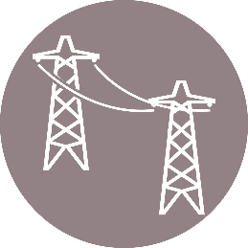
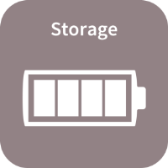
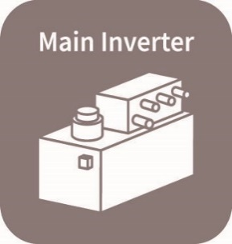



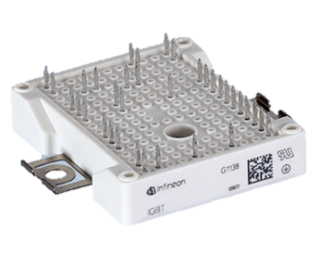


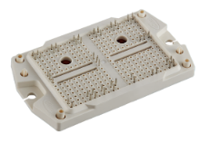

High Efficiency Power Converter for 1500V PV and Energy Storage Systems
PV Panel
DC Link
DC/AC
Inverter
AC Filter
T & D
Power
Converter
DC/DC
Boost (2L/3L)
Low Cost
Low Inductance
Packaging
Efficiency
System Cost
Size & Weight
Long Term
Reliability
Advanced Chip
Design
Active Neutral
Point Clamp
Topology
+
+
+
=

