Slide 1
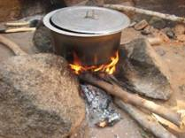
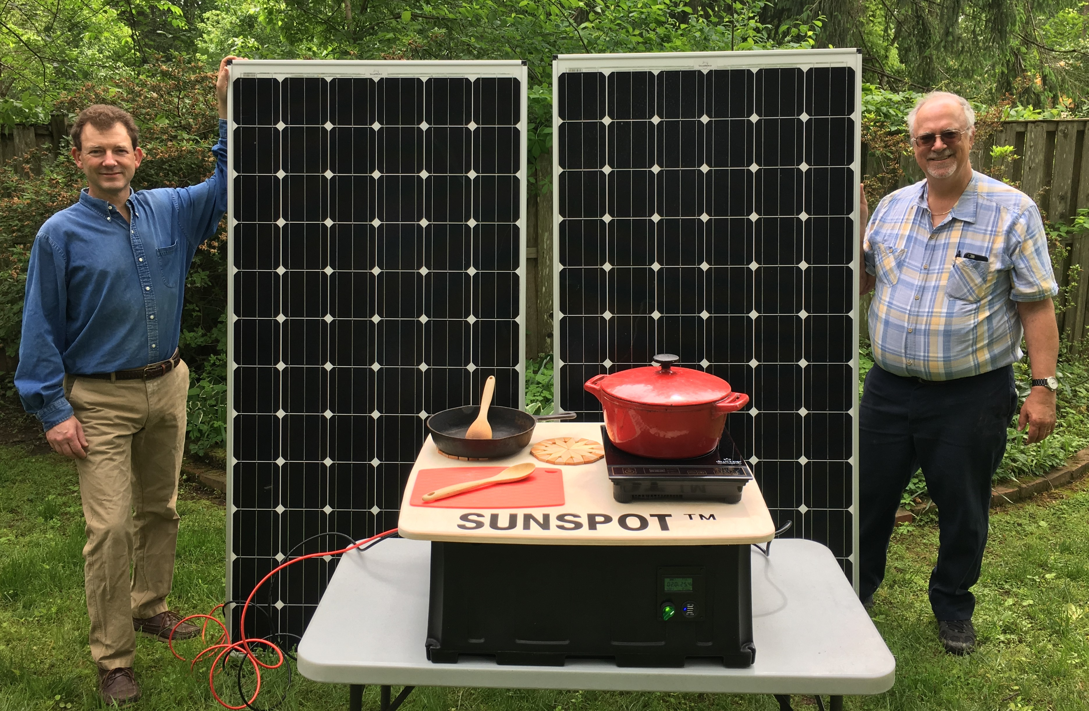
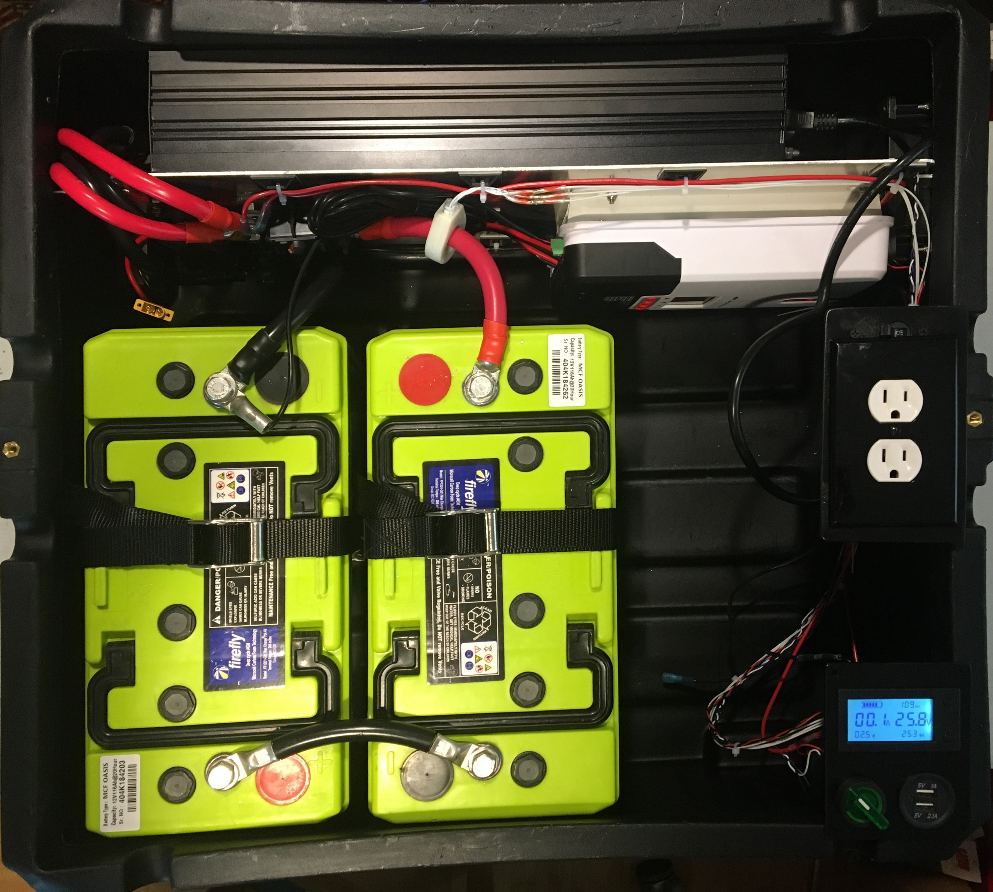
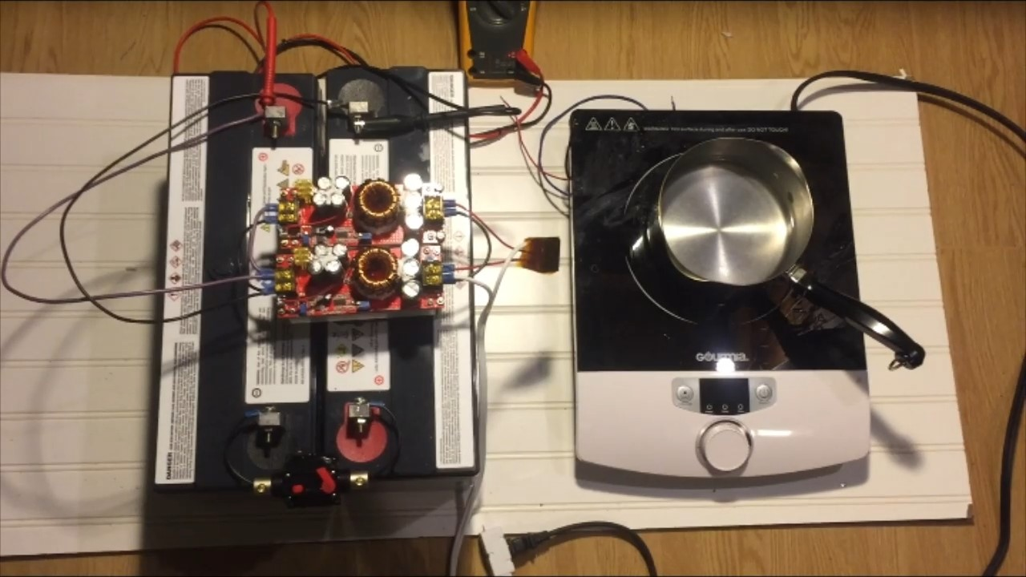


SUNSPOT™ Solar Electric Cooking System
A Submission to the “American-Made Solar Prize” Set! Round
Three billion people around the world continue to cook with biomass fuels, causing significant problems both to their health and to the environments around the. The SUNSPOT™ is a cost effective alternative to traditional cookstoves.
Benefits of SUNSPOT™ include:
Elimination of hazardous fumes from cooking fires
Reduced time collecting fuel and tending fires
Improved fire safety – no open flames
Instant on-off reduces wasted fuel
Reduced pressure on forests
PAYG financing makes systems affordable
The American-Made Solar Prize has enabled the SUNSPOT™ team to build a first generation solar electric cooking system and to develop and test a proof-of-concept for the second generation power electronics, which will power appliances using DC instead of requiring a complex and expensive inverter.
We are developing a hybrid franchise / cooperative business model to enable scaling into the target markets. We are collaborating with EarthSpark International to do a field trial in Haiti.
www.sunspotPV.com
Doug Danley
doug.danley@gmail.com

