Slide 1

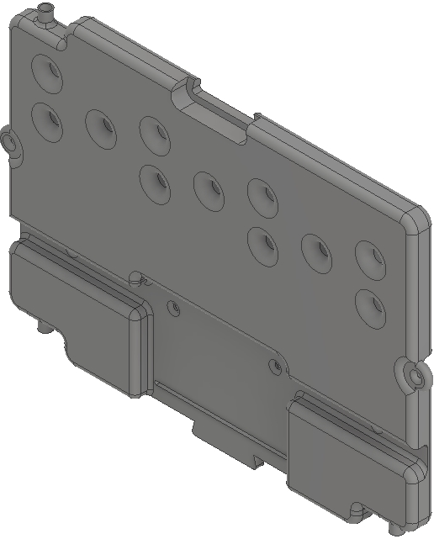

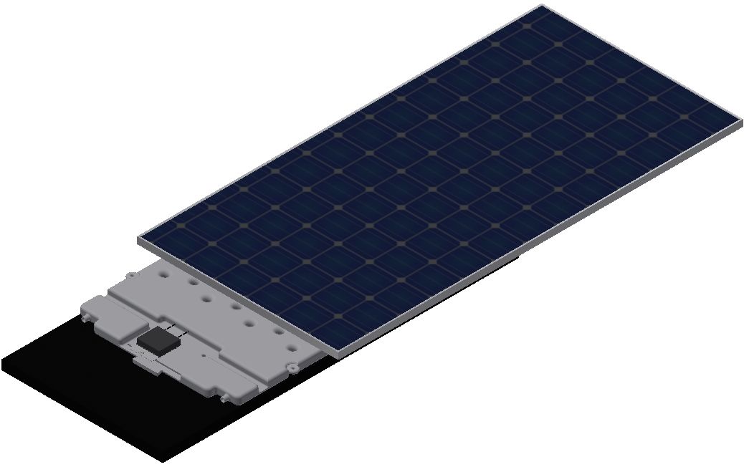



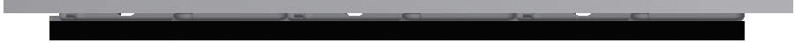
60 Cell I 72 Cell
Integrated Solar Unit
Increased module production by up to 7%
80% faster install, 30% lower overall array cost
No penetration installation on surfaces to 50 degree slope
40 degree (F) lower temperature in Standard Conditions
Water Ballasted Friction Plate

