Slide 1
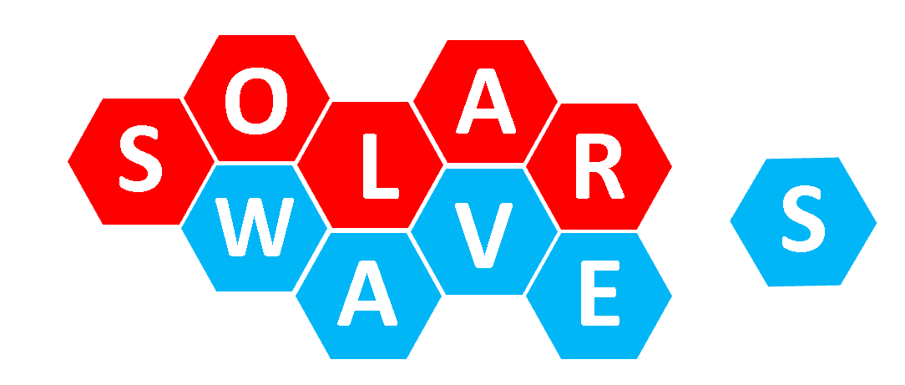
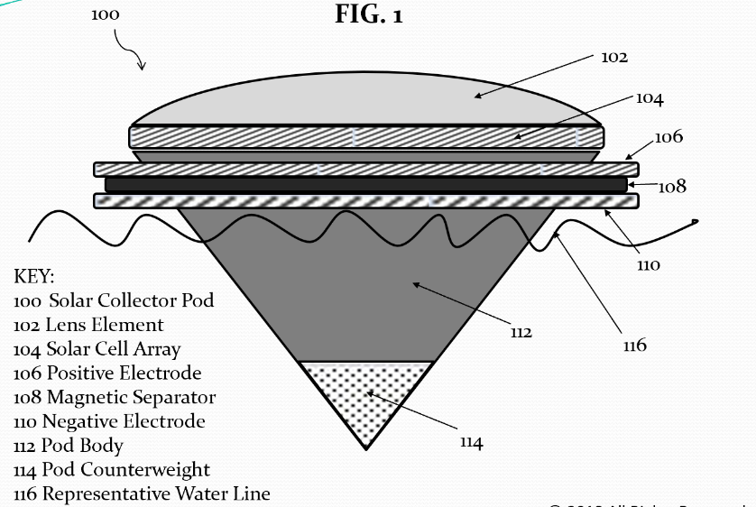
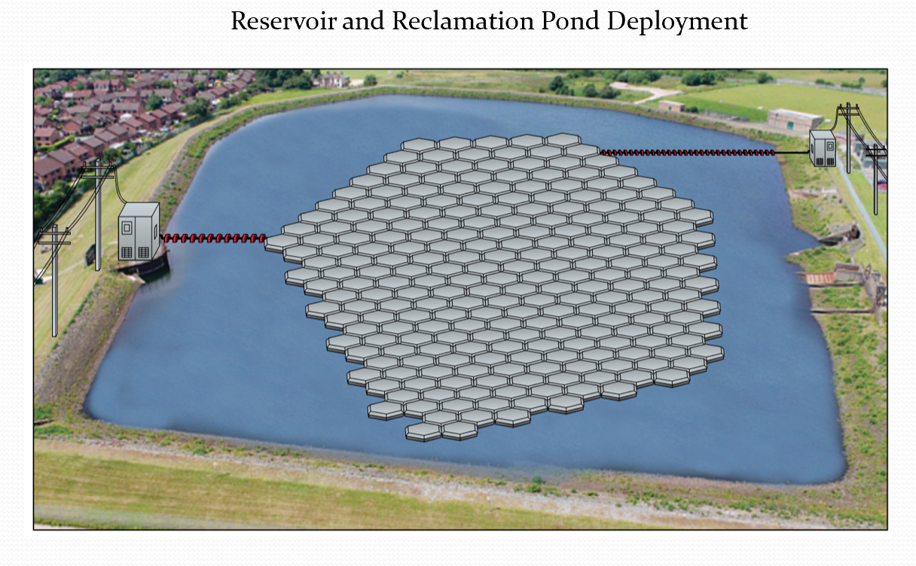
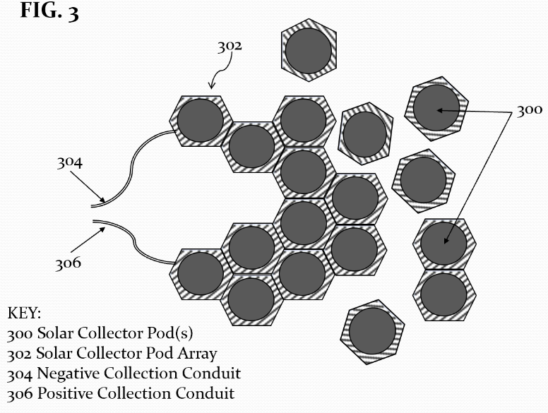
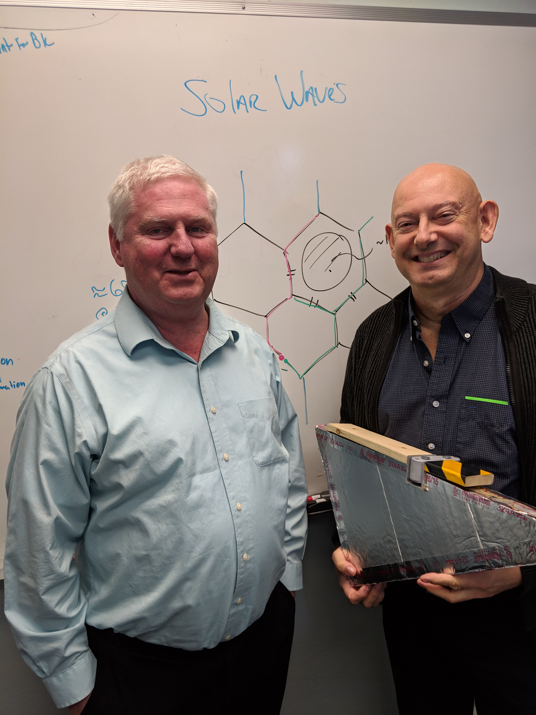
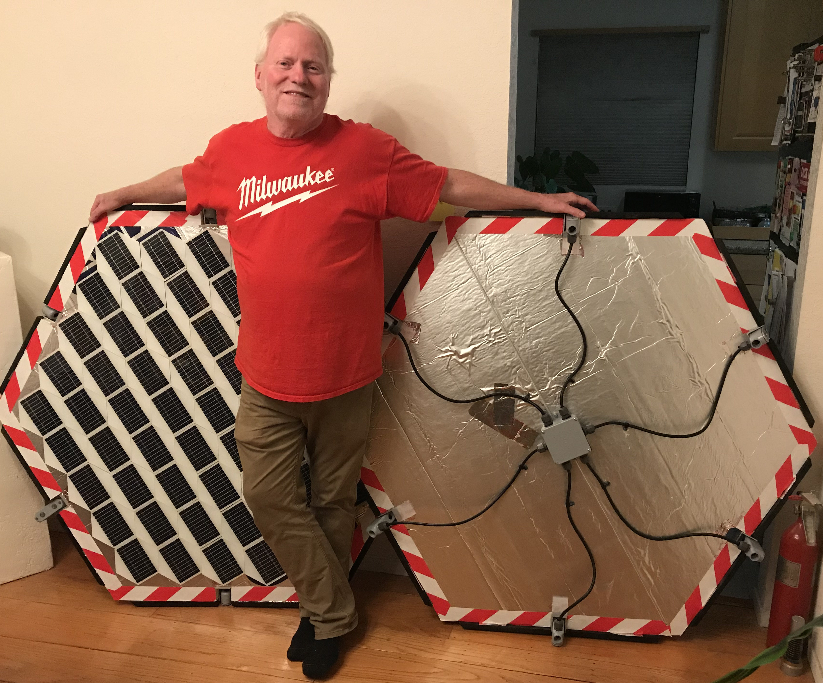
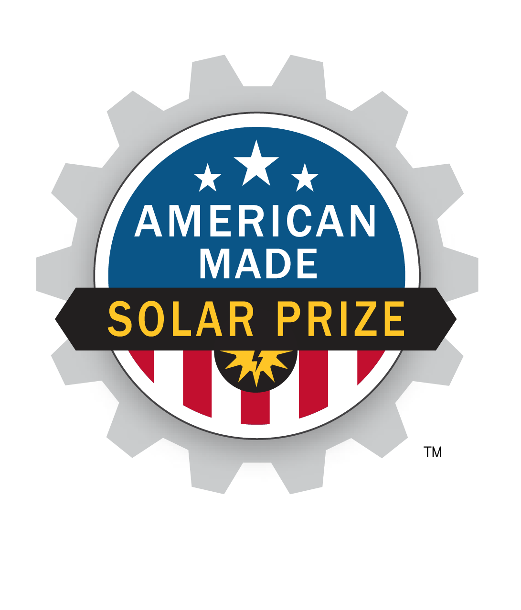
Solar Prize
Team Solar Waves
Solar Pods
Floating solar pods that electro-magnetically couple together forming a self-assembling/repairing array covering the surfaces of lakes, reservoirs and ponds that reduces water loss while harvesting solar energy from otherwise open, underutilized and shade-free resource.
Progress to Date
Scaled and full-sized pods tested well for self-assembly, manually handling and placement/retrieval
Electromagnetic coupling concept validated
Some coupling and safety improvements identified
Next Steps
Modeling of power, current flow in larger solar pod arrays
Additional prototyping to refine design/manufacturability
Fabrication and testing, corrosion/environmental exposure
Validation and performance tests
Scaled up testing/performance on larger bodies of water

