Slide 1

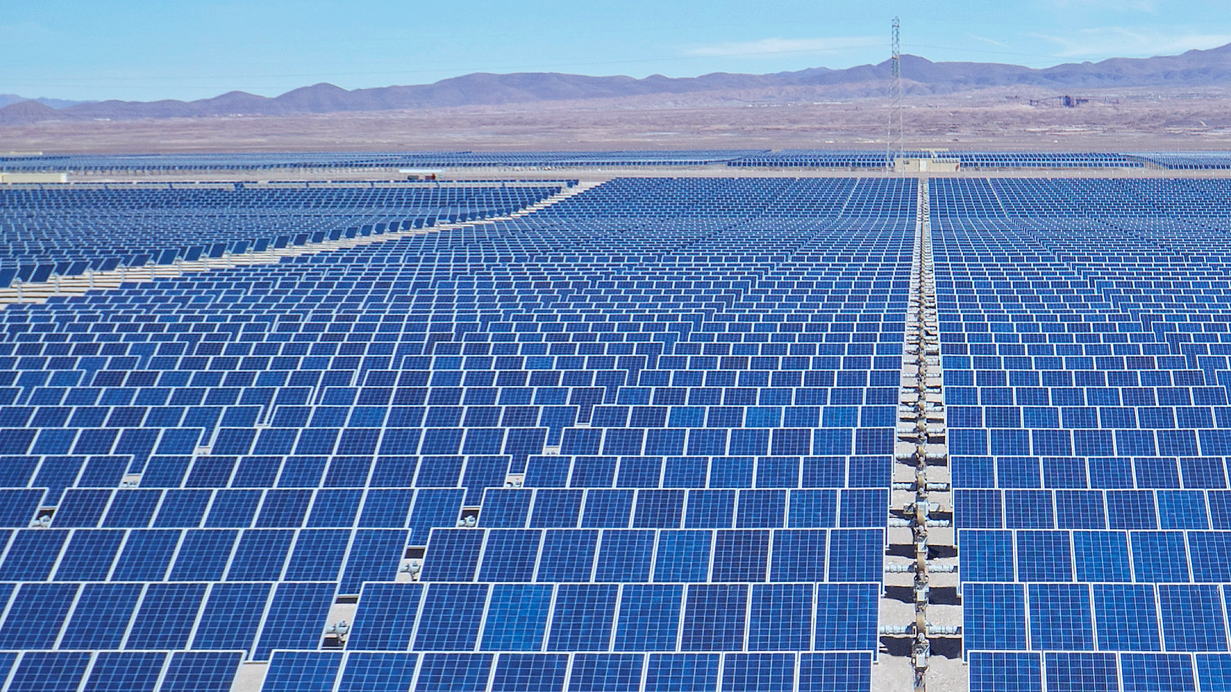
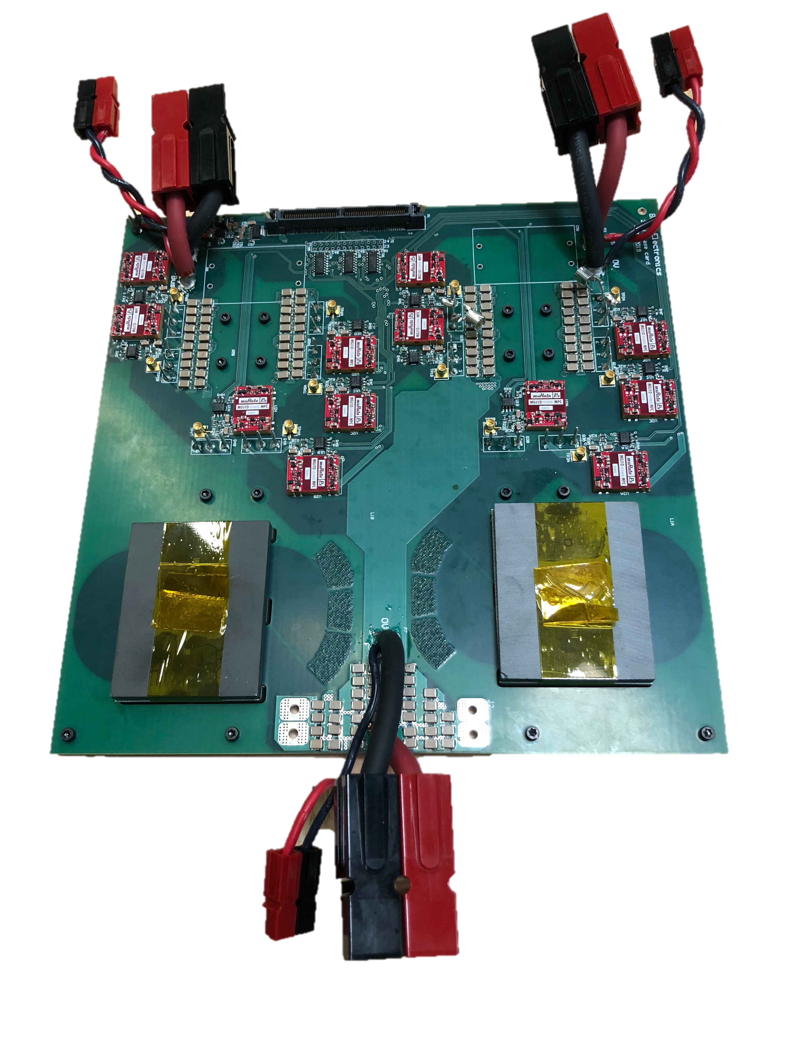
High Capacity 250 kW Silicon Carbide
Solar String Inverter
New Composite Architecture with
novel Planar Magnetics optimized for SiC
Double the power at same size and weight
when compared to conventional Silicon
System Efficiency > 98%
Longer inverter life
Built in the USA
Designed for scalability, portability, high performance,
and high reliability 40% savings in CAPEX and OPEX

