Slide 1

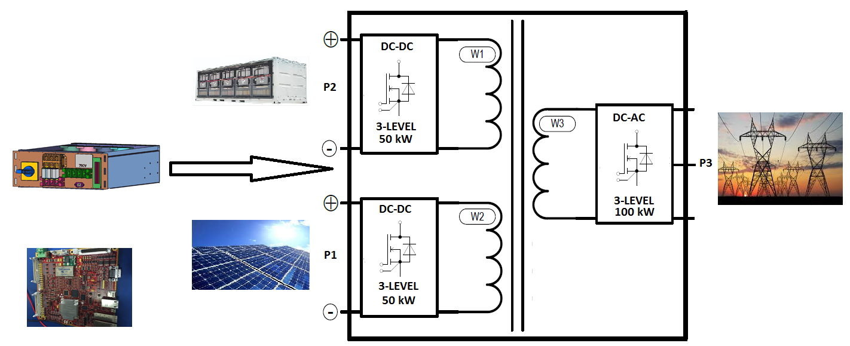
Three port highly compact, high efficiency multi-port modular, power conversion system with decentralized energy storage utilizing a three-level Wide Band Gap (WBG) SiC based power module for 1500 V DC solar applications
Technology Summary
Develop extremely compact (>6 kW/L), high efficiency 50kW-50W-100kW, three-port power conversion system based on three level SiC modular power configuration (PEBB based )
Introduce Solid Stae Transformer to Soalr Industry which is an enabler for the future low voltage and medium voltage grid applications
Demonstrate high-bandwidth FPGA based controller to take advantage of high switching frequency of SiC module.
Integration with 50 kWhr Li-ion battery to provide a system level solar-energy storage solution for compact, efficient, and decentralized system with improved reliability
Technology Enablers
Imagen’s Compact Inverter
Technology
Hi-Speed FPGA
Technology and Economical Impact
Introduction of SiC based next generation power electronics systems to future 1500 VDC solar systems with high energy harness efficiency
Penetration of SiC based system will help to bring the SiC based PE system cost down and further SiC usage.
This configuration can be an excellent applications for fast growing Electric vehicle including V2G (Vehicle-to-Grid) and V2L (Vehicle-to-Load)
4th DC-DC port can be added to support EV 12V/48V Loads
Imagen’s Proprietary Power Electronics Packaging/magnetic design
Low Inductive SiC Power Module Packaging in 3-Level configuration supported by High frequency magnetics
High bandwidth FPGA based control with control step time <0.1us
Innovative faster controls for common mode voltage and neutral
point voltage controls including reduced EMI

