Slide 1



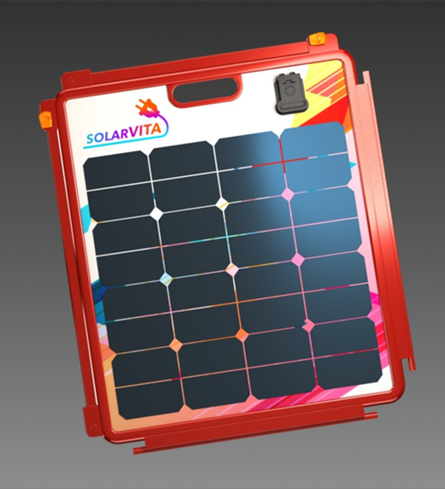




Solar Building Blocks for Portable, Plug & Play Power
SolarVITA
Small size, big power with high efficiency cells
Directly plug into
Lightweight
(5 lbs.)
Snap together for more power
2’
…
2’
2’
Portable and easily stored
Waterproof
Patent-pending
Easy | Plug & Play | Portable | Multiuse| Waterproof
Notes:
This is how it works…

