Slide 1
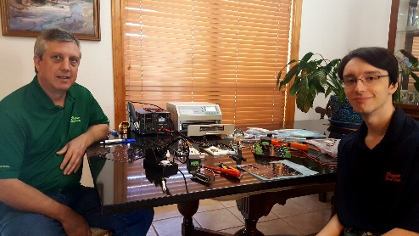
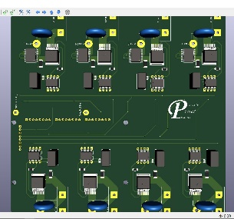
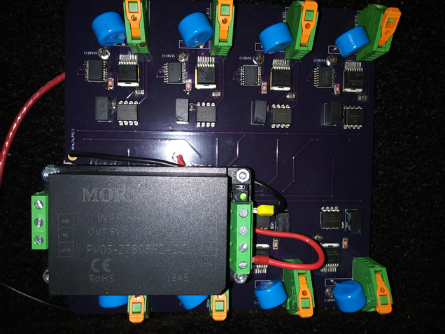
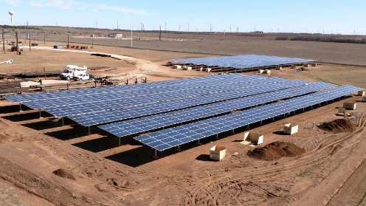
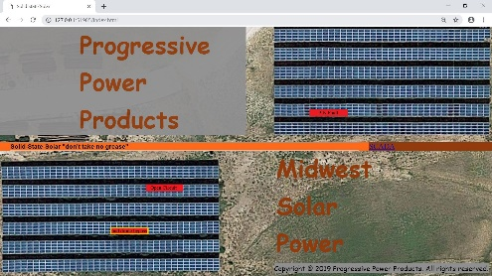


Progressive Power Products LLC,
Making solar safer and improving production with power-electronics
Why would you use a 15-Amp fuse on a Solar string that can only generate 9 Amps?
Why would you rely on a hand held voltmeter to monitor faults on a 100MW+ solar site?
Why would you operate a solar array with no safety protections against exposed open-circuits (electrocution hazards) or shorts (fire hazards)?
Why Not use instead:
Solid-state Power-electronics for Protection, Control and Monitoring
Jimmy Chandler
SolidStateSolar.com
JC@CoopSolarPower.com

