Slide 1
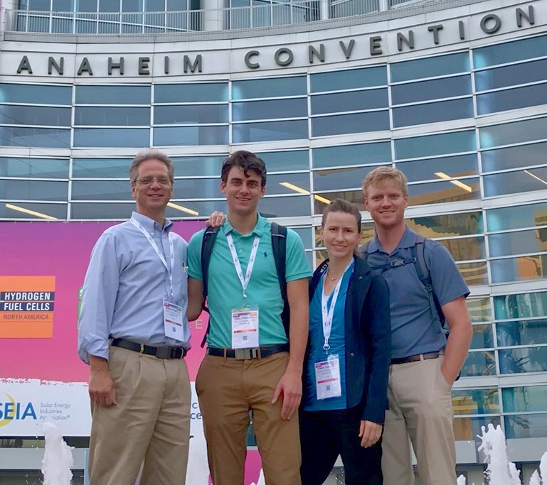
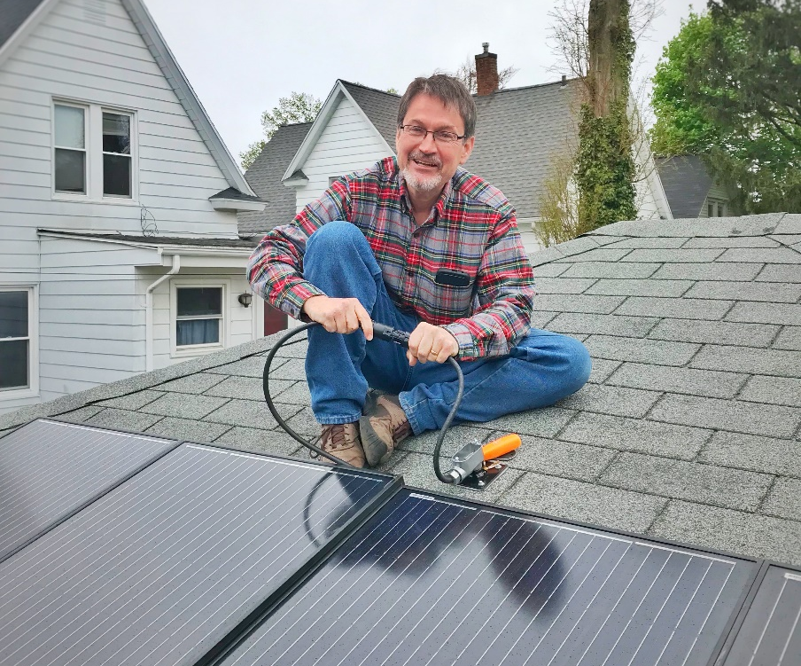
Team Catalyst
Project: 1st Step Solar
Goal: Accelerate the adoption of residential rooftop solar.
Challenge: There are homeowners interested in solar panels who haven’t yet acted. We will move them forward by making rooftop solar simple, scalable, and paying back.
Plan: Offer a plug-in solar appliance for $400.
Homeowner setup will be as easy as putting a light-up Santa Claus on one’s roof.
Initial Cost: $430
After 30% Tax Credit: $300
Electric Bill Reduction: $80/year
x 4 years = $320
Solar panels pay back in FOUR years!!!

