Slide 1
Thoughtful A.I.

Slide 2

WHAT IS AI?
Based on the Artificial Neural Network, Artificial Intelligence is self-customizing process to complete tasks usually reserved for humans.

Slide 3
’’
“Before we work on artificial intelligence why don’t we do something about natural stupidity?”
—Steve Polyak

Slide 4
WHAT DO WE NEED A.I. TO DO?
“Turing belives machines think.
Turing lies with men.
Therefore machines do not
think.”
Yours in distress,
Alan”
-Alan Turing
UNDERSTAND
1
PERFORM
2
INTERACT
3

Slide 5

Thoughtful A.I. Requires understanding human behaviors, emotions, and unconscious drives

Slide 6

Reactions and Emotions are the Parts of the Iceberg seen from the Surface
Conscious
Unconscious

Slide 7
OVERVIEW OF HUMAN EMOTIONS AND RESPONSES
Facial Expressions
Physical Movements
(Automatic Responses)
Initial Verbal Responses
Auto-
matic
Externalized
Response
Externalized Responses
Mature
Immature
Conscious Reactions informed by
the unconscious
Mature
Responses
Immature
Responses
Underlying Mechanisms
Self-Actualization
Insecurity
Self-Concept
Self-Esteem / Self-Concept
Unconscious
Unconscious Processes
Many behaviors and reactions are based on unconscious mechanisms, like the “tell” in poker.

Slide 8
Facial Expressions

Slide 9
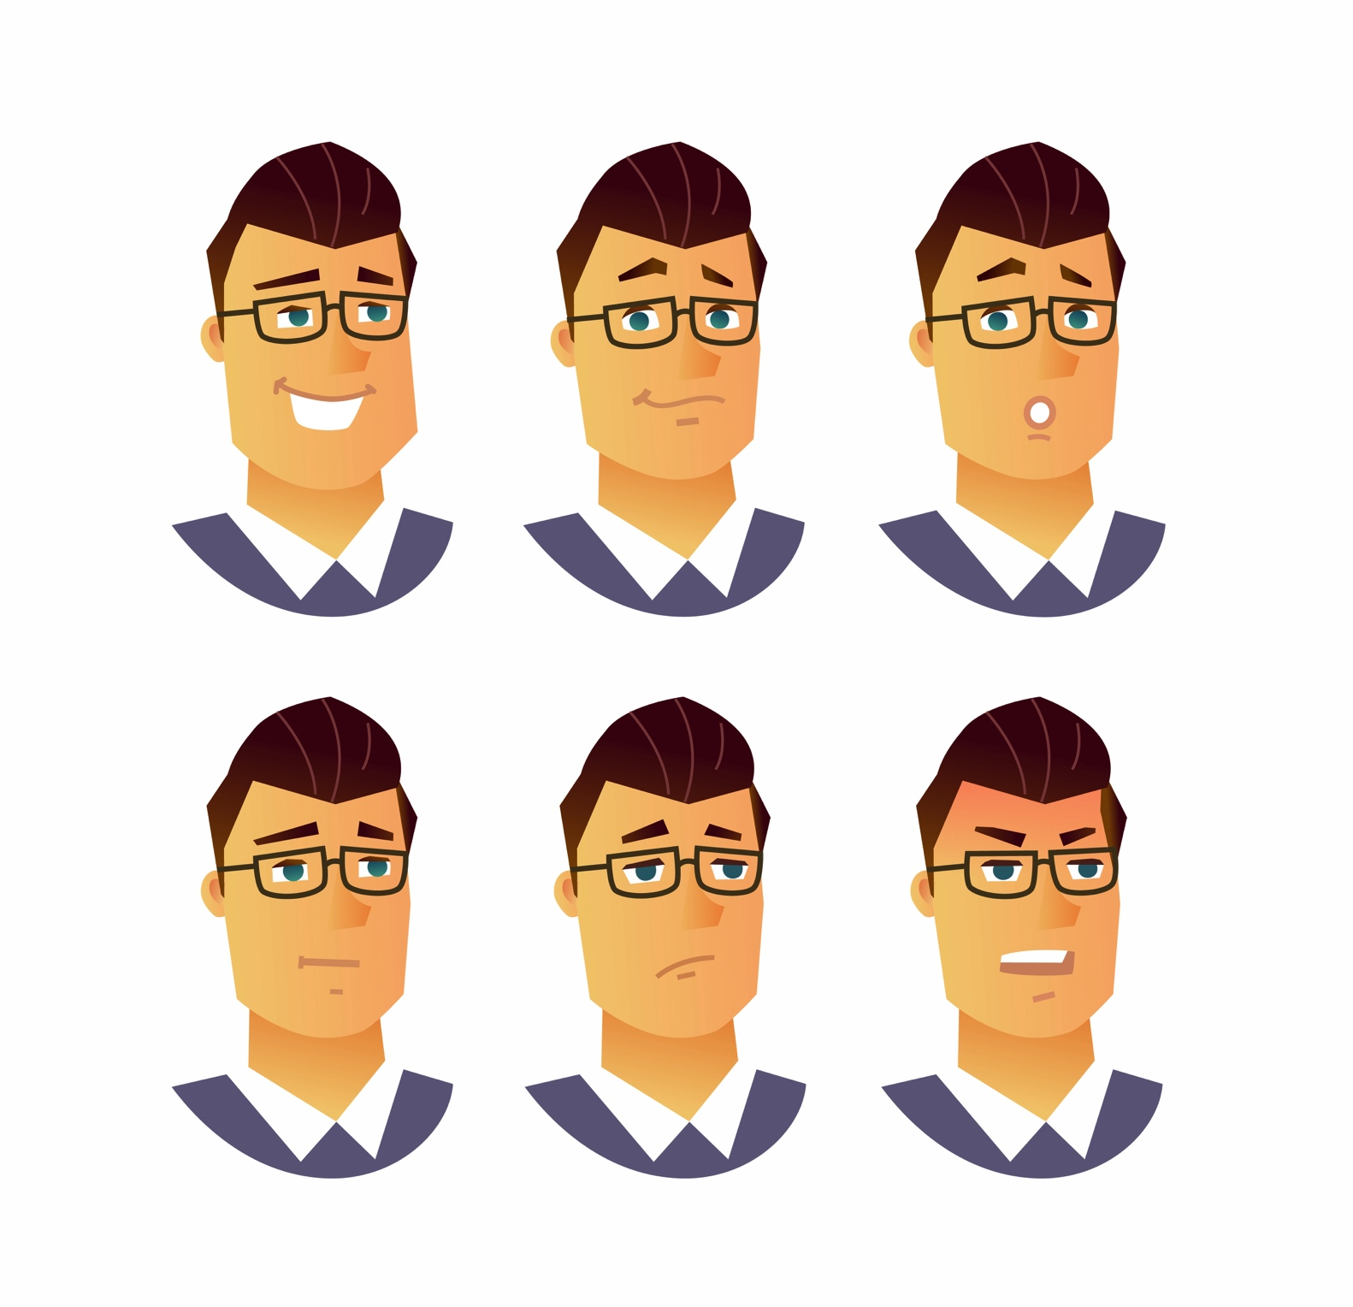
Facial Expressions result from
Automatic responses (unconscious)
Intention (conscious)
Externalized responses (conscious + unconscious)

Slide 10

LEARNING FROM HUMAN FACIAL REACTIONS
POSITIVE
Euphoric
Content
Happy
Furtive (+/-)
Inquisitive
Joyful
Mischievous (+/-)
Surprised (+/-)
NEUTRAL
Absent (neutral/-)
Deadpan
Incredulous (neutral/-)
Inscrutable
Staring
NEGATIVE
Angry
Despondent
Disappointed
Disgusted
Fearful
Hostile
Languishing
Preoccupied
Woeful
Even when we have an exact term for a facial expression, it can be hard to classify as positive, neutral, or negative

Slide 11
Underlying Emotions and Behaviors

Slide 12
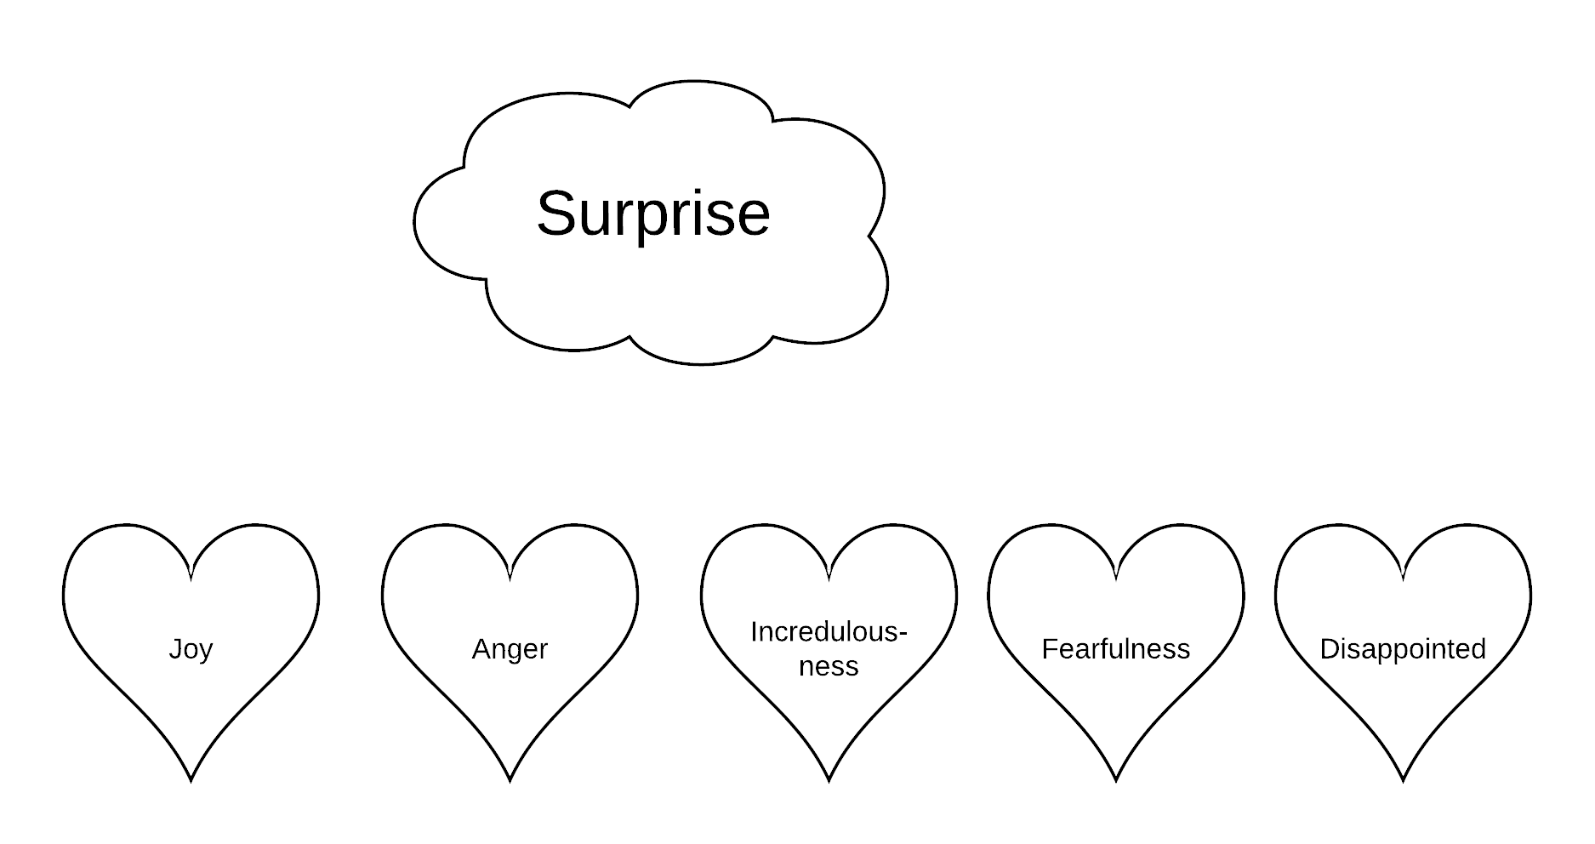
UNDERLYING EMOTIONS
Our expressions do not always reflect our feelings
Facial Expression
Feelings

Slide 13
Behavioral Responses are often the result of unconscious processes

Slide 14
An Example: Narcissism
Bragging about accomplishments, intelligence, etc.
Outward Behavior
Underlying Issues
Unconscious Processes
Insecurity about intelligence, accomplishments.
History of parental demands to accomplish, being denigrated by parent for being “stupid,” etc.

Slide 15
Habitual Behaviors from Unconscious Processes become Defense Mechanisms

Slide 16
DEFENSE MECHANISMS
Immature Defenses
fantasy
projection
passive aggression
acting out
Neurotic Defenses
intellectualization
reaction formation
dissociation
displacement
repression
Mature Defenses
humor
sublimation
altruism
anticipation

Slide 17
Human Interaction can form the basis for training A.I.
But we must consider the counterintuitive nature of some human responses.

Slide 18
Repeated interaction will help teach A.I. about the black box of human emotion/behavior

Slide 19
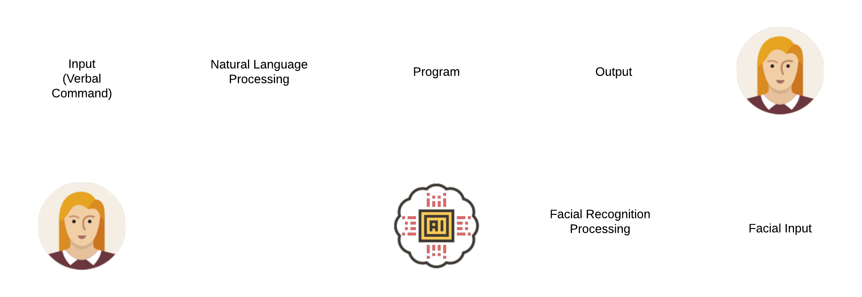
THE MACHINE LEARNS
#$%*&!
Learning occurs through a feedback loop. Here is an example of learning by feedback from facial expressions

Slide 20
Through Repeated Interaction and Feedback from Human,
The Machine Learns

Slide 21
THE CRUX OF THOUGHTFUL A.I.
THE DECISION BALANCE
How to do stop A.I. from destroying mankind?
Or more applicable: How do we stop A.I. from completing a task at the expense of something else?

Slide 22
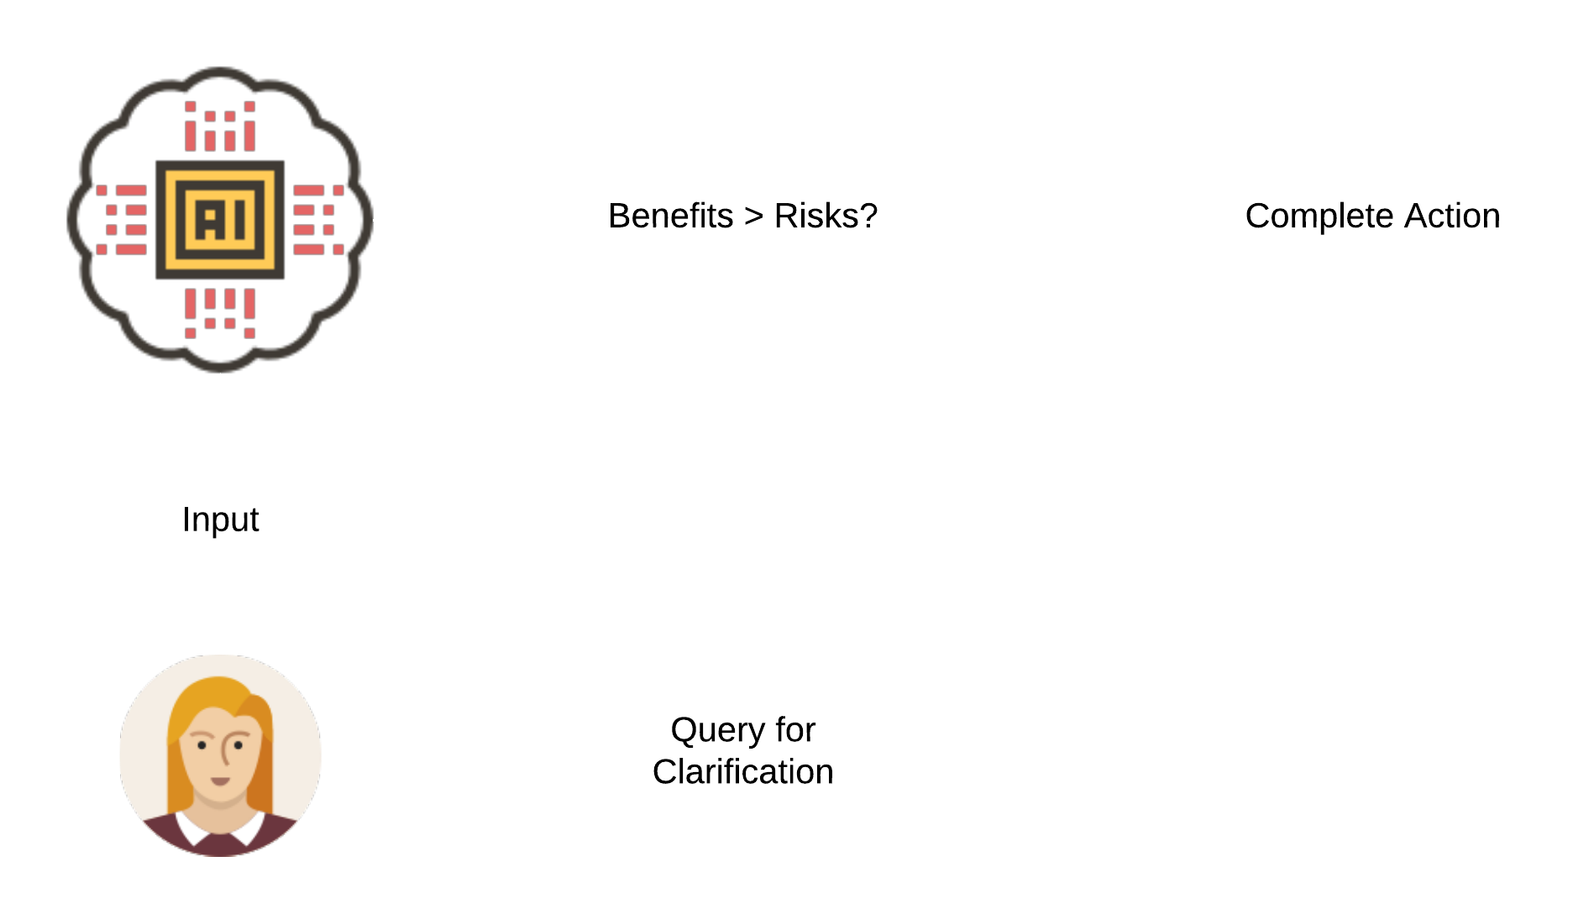
THE CRUX OF THOUGHTFUL A.I.
THE DECISION BALANCE
The Decision Balance weighs the risks and benefits of completing an action

Slide 23
THE CRUX OF THOUGHTFUL A.I.
THE DECISION BALANCE
Risks to Consider
Potential Damage
(Damage to People > Damage to Hardware)
Costs
Processor Usage
Energy Usage
(and many more)

Slide 24
“Traditional artificial intelligence focuses on minimizing loss or error function. Compassionate artificial intelligence focuses on minimizing pain or suffering of the society.”
-Amit Ray

Slide 25
NEXT STEPS
Bringing the data to life
Jeremy D. Martinez, M.D.
Board Certified in Psychiatry, Addiction Psychiatry, and Addiction Medicine.
The treatment of addiction required understanding the cause and effect of conscious and unconscious behaviors. Dr. Martinez is please to share his expertise in behavioral health as it relates to the development of artificial intelligence applications.

Slide 26
Jeremy D. Martinez, M.D.
Addiction Psychiatrist
Clinical Instructor, UCLA School of Medicine
www.jeremymartinezmd.com
jdmartinez@mednet.ucla.edu
10921 Wilshire Blvd. Suite 412
Los Angeles, CA 90024
626-227-6020

