Slide 2
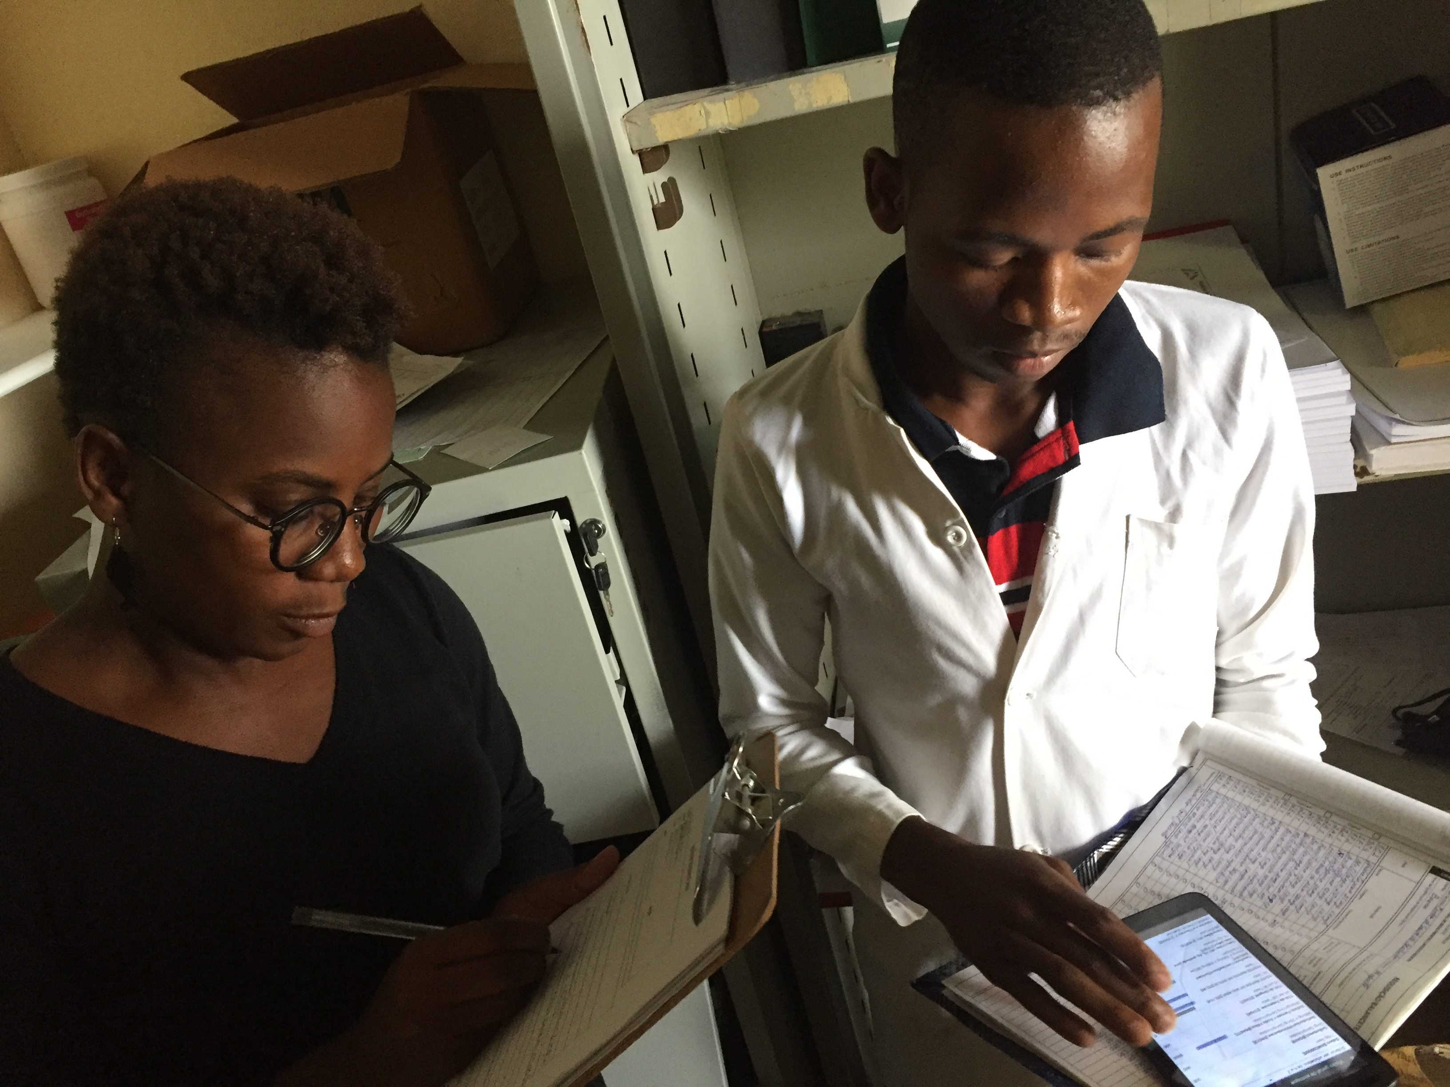
SIGLUS Open LMIS tablet-based solution for
commodities logistics management
at Health Facilities
Mozambique, Country Director Dimitri Peffer

Slide 3
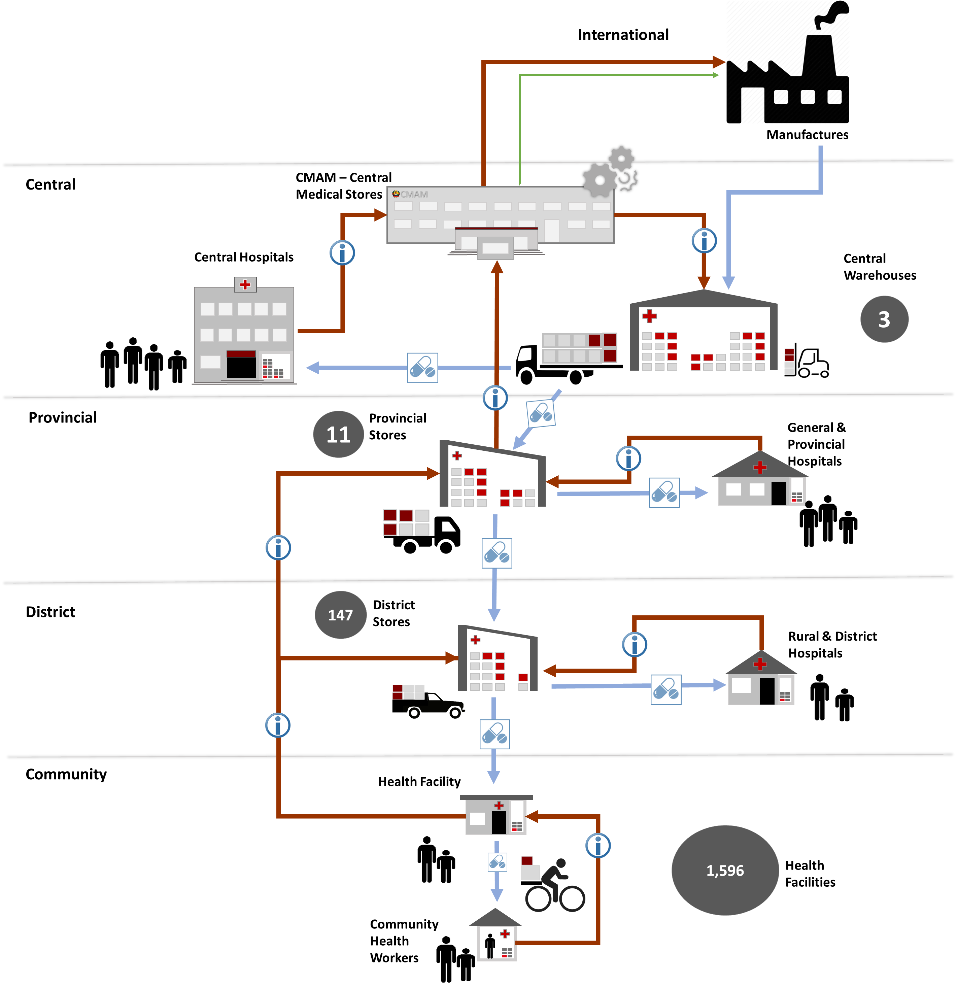
Mozambique Supply Chain
Supply Chain Structured in 4 levels; plus the community
Central Level Central Medical Stores & 3 Regional Warehouses
^{11 Provincial Warehouses}
^{147 District warehouses}
^{1.596 Health Facilities}
3.500 plus Community health workers

Slide 4

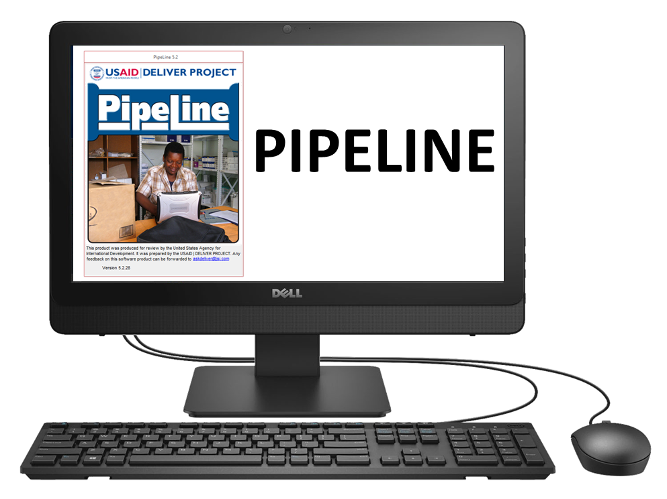

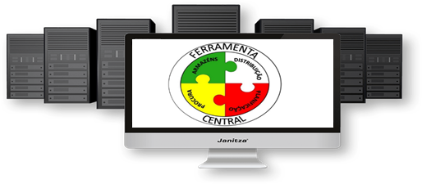
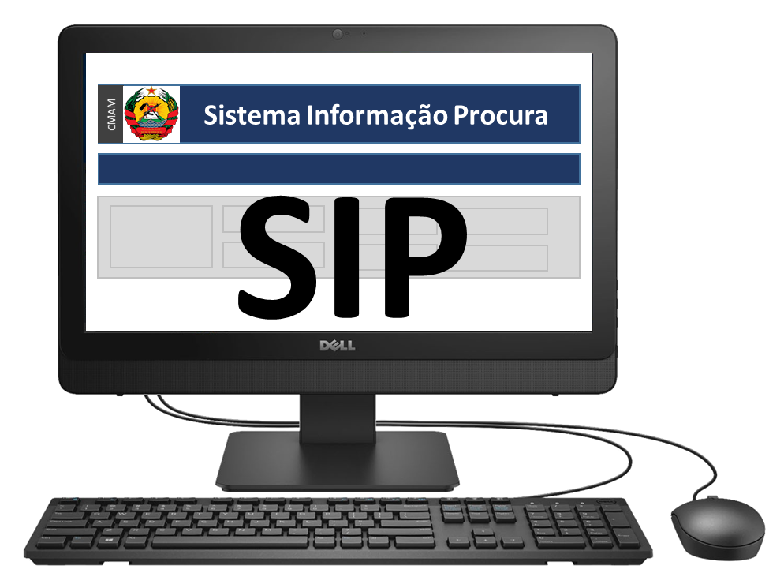
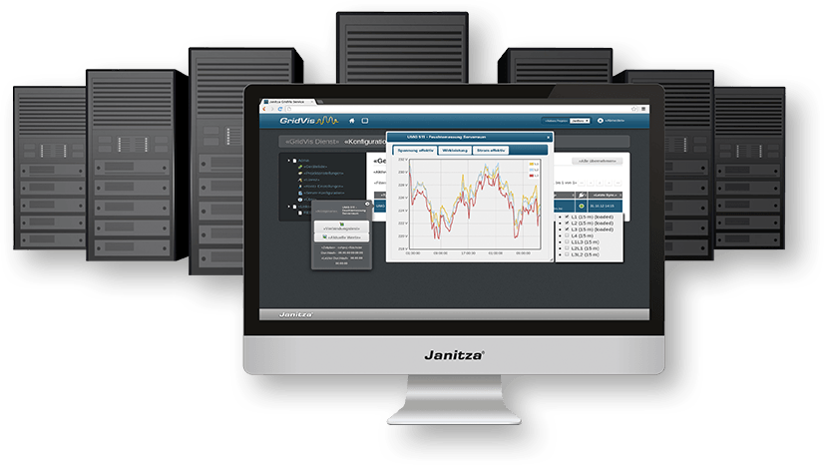
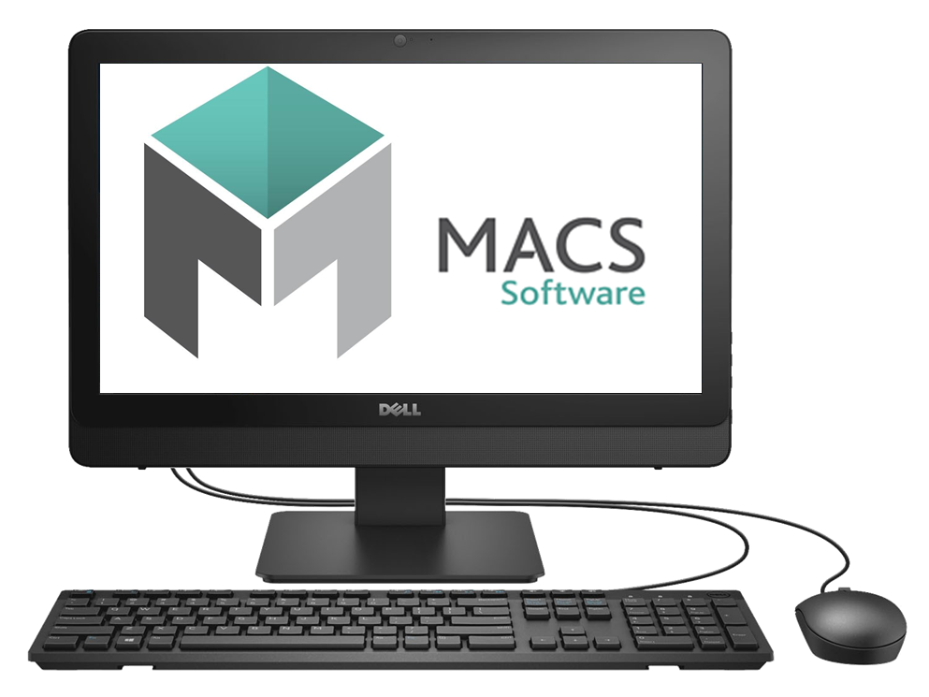
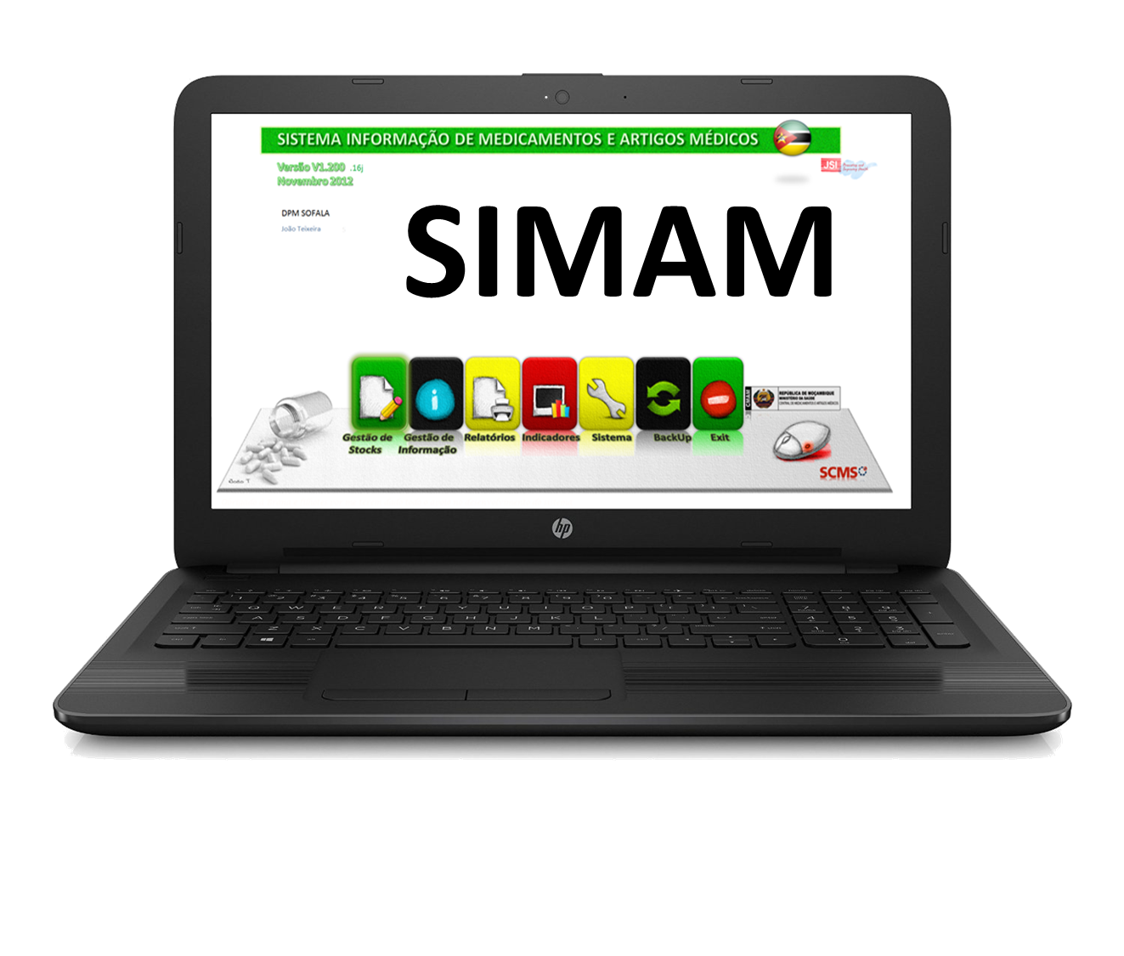

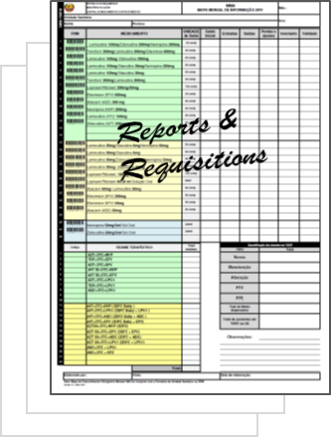
Mozambique Logistics Management Information Systems
Ferramenta Central
Quantification
SIGLUS
WEB PORTAL
Procurement
CMAM
Warehousing
Central
Warehousing
&
LMIS
DPM & CHosp
Provincial
DDM, PH & RH
District
Health Facilities
Stock Management
&
LMIS
Paper Based
LMIS
Health Facility

Slide 5




The data gap in supply chain
Only Central, Provincial and District Warehouses have computerized system.
Decision makers lack visibility over stock information in the majority of the public health system.
Majority of the system rely on paper and aggregated data.
No visibility of the large bottom of the Pyramid -98%
Missing critical data of accessibility to medicines at Service Delivery Point.
2%
98%

Slide 6
Towards in-country end-to-end data visibility
PELF Strategic Plan for Mozambique’s Supply Chain
LMIS Objective: Stock levels, actual consumption and lost opportunities, losses and stock adjustments are swiftly and regularly reported at lower levels and are available.
MIS Objective: An information system that includes preparation of forecasts, procurement management, warehouse and stock management, order management, as well as financial management. The system should enable the sharing and exchange of data between different components.
CMAM Strategy for Logistics Information Systems
(Being developed by CMAM, with PSM TA)
MIS systems support evidence-based decision making that generates insights into supply chain performance and transforms reporting by ensuring seamless interoperability across appropriate systems.
Selection of one LMIS for health facilities
(By CMAM, with PSM TA)
Selection criteria: transactional stock management, replicate CMAM procedures, operates on-off line, Open Source

Slide 7
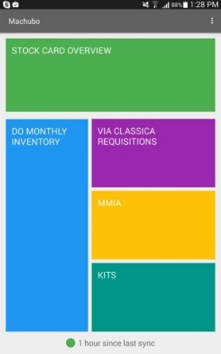



Proof of the Concept (Jan-Dec 2016)
SIGLUS Logistic Management Information System for the Health Facilities
Developed and piloted a mobile application for health facility using the OpenLMIS platform
This work proved the concept for:
Transactional stock-management tool
Workflow contextualization from an Open Source system
Health-facility level electronic LMIS solution
User-accepted Android application on tablets
Clinton Health Access Initiative (CHAI)
Funded through DFID
with technology partner

Slide 8

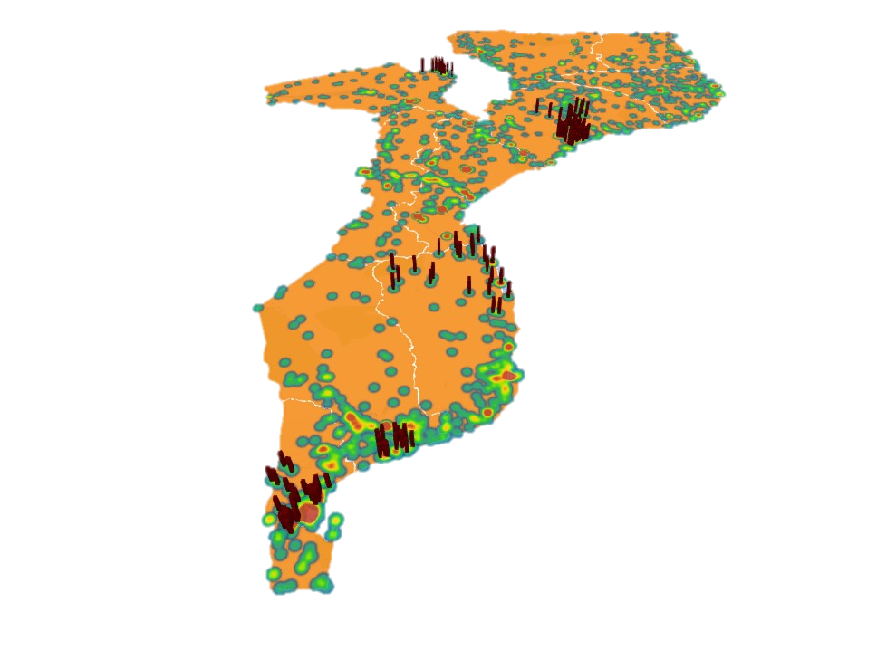
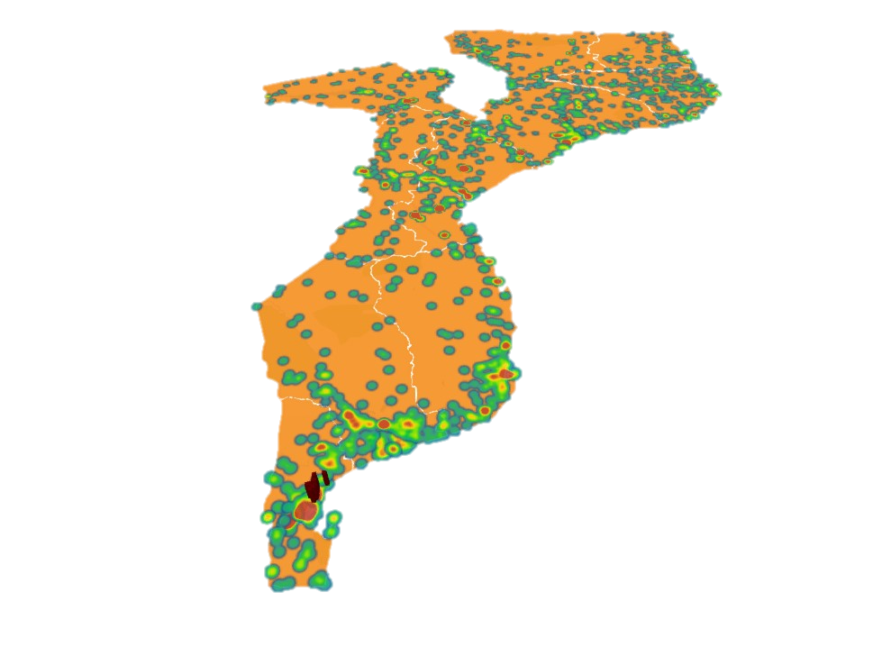
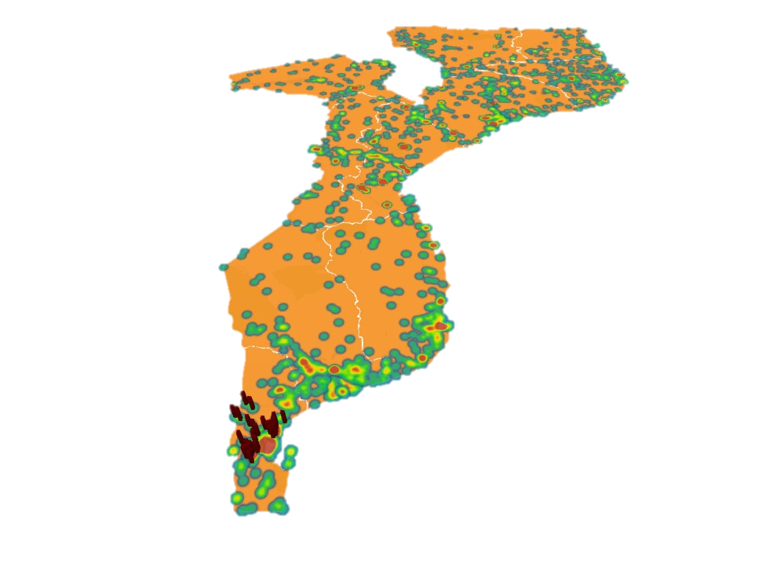
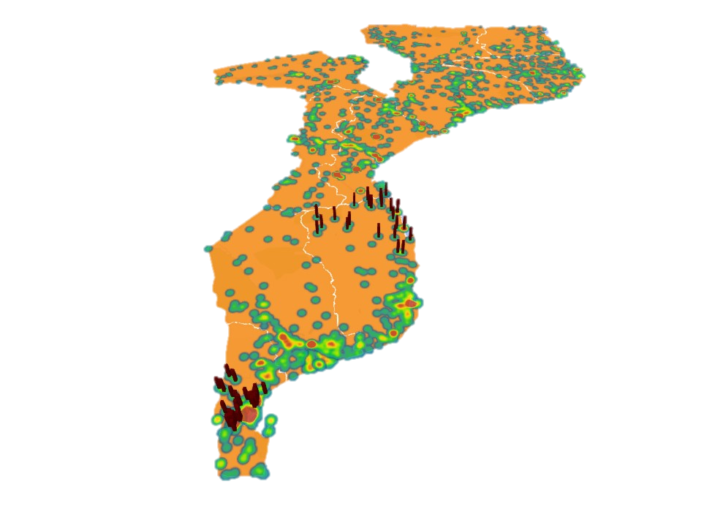







Moving from Concept to Scale (from 2017)
PSM-supported expansion, directly and garners other partners involvement
Transition of application maintenance, support and further development from CHAI to PSM
Continuous development and integration with other applications
Three levels Help Desk by MOH (1st), PSM (2nd) and ThoughtWorks (3rd)
Training curricul;um (TOT, training material, …)
Direct implementation by PSM to 109 sites by FY17
Electronic equipment provided by UNFPA and PSM and internet bundle by UNFPA
2018: expected 300 sites scale-up, leveraging additional support from PEPFAR, UNICEF, MSF and others
Zambezia Province
Nicoadala
Mocuba
May-2017
Zambezia Province
Quelimane
Namacurra
Jul-2017
Tete Province
Angónia
Jul-2017
Inhambane Province
Vilankulo
Mabote
Inhassoro
Govuro
May-2017
Maputo Province
Marracuene
Dec-2015
Gaza Province
Limpopo
Jun-2017
Maputo Province
Moamba & Boane
Dec-2016

Slide 9

Characteristics of the Solution

Slide 10
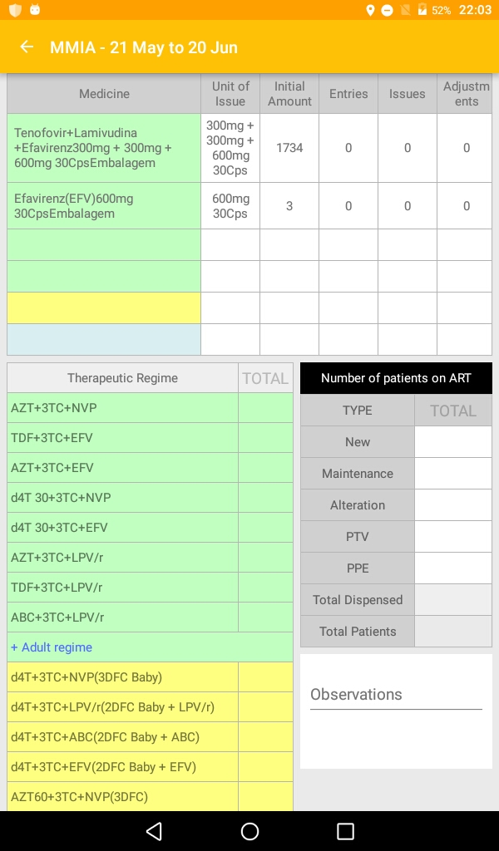
Characteristics of the Solution
SIGLUS Logistic Management Information System for the Health Facilities
Online/offline functionality with automatic synchronization when mobile signal available
Transactional workflows (as opposed to a reporting tool), therefore assists healthcare worker with their job
Automated calculations for requisition process, including suggested reorder amounts to help reduce workload and improve uptake
Alerts for low stock levels, overstocking, and upcoming expiries
Lot information permits more granular product management
Submission process sends requisitions to supply node
User interface mimics paper forms familiar to healthcare workers to reduce training burden

Slide 11
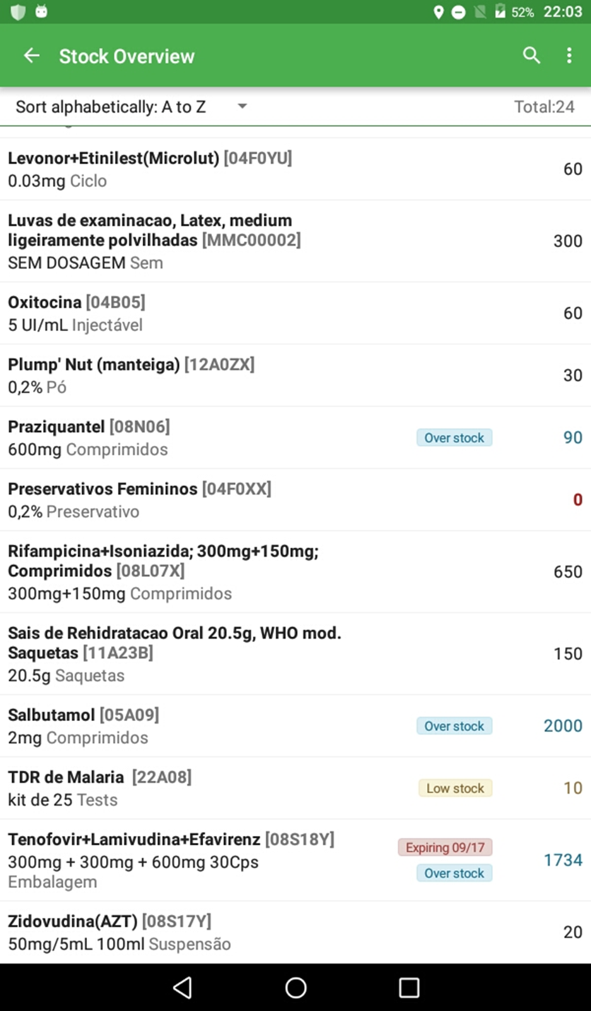
Characteristics of the Solution
SIGLUS Mobile Application Screenshot
Searchable/sortable stock on hand product list
Color coded alerts for over stock and upcoming expiries
Optimized for 9” tablets
All Essential Products including
  Anti Malaria drugs
  Anti-retroviral
  Contraceptives
  Rapid Diagnostic Tests
  Antibiotics
  Essential Medicines
  Key Medical Articles

Slide 12

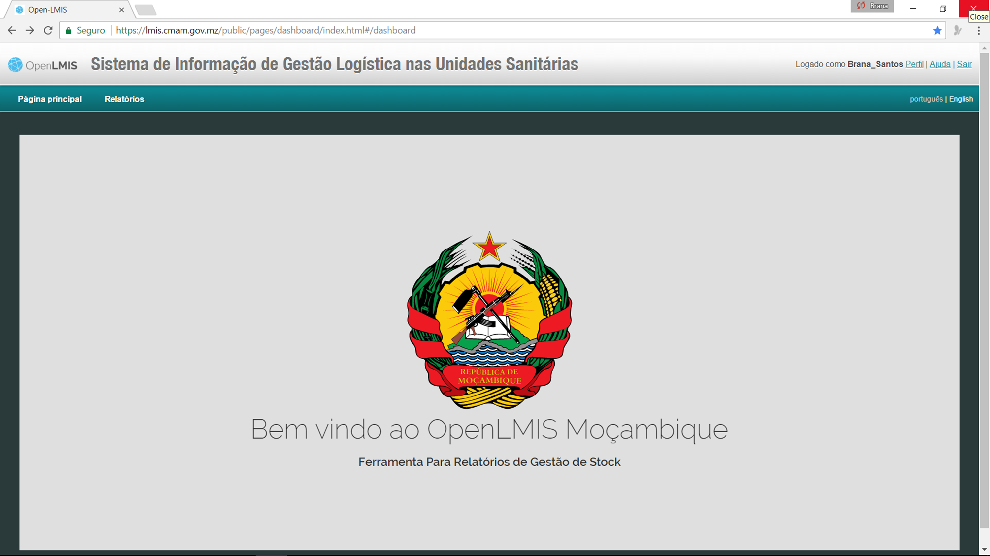
Characteristics of the Solution
SIGLUS Web Portal
Web portal highlights:
Leverage OpenLMIS interface, administrative functions and user management
Facility-level and aggregate reports and visualizations
Data export for further analysis
Access to all submitted requisitions
Tracking of synchronization status and order requisition timeliness
Customized reports for Mozambique, such as weekly tracer medicine stock-out report

Slide 13
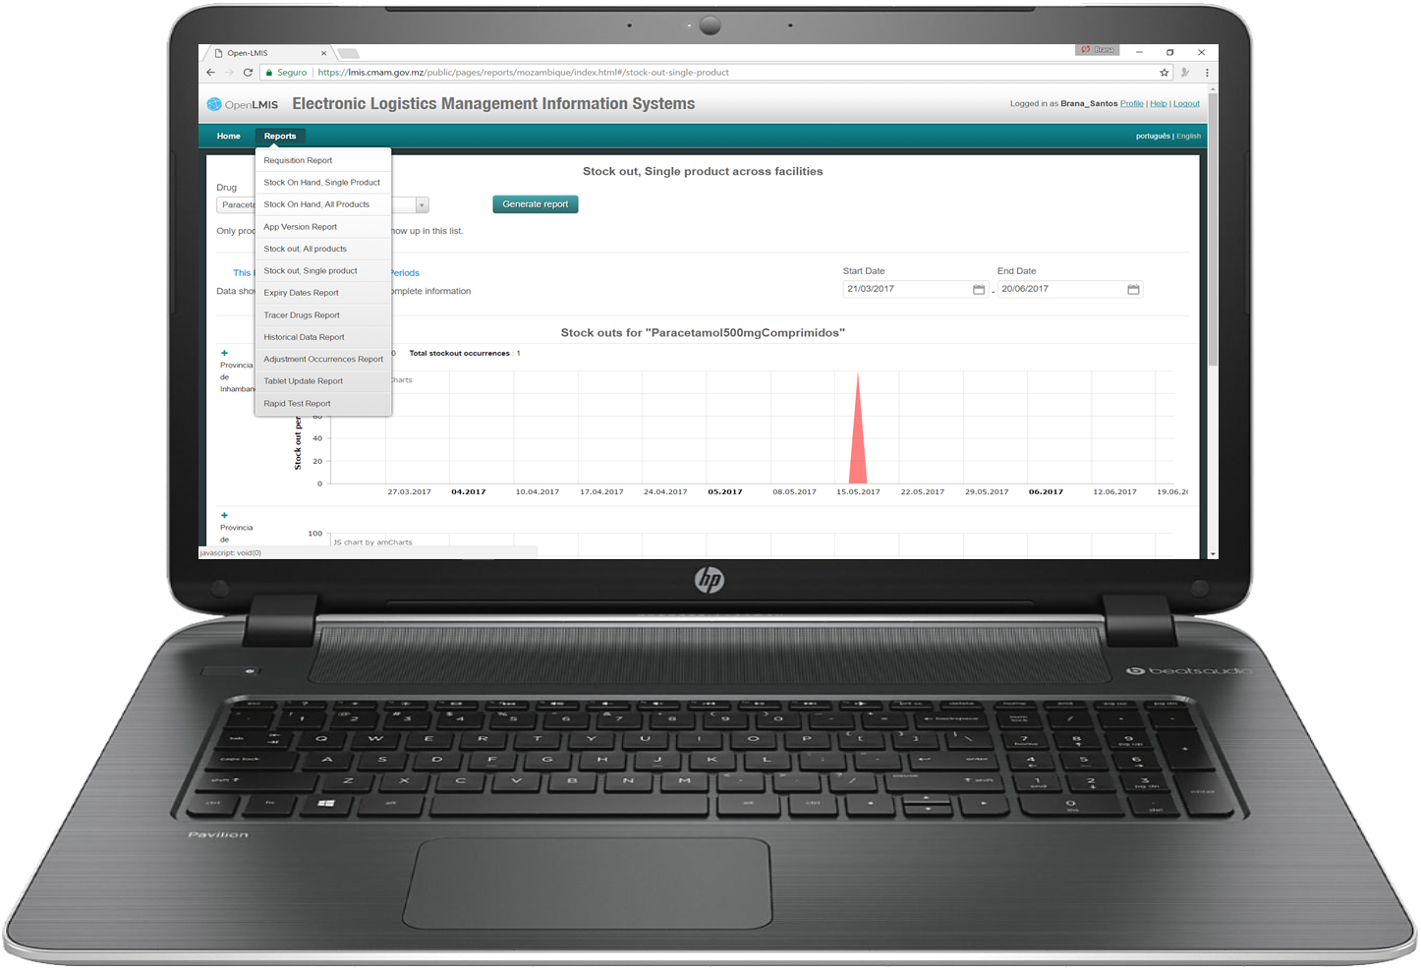
Characteristics of the Solution
SIGLUS Web Portal Key Reports
Uses OpenLMIS standard web portal framework
List of variety of standardized reports
  Requisitions
  Stock on Hand by product
  Stockouts, All product
  Expiry Dates
  Tracer Drugs
  Historical Data
  Adjustments Occurrences
  Rapid Tests Report

Slide 14
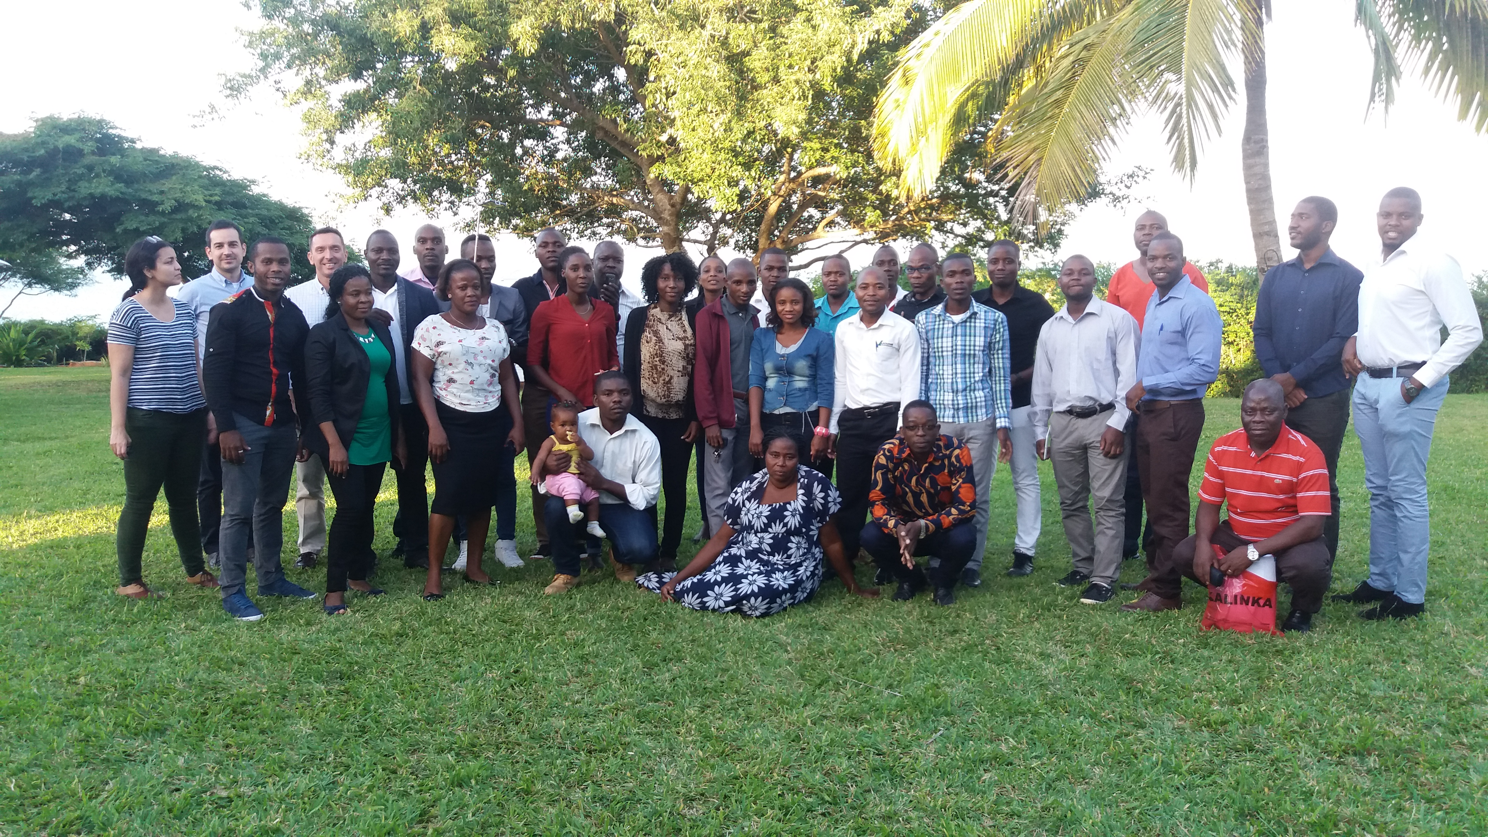
Opportunities and Challenges

Slide 15
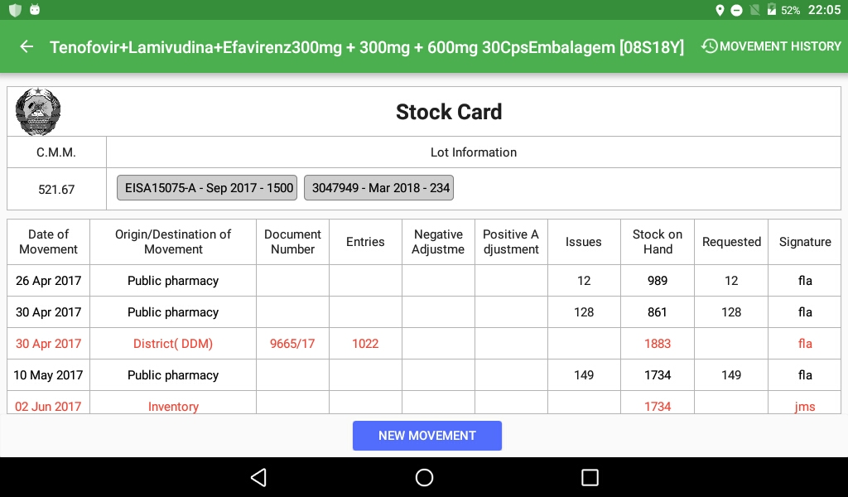
Opportunities
SIGLUS Logistic Management Information System for the Health Facilities
Cultivate OpenLMIS community globally and regionally to ensure support, maintenance.
Shared investment, Shared benefits (OpenLMIS 3.0) for regional platform.
Evidence based decision making;
Interconnectivity with Ferramenta Central & SIMAM
Support from PEPFAR Implementing Partners to maintain the scale-up pass

Slide 16
Scale-Up Challenges
Auditability of the system;
Removing paper based system for processes;
Approval at the highest government authorities to make an official national system;
Involvement of all departments within CMAM in the scale-up process;
Involvement of all partners in the implementation
Ensuring continuous support and accountability of local partners in implementation;
Ensuring support and scale-up funds by the government;
Inclusion of internet costs in the local budgets as well as national budget;
Changing from data access to decision-making
Leverage local partnership with IS companies to continue support and development of product;

Slide 17
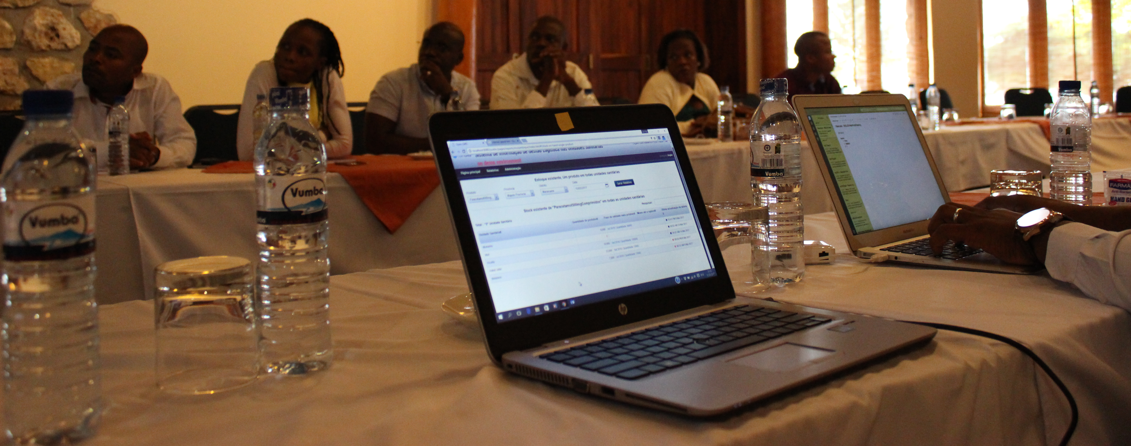
It’s for real!
SIGLUS portal : https://lmis.cmam.gov.mz/public/pages/login.html
SIGLUS used in Boane Health Center: https://youtu.be/d61wKmVxq6Q

Slide 18
OBRIGADO!
Thank you!
Kanimanbo!
Merci!
Tak!

